Slide 1
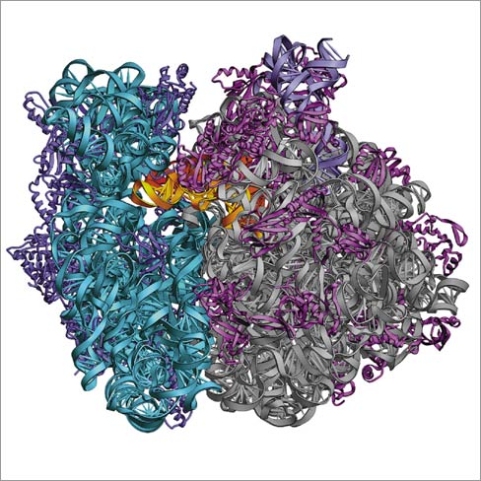
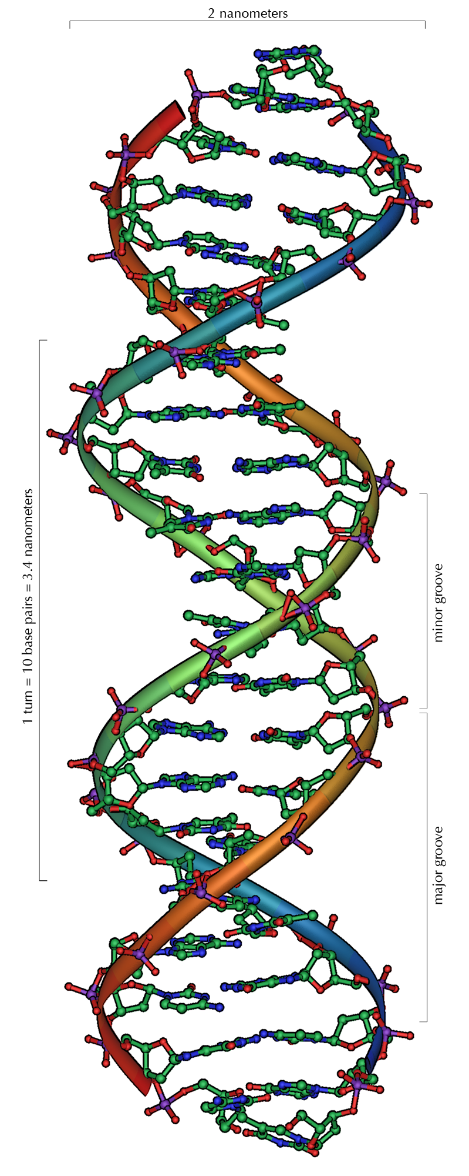
Nucleic Acids
Information
storage

Slide 2
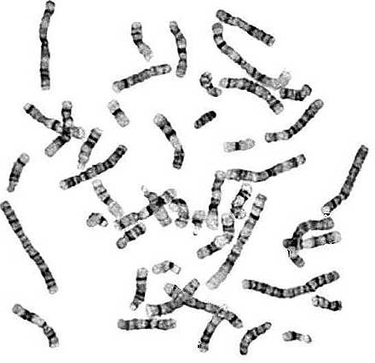

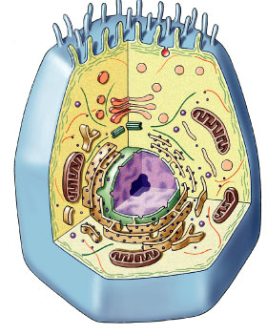
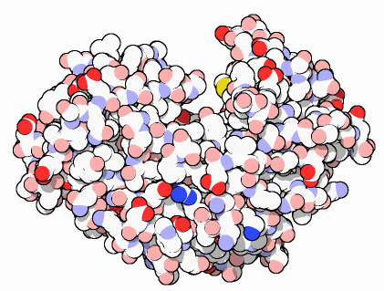
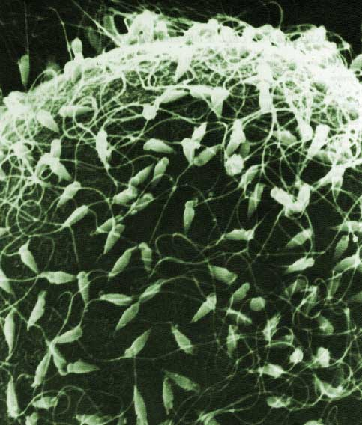
Nucleic Acids
Function:
  genetic material
    stores information
      genes
      blueprint for building proteins
        DNA → RNA → proteins
    transfers information
      blueprint for new cells
      blueprint for next generation
DNA
proteins

Slide 3
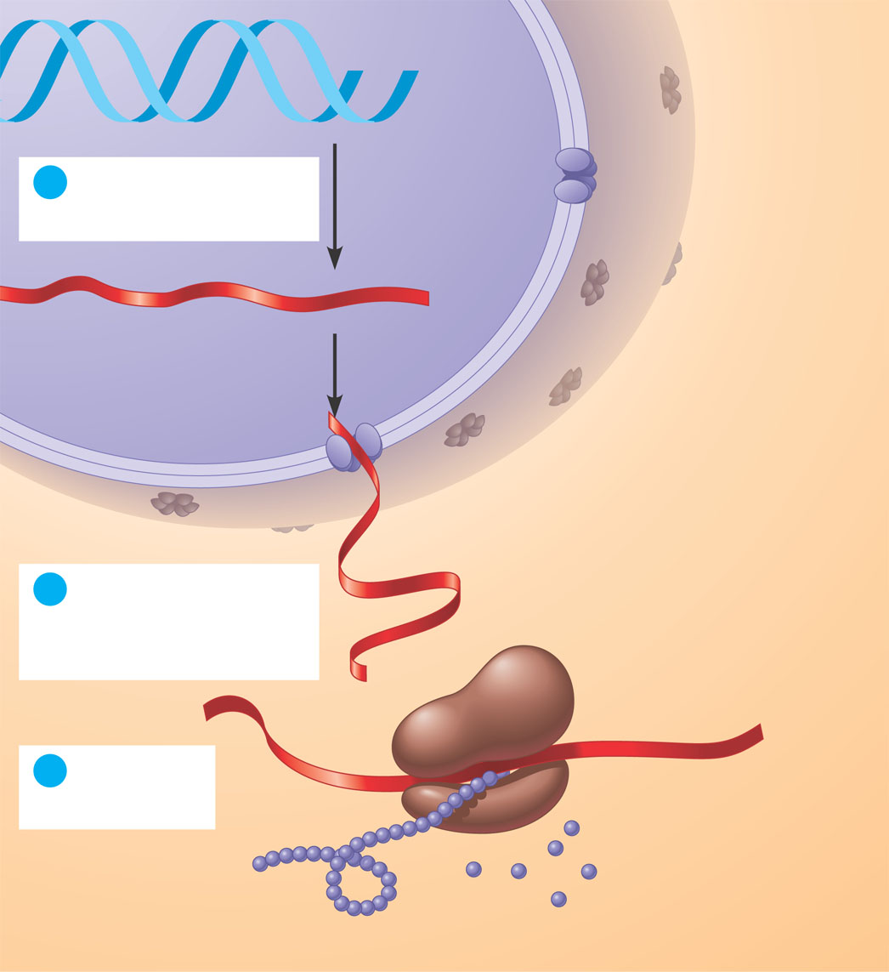
DNA → RNA → protein: information flow in a cell
DNA
1
Synthesis of
mRNA in the nucleus
mRNA
NUCLEUS
CYTOPLASM
mRNA
2
Movement of
mRNA into cytoplasm
via nuclear pore
Ribosome
3
Synthesis
of protein
Amino
acids
Polypeptide

Slide 4
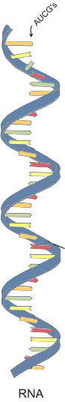
Nucleic Acids
Examples:
  RNA (ribonucleic acid)
    single helix
  DNA (deoxyribonucleic acid)
    double helix
Structure:
  monomers = nucleotides
RNA

Slide 5
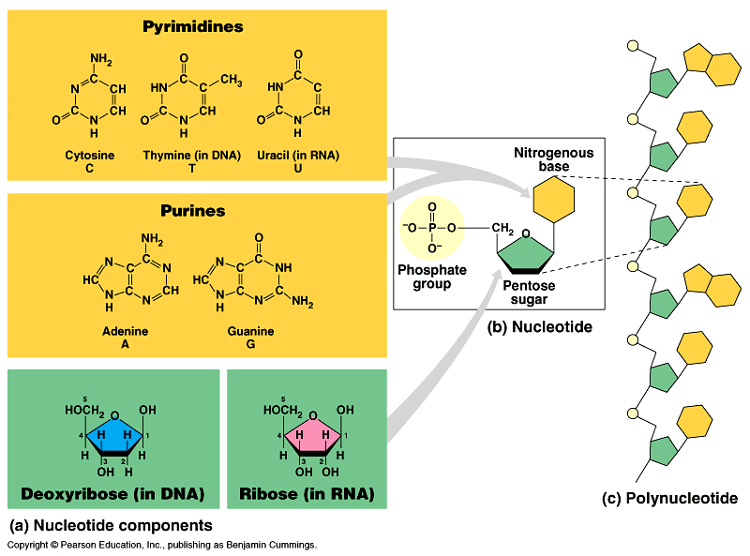
Nucleotides
3 parts
  nitrogen base (C-N ring)
  pentose sugar (5C)
    ribose in RNA
    deoxyribose in DNA
  phosphate (PO₄) group
Nitrogen base
I’m the
A,T,C,G or U
part!
Are nucleic acids
charged molecules?
Notes:
DNA & RNA are negatively charged:
Don’t cross membranes.
Contain DNA within nucleus
Need help transporting mRNA across nuclear envelope.
Also use this property in gel electrophoresis.

Slide 6
3.16 Nucleic acids are information-rich polymers of nucleotides
DNA nitrogenous bases are adenine (A), thymine (T), cytosine (C), and guanine (G)
  RNA also has A, C, and G, but instead of T, it has uracil (U)
Copyright © 2009 Pearson Education, Inc.
Notes:
Student Misconceptions and Concerns
1. Module 3.16 is the first time the authors present the concept of transcription and translation, discussed extensively in later chapters. The basic conceptual flow of information from DNA to RNA to proteins is essential to these later discussions.
Teaching Tips
1. The “NA” in the acronyms DNA and RNA stands for “nucleic acid.” Students often do not make this association without assistance.

Slide 7
Types of nucleotides
Purine = AG
Pure silver!
2 types of nucleotides
  different nitrogen bases
  purines
    double ring N base
    adenine (A)
    guanine (G)
  pyrimidines
    single ring N base
    cytosine (C)
    thymine (T)
    uracil (U)

Slide 8
Nucleic polymer
Backbone
  sugar to PO₄ bond
  phosphodiester bond
    new base added to sugar of previous base
    polymer grows in one direction
  N bases hang off the
  sugar-phosphate backbone
Dangling bases?
Why is this important?

Slide 9
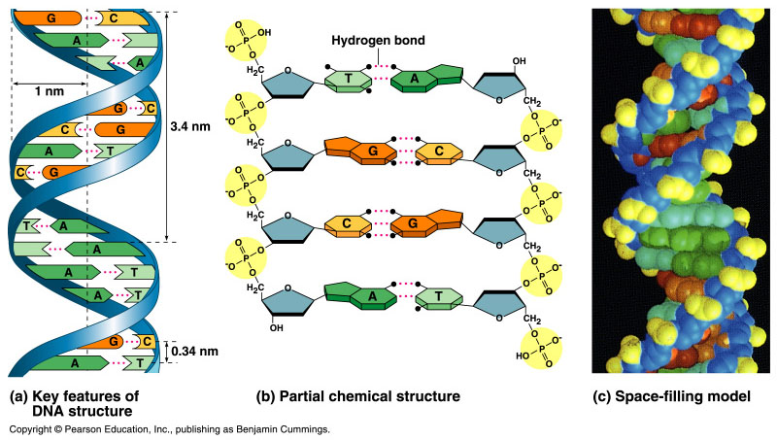
Pairing of nucleotides
Nucleotides bond between
DNA strands
  H bonds
  purine :: pyrimidine
  A :: T
    2 H bonds
  G :: C
    3 H bonds
Matching bases?
Why is this important?
Notes:
The 2 strands are complementary.
One becomes the template of the other & each can be a template to recreate the whole molecule.

Slide 10
3.16 Nucleic acids are information-rich polymers of nucleotides
Two polynucleotide strands wrap around each other to form a DNA double helix
  The two strands are associated because particular bases always hydrogen bond to one another
  A pairs with T, and C pairs with G, producing base pairs
RNA is usually a single polynucleotide strand
Copyright © 2009 Pearson Education, Inc.
Notes:
Student Misconceptions and Concerns
1. Module 3.16 is the first time the authors present the concept of transcription and translation, discussed extensively in later chapters. The basic conceptual flow of information from DNA to RNA to proteins is essential to these later discussions.
Teaching Tips
1. The “NA” in the acronyms DNA and RNA stands for “nucleic acid.” Students often do not make this association without assistance.

Slide 11
DNA molecule
Double helix
  H bonds between bases join the 2 strands
    A :: T
    C :: G
H bonds?
Why is this important?
Notes:
H bonds = biology’s weak bond
• easy to unzip double helix for replication and then re-zip for storage
• easy to unzip to “read” gene and then re-zip for storage

Slide 12
3.16 Nucleic acids are information-rich polymers of nucleotides
A particular nucleotide sequence that can instruct the formation of a polypeptide is called a gene
  Most DNA molecules consist of millions of base pairs and, consequently, many genes
  These genes, many of which are unique to the species, determine the structure of proteins and, thus, life’s structures and functions
Copyright © 2009 Pearson Education, Inc.
Notes:
Student Misconceptions and Concerns
1. Module 3.16 is the first time the authors present the concept of transcription and translation, discussed extensively in later chapters. The basic conceptual flow of information from DNA to RNA to proteins is essential to these later discussions.
Teaching Tips
1. The “NA” in the acronyms DNA and RNA stands for “nucleic acid.” Students often do not make this association without assistance.

Slide 13
3.17 EVOLUTION CONNECTION: Lactose tolerance is a recent event in human evolution
Mutations are alterations in bases or the sequence of bases in DNA
  Lactose tolerance is the result of mutations
  In many people, the gene that dictates lactose utilization is turned off in adulthood
  Apparently, mutations occurred over time that prevented the gene from turning off
  This is an excellent example of human evolution
Copyright © 2009 Pearson Education, Inc.
Notes:
Mutations that lead to lactose tolerance are relativity recent events. The mutation was useful because it allowed people to drink milk when other foods were unavailable. In other words, it provided a survival advantage.
Student Misconceptions and Concerns
1. The evolution of lactose tolerance within human groups in East Africa does not represent a deliberate decision, yet this evolutionary change appears logical. Many students perceive adaptations as deliberate events with purpose. As students develop a better understanding of the mechanisms of evolution, it will be important to point out that mutations arise by chance, with the culling hand of natural selection favoring traits that convey advantage. Organisms cannot plan evolutionary change.
Teaching Tips
1. When discussing the sequence of nucleotides in DNA and RNA, consider challenging your students with the following questions based upon prior analogies. If the 20 possible amino acids in a polypeptide represent “words” in a long polypeptide sentence, how many possible words are in the language of a DNA molecule? (Four nucleotides, GCAT, are possible). Are these the same “words” used in RNA? (Answer: No. Uracil substitutes for thymine.)

Slide 14
Copying DNA
Replication
  2 strands of DNA helix are complementary
    have one, can build other
    have one, can rebuild the whole
Matching halves?
Why is this
a good system?
Notes:
when cells divide, they must duplicate DNA exactly for the new “daughter” cells
Why is this a good system?

Slide 15
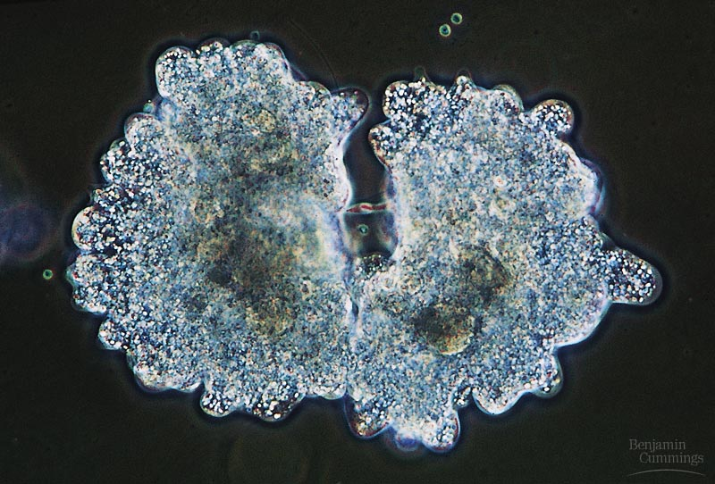

When does a cell copy DNA?
When in the life of a cell does DNA have to be copied?
  cell reproduction
    mitosis
  gamete production
    meiosis
Notes:
when cells divide, they must duplicate DNA exactly for the new “daughter” cells
Why is this a good system?

Slide 16
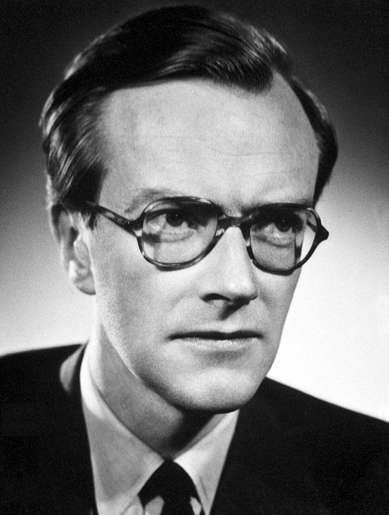



Maurice Wilkins… and…
1953 | 1962

Slide 17
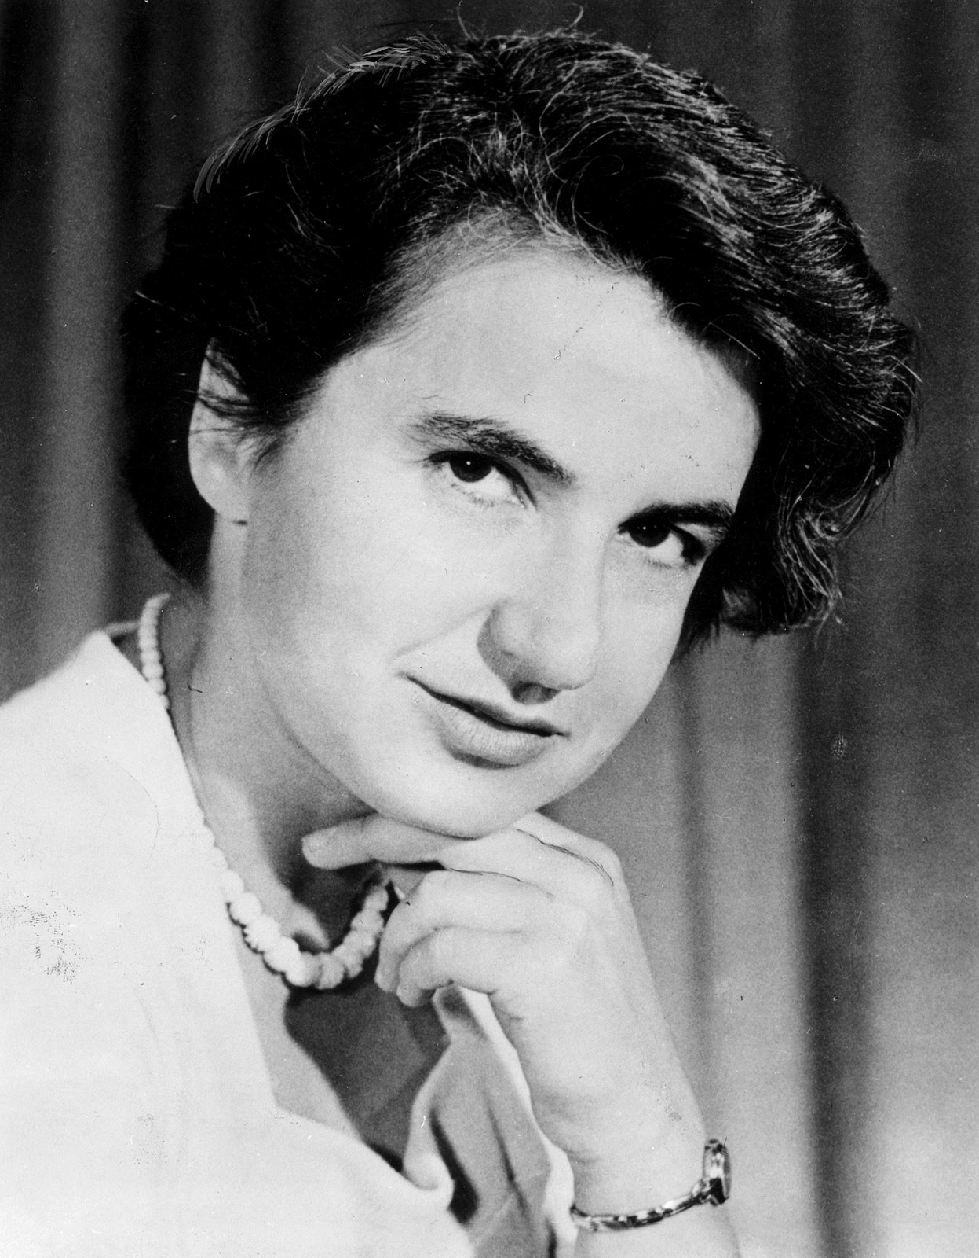
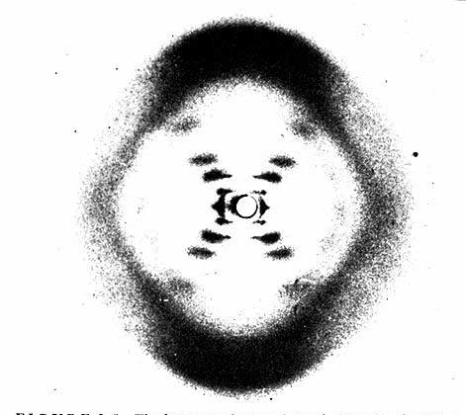
Rosalind Franklin (1920-1958)
Notes:
A chemist by training, Franklin had made original and essential contributions to the understanding of the structure of graphite and other carbon compounds even before her appointment to King's College. Unfortunately, her reputation did not precede her. James Watson's unflattering portrayal of Franklin in his account of the discovery of DNA's structure, entitled "The Double Helix," depicts Franklin as an underling of Maurice Wilkins, when in fact Wilkins and Franklin were peers in the Randall laboratory. And it was Franklin alone whom Randall had given the task of elucidating DNA's structure. The technique with which Rosalind Franklin set out to do this is called X-ray crystallography. With this technique, the locations of atoms in any crystal can be precisely mapped by looking at the image of the crystal under an X-ray beam. By the early 1950s, scientists were just learning how to use this technique to study biological molecules. Rosalind Franklin applied her chemist's expertise to the unwieldy DNA molecule. After complicated analysis, she discovered (and was the first to state) that the sugar-phosphate backbone of DNA lies on the outside of the molecule. She also elucidated the basic helical structure of the molecule.
After Randall presented Franklin's data and her unpublished conclusions at a routine seminar, her work was provided - without Randall's knowledge - to her competitors at Cambridge University, Watson and Crick. The scientists used her data and that of other scientists to build their ultimately correct and detailed description of DNA's structure in 1953. Franklin was not bitter, but pleased, and set out to publish a corroborating report of the Watson-Crick model. Her career was eventually cut short by illness. It is a tremendous shame that Franklin did not receive due credit for her essential role in this discovery, either during her lifetime or after her untimely death at age 37 due to cancer.

Slide 18
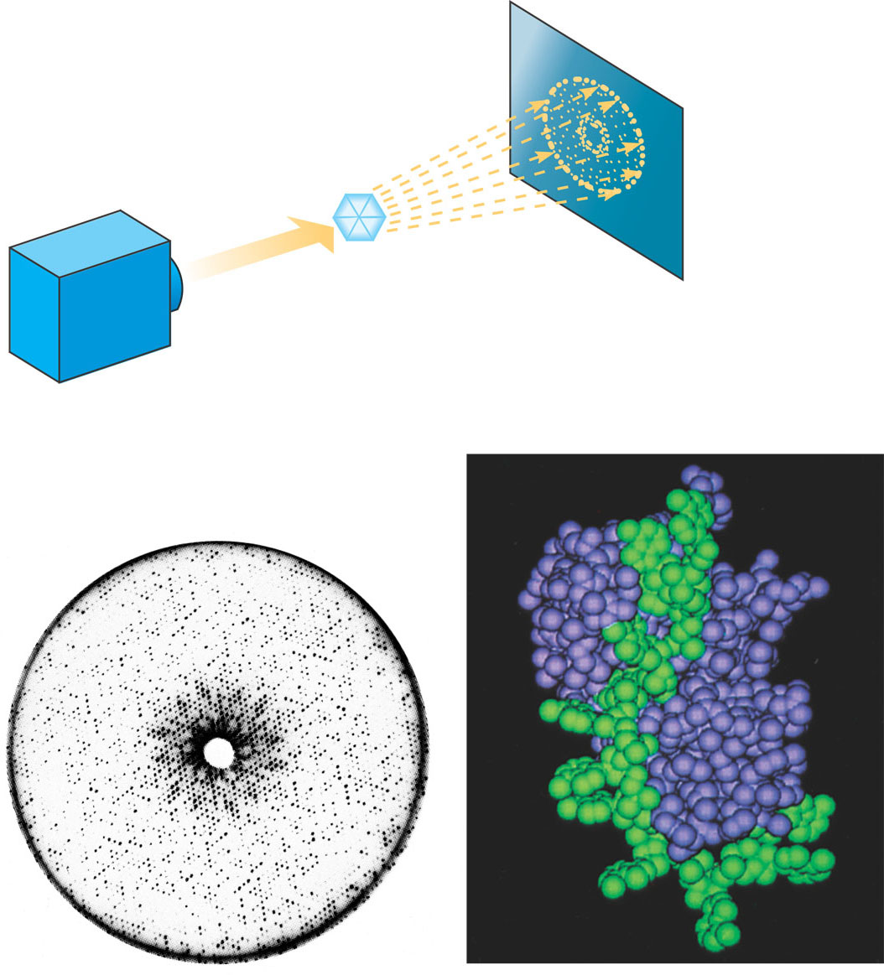
X-ray crystallography
X-ray
diffraction pattern
Photographic film
Diffracted X-rays
X-ray
source
X-ray
beam
Crystal
Nucleic acid
Protein
(a) X-ray diffraction pattern
(b) 3D computer model

Slide 19
Interesting note…
Ratio of A-T::G-C
affects stability
of DNA molecule
  2 H bonds vs. 3 H bonds
  biotech procedures
    more G-C =
    need higher T° to
    separate strands
  high T° organisms
    many G-C
  parasites
    many A-T (don’t know why)
Notes:
At the foundation of biology is chemistry!!

Slide 20
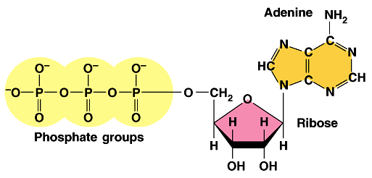
Another interesting note…
ATP
Adenosine triphosphate
  modified nucleotide
    adenine (AMP) + P_{i} + P_{i}
+
+

Slide 21
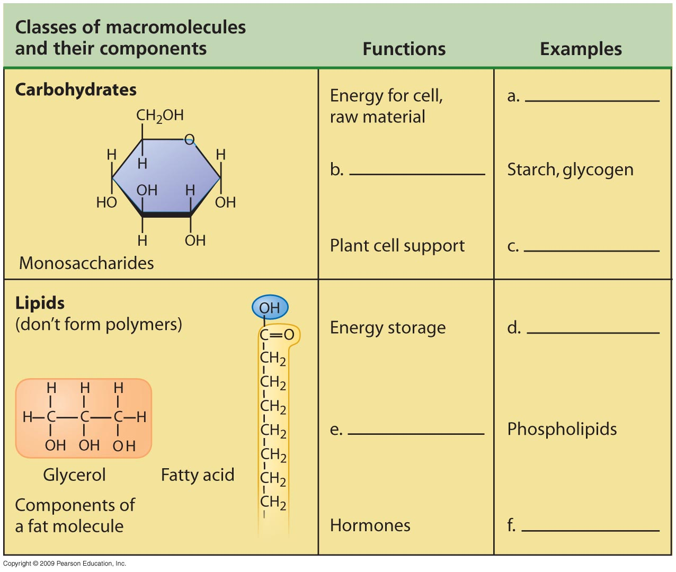

Slide 22
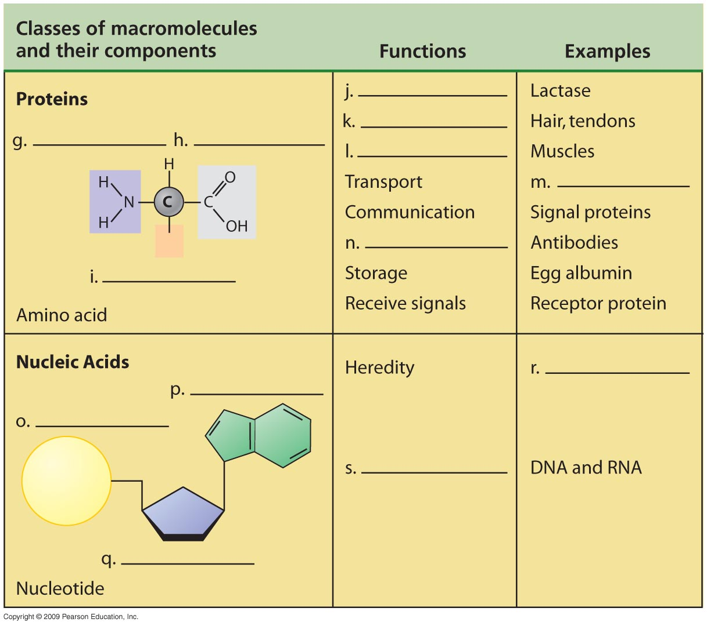

Slide 23
You should now be able to
Discuss the importance of carbon to life’s molecular diversity
Describe the chemical groups that are important to life
Explain how a cell can make a variety of large molecules from a small set of molecules
Define monosaccharides, disaccharides, and polysaccharides and explain their functions
Define lipids, phospholipids, and steroids and explain their functions
Copyright © 2009 Pearson Education, Inc.

Slide 24
You should now be able to
Describe the chemical structure of proteins and their importance to cells
Describe the chemical structure of nucleic acids and how they relate to inheritance
Copyright © 2009 Pearson Education, Inc.

