Slide 1
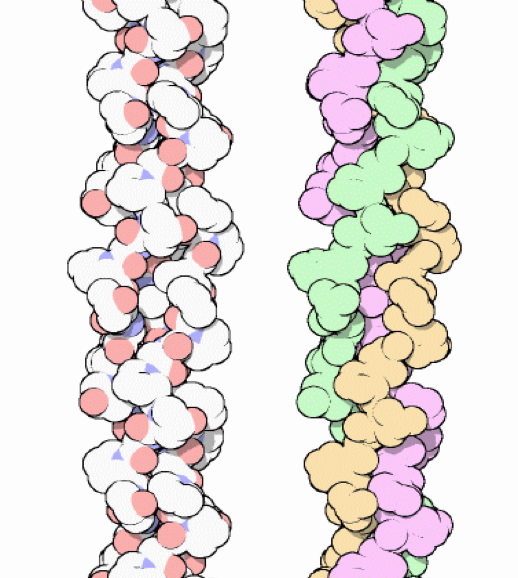
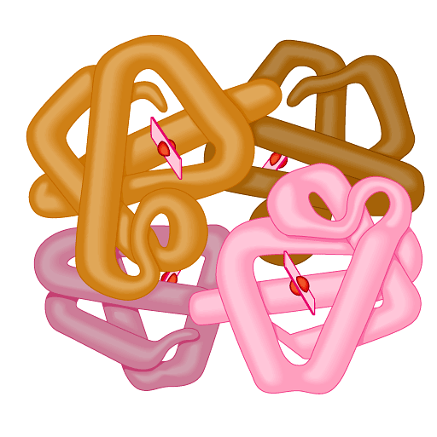
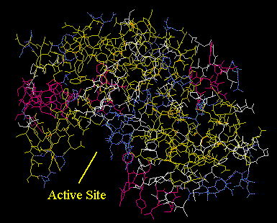
Protein structure & function
Function depends on structure
3-D structure
twisted, folded, coiled into unique shape
pepsin
hemoglobin
collagen
Notes:
Hemoglobin
Hemoglobin is the protein that makes blood red. It is composed of four protein chains, two alpha chains and two beta chains, each with a ring-like heme group containing an iron atom. Oxygen binds reversibly to these iron atoms and is transported through blood.
Pepsin
Pepsin is the first in a series of enzymes in our digestive system that digest proteins. In the stomach, protein chains bind in the deep active site groove of pepsin, seen in the upper illustration (from PDB entry 5pep), and are broken into smaller pieces. Then, a variety of proteases and peptidases in the intestine finish the job. The small fragments--amino acids and dipeptides--are then absorbed by cells for use as metabolic fuel or construction of new proteins.
Collagen– Your Most Plentiful Protein
About one quarter of all of the protein in your body is collagen. Collagen is a major structural protein, forming molecular cables that strengthen the tendons and vast, resilient sheets that support the skin and internal organs. Bones and teeth are made by adding mineral crystals to collagen. Collagen provides structure to our bodies, protecting and supporting the softer tissues and connecting them with the skeleton. But, in spite of its critical function in the body, collagen is a relatively simple protein.

Slide 2
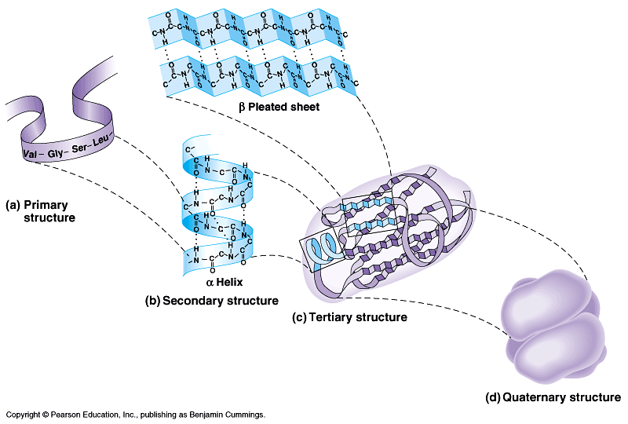
Protein structure (review)
R groups
hydrophobic interactions
disulfide bridges
(H & ionic bonds)
3°
multiple polypeptides
hydrophobic interactions
1°
amino acid sequence
peptide bonds
4°
2°
determined by DNA
R groups
H bonds
Notes:
sequence determines structure and…
structure determines function.
Change the sequence & that changes the structure which changes the function.

Slide 3
3.14 A protein’s shape depends on four levels of structure
The primary structure of a protein is its unique amino acid sequence
The correct amino acid sequence is determined by the cell’s genetic information
The slightest change in this sequence affects the protein’s ability to function
Copyright © 2009 Pearson Education, Inc.
Notes:
Sickle cell disease is manifested by an inability of hemoglobin in red blood cells to carry oxygen, the primary function of hemoglobin. This blood disorder is the result of change in a single amino acid.
Teaching Tips
1. Consider this assignment to review the organic molecules in our diets. Have students, working individually or in small groups, analyze a food label listing the components of a McDonalds’ Big Mac or other fast-food sandwich. Note the most abundant organic molecule class (perhaps by weight) found in each component.

Slide 4
3.14 A protein’s shape depends on four levels of structure
Protein secondary structure results from coiling or folding of the polypeptide
Coiling results in a helical structure called an alpha helix
Folding may lead to a structure called a pleated sheet
Coiling and folding result from hydrogen bonding between certain areas of the polypeptide chain
Copyright © 2009 Pearson Education, Inc.
Notes:
Hydrogen bonding is an important component of the silk protein of a spider’s web. The many hydrogen bonds makes the web as strong as steel.
Teaching Tips
1. Consider this assignment to review the organic molecules in our diets. Have students, working individually or in small groups, analyze a food label listing the components of a McDonalds’ Big Mac or other fast-food sandwich. Note the most abundant organic molecule class (perhaps by weight) found in each component.

Slide 5
3.14 A protein’s shape depends on four levels of structure
The overall three-dimensional shape of a protein is called its tertiary structure
Tertiary structure generally results from interactions between the R groups of the various amino acids
Disulfide bridges are covalent bonds that further strengthen the protein’s shape
Copyright © 2009 Pearson Education, Inc.
Notes:
Teaching Tips
1. Consider this assignment to review the organic molecules in our diets. Have students, working individually or in small groups, analyze a food label listing the components of a McDonalds’ Big Mac or other fast-food sandwich. Note the most abundant organic molecule class (perhaps by weight) found in each component.

Slide 6
3.14 A protein’s shape depends on four levels of structure
Two or more polypeptide chains (subunits) associate providing quaternary structure
Collagen is an example of a protein with quaternary structure
Its triple helix gives great strength to connective tissue, bone, tendons, and ligaments
Copyright © 2009 Pearson Education, Inc.
Notes:
Misfolding of proteins cause diseases, such as Alzheimer’s and Parkinson’s. Both are manifested by accumulations of misfolded proteins.
Consider an assignment to review the organic molecules in our diets. Have students, working individually or in small groups, analyze a food label listing the components of a McDonald’s Big Mac or other fast food sandwich. Note the most abundant organic molecule class (perhaps by weight) found in each component.
For the BLAST Animation Protein Primary Structure, go to Animation and Video Files.
For the BLAST Animation Protein Secondary Structure, go to Animation and Video Files.
For the BLAST Animation Protein Tertiary Structure, go to Animation and Video Files.
For the BLAST Animation Protein Quaternary Structure, go to Animation and Video Files.
Teaching Tips
1. Consider this assignment to review the organic molecules in our diets. Have students, working individually or in small groups, analyze a food label listing the components of a McDonalds’ Big Mac or other fast-food sandwich. Note the most abundant organic molecule class (perhaps by weight) found in each component.

Slide 7
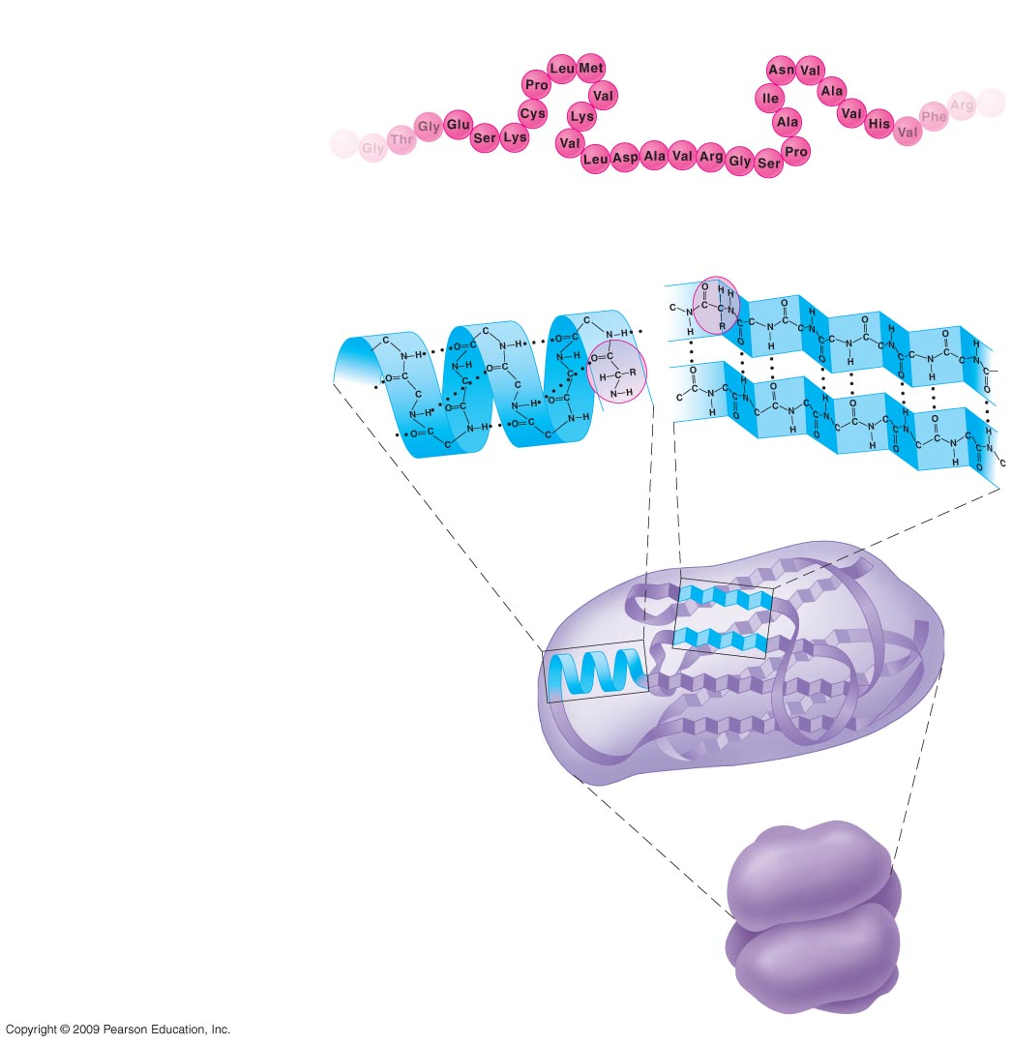
Four Levels of Protein Structure
Primary structure
Amino acids
Hydrogen
bond
Secondary structure
Alpha helix
Pleated sheet
Tertiary structure
Polypeptide
(single subunit
of transthyretin)
Transthyretin, with
four identical
polypeptide subunits
Quaternary structure
Notes:
Figure 3.14A Primary structure.
Figure 3.14B Secondary structure.
Figure 3.14C Tertiary structure.
Figure 3.14D Quaternary structure.

Slide 8
3.13 A protein’s specific shape determines its function
If for some reason a protein’s shape is altered, it can no longer function
Denaturation will cause polypeptide chains to unravel and lose their shape and, thus, their function
Copyright © 2009 Pearson Education, Inc.
Notes:
Excessive heat can also denature a protein. A good example is frying or boiling an egg. The proteins in the egg “white” become solid, white, and opaque upon denaturation.
Student Misconceptions and Concerns
1. The functional significance of protein shape is an abstract molecular example of form and function relationships, which might be new to some students. The binding of an enzyme to its substrate is a type of molecular handshake, which permits specific interactions. To help students think about form and function relationships, share some concrete analogies in their lives—perhaps flathead and Phillips screwdrivers that match the proper type of screws or the fit of a hand into a glove.
Teaching Tips
1. Most cooking results in changes in the texture and color of food. The brown color of a cooked steak is the product of the denaturation of proteins. Fixatives such as formalin also denature proteins and cause color changes. Students who have dissected vertebrates will realize that the brown color of the muscles makes it look as if the animal has been cooked.

Slide 9
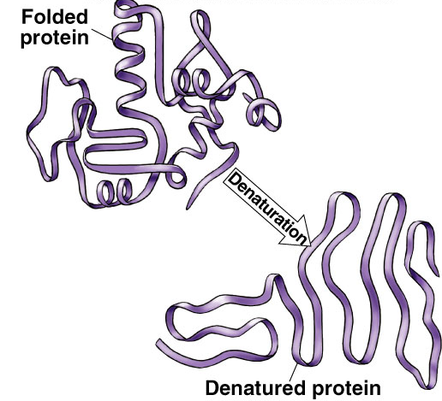
Protein denaturation
Unfolding a protein
conditions that disrupt H bonds, ionic bonds, disulfide bridges
temperature
pH
salinity
alter 2° & 3° structure
alter 3-D shape
destroys functionality
some proteins can return to their functional shape after denaturation, many cannot

