Slide 1
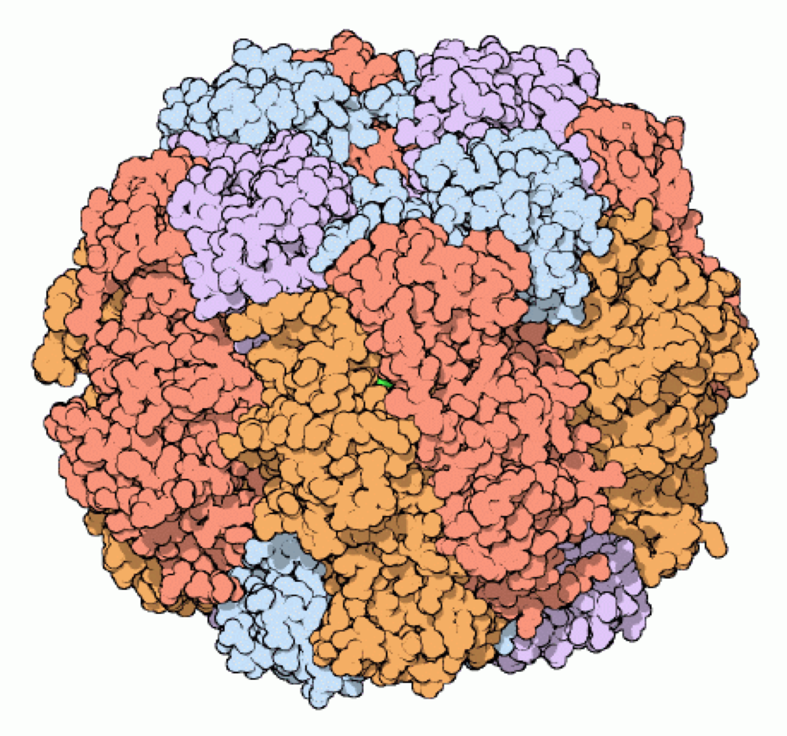
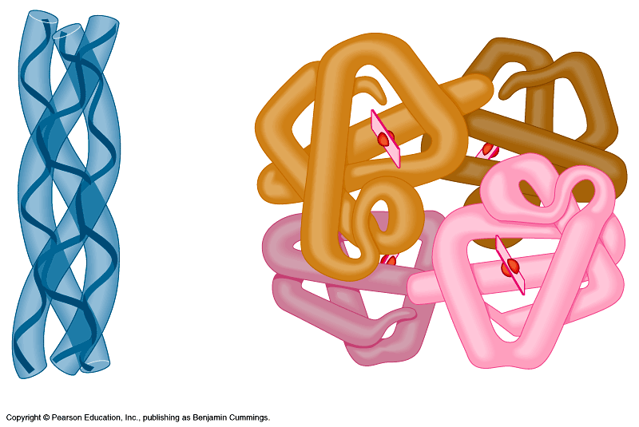
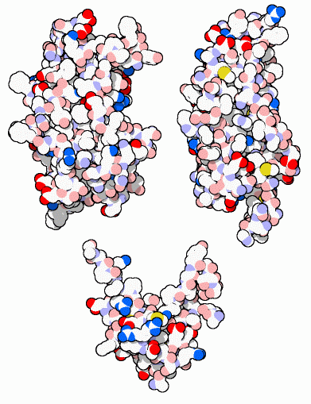
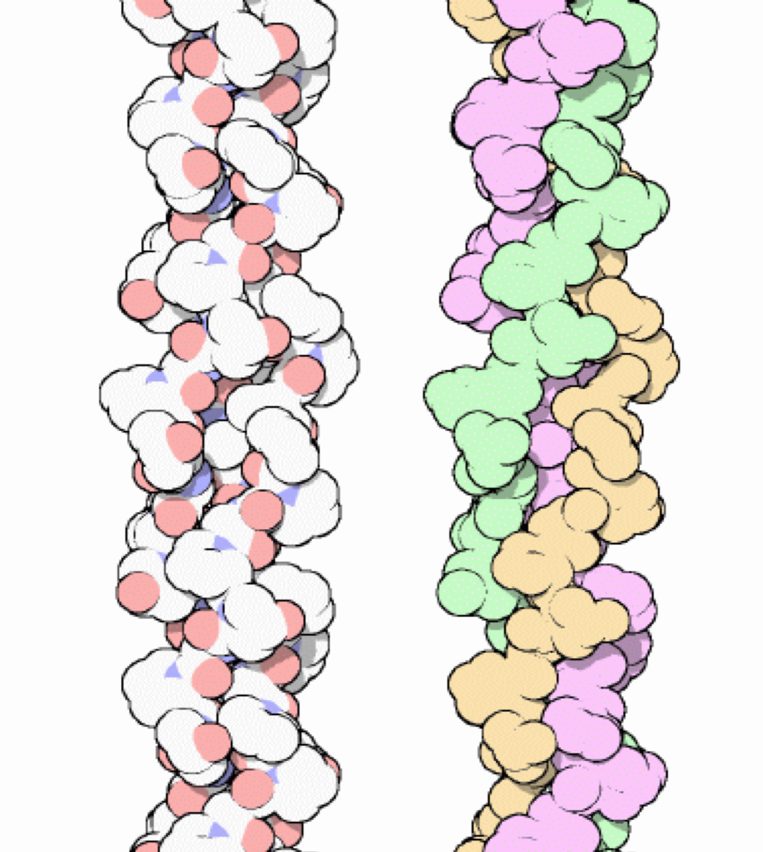
Proteins
Multipurpose
molecules
AP Biology
Notes:
clockwise:
Rubisco — most important protein on the planet?
Hemoglobin — a red blooded protein :-)
Collagen — strings you together
Growth Hormones — working hard in you right now!

Slide 2
3.11 Proteins are essential to the structures and functions of life
A protein is a polymer built from various combinations of 20 amino acid monomers
  Proteins have unique structures that are directly related to their functions
  Enzymes, proteins that serve as metabolic catalysts, regulate the chemical reactions within cells
Copyright © 2009 Pearson Education, Inc.
Notes:
Proteins account for more than 50% of the dry mass of cells.
Structural proteins provide associations between body parts and contractile proteins are found within muscle
Defensive proteins include antibodies of the immune system, and signal proteins are best exemplified by the hormones
Receptor proteins serve as antenna for outside signals, and transport proteins carry oxygen
Teaching Tips
1. Many analogies help students appreciate the diversity of proteins that can be made from just 20 amino acids. The authors note that our language uses combinations of 26 letters to form words. Proteins are much longer “words,” creating even more diversity. Another analogy is to trains. This builds upon the earlier analogy when polymers were introduced. Imagine making different trains about 100 cars long, using any combination of 20 types of railroad cars. Mathematically, the number of possible trains is 20¹⁰⁰, a number beyond imagination.

Slide 3
Proteins
Most structurally & functionally diverse group
Function: involved in almost everything
  enzymes (pepsin, DNA polymerase)
  structure (keratin, collagen)
  carriers & transport (hemoglobin, aquaporin)
  cell communication
    signals (insulin & other hormones)
    receptors
  defense (antibodies)
  movement (actin & myosin)
  storage (bean seed proteins)
Notes:
Storage: beans (seed proteins)
Movement: muscle fibers
Cell surface proteins: labels that ID cell as self vs. foreign
Antibodies: recognize the labels
ENZYMES!!!!

Slide 4
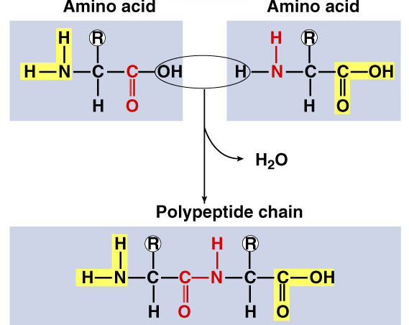
Proteins
Structure
  monomer = amino acids
    20 different amino acids
  polymer = polypeptide
    protein can be one or more polypeptide chains folded & bonded together
    large & complex molecules
    complex 3-D shape
H₂O
hemoglobin
Rubisco
growth
hormones
AP Biology
Notes:
Rubisco = 16 polypeptide chains
Hemoglobin = 4 polypeptide chains (2 alpha, 2 beta)

Slide 5
Amino acids
H
O
|
—C—
|
Structure
  central carbon
  amino group
  carboxyl group (acid)
  R group (side chain)
    variable group
    different for each amino acid
    confers unique chemical properties to each amino acid
      like 20 different letters of an alphabet
      can make many words (proteins)
H
||
C—OH
N
H
R
Oh, I get it!
amino = NH₂
acid = COOH

