Slide 1
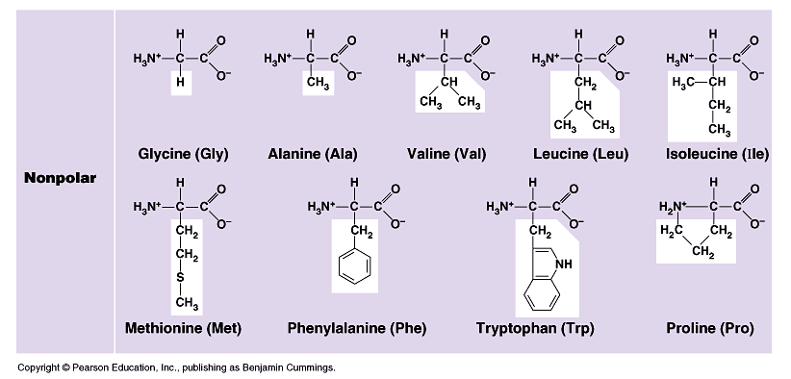
Effect of different R groups: Nonpolar amino acids
nonpolar & hydrophobic
Why are these nonpolar & hydrophobic?

Slide 2
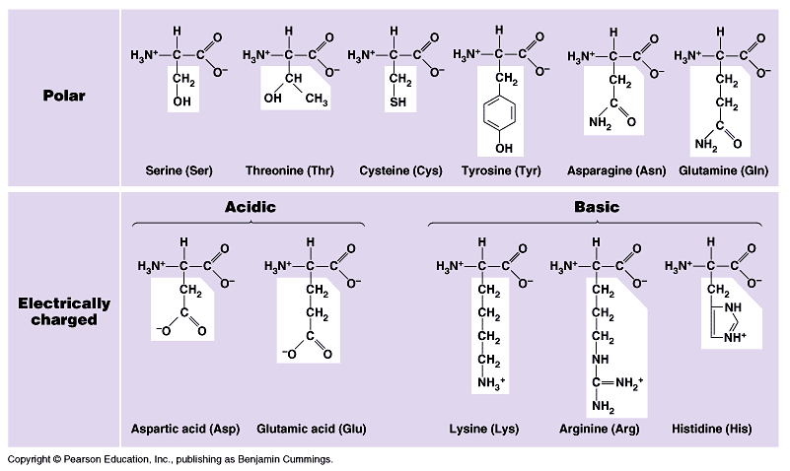
Effect of different R groups: Polar amino acids
polar or charged & hydrophilic
Why are these polar & hydrophillic?

Slide 3
Ionizing in cellular waters
H+ donors

Slide 4
Ionizing in cellular waters
H+ acceptors

Slide 5
Sulfur containing amino acids
Form disulfide bridges
covalent cross links betweens sulfhydryls
stabilizes 3-D structure
H-S – S-H

Slide 6
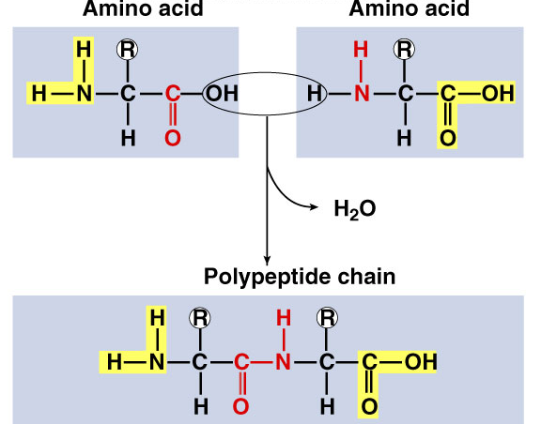
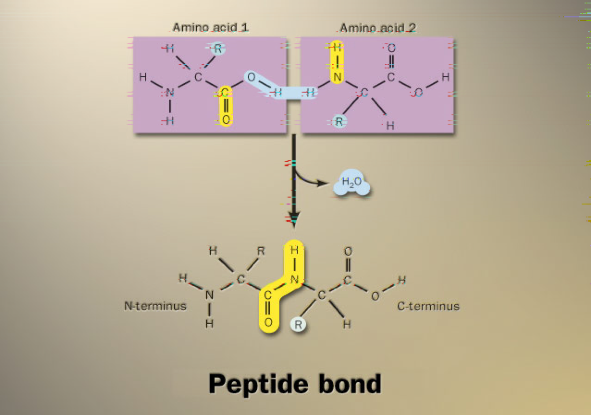
Building proteins
Peptide bonds
covalent bond between NH₂ (amine) of one amino acid & COOH (carboxyl) of another
C–N bond
H₂O
dehydration synthesis
peptide bond
AP Biology
Notes:
free COOH group on one end is ready to form another peptide bond so they “grow” in one direction from N-terminal to C-terminal

Slide 7
Peptide
bond
Carboxyl
group
Amino
group
Dehydration
reaction
Amino acid
Amino acid
Dipeptide
Notes:
Figure 3.12C Peptide bond formation.
As more and more amino acids are added, a chain of amino acids called a polypeptide results. The combination of amino acids is determined by expression of genes on DNA. Although there seems to be an unlimited number of combinations of 20 amino acids, the combinations are limited in an individual because of inheritance.

Slide 8
Building proteins
Polypeptide chains have direction
N-terminus = NH₂ end
C-terminus = COOH end
repeated sequence (N-C-C) is the polypeptide backbone
can only grow in one direction

