Slide 1
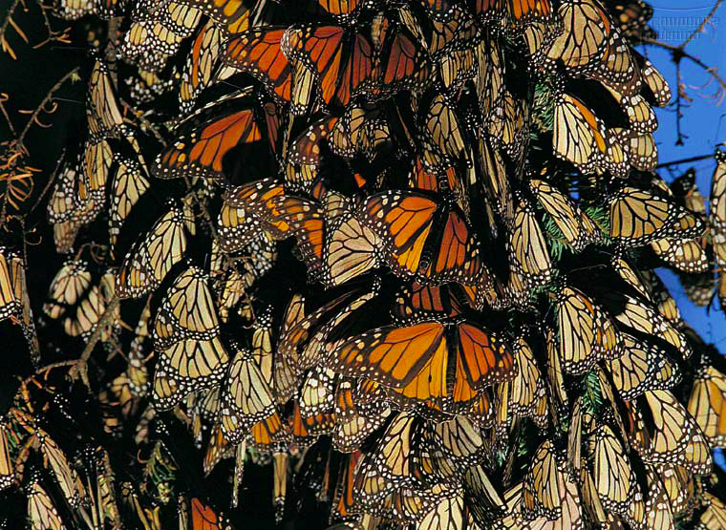
organism
population
community
ecosystem
biosphere
Population Ecology

Slide 2
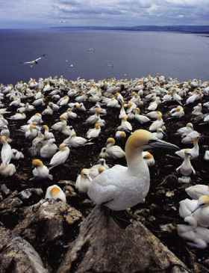

Life takes place in populations
Population
  group of individuals of same species in same area at same time
rely on same resources
interact
interbreed
Population Ecology: What factors affect a population?
Notes:
Population ecology is the study of populations in relation to environment, including environmental influences on density and distribution, age structure, and population size

Slide 3
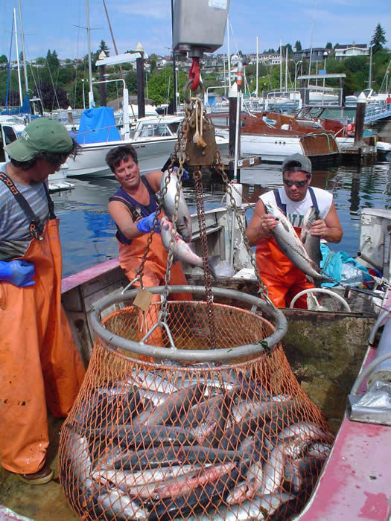
Why Population Ecology?
Scientific goal
  understanding the factors that influence the size of populations
    general principles
    specific cases
Practical goal
  management of populations
    increase population size
      endangered species
    decrease population size
      pests
    maintain population size
      fisheries management
        maintain & maximize sustained yield

Slide 4
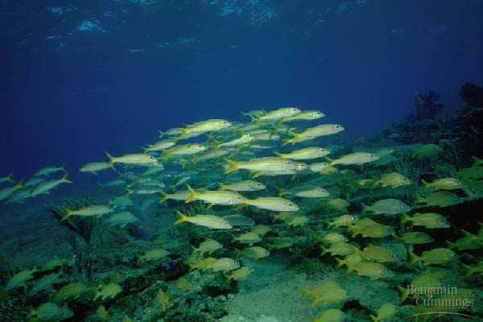
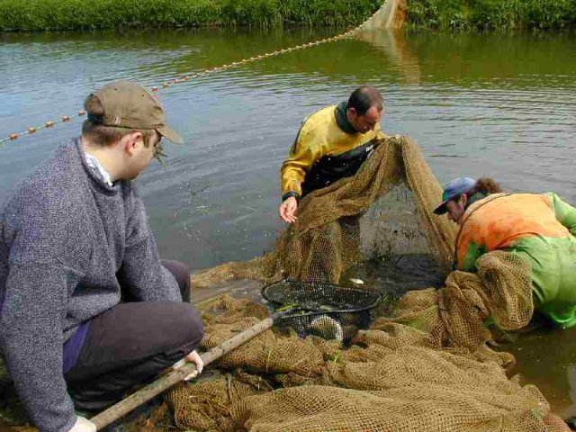
Measuring population density
How do we measure how many individuals in a population?
  number of individuals in an area
  mark & recapture methods
Difficult to count a moving target
sampling populations

Slide 5
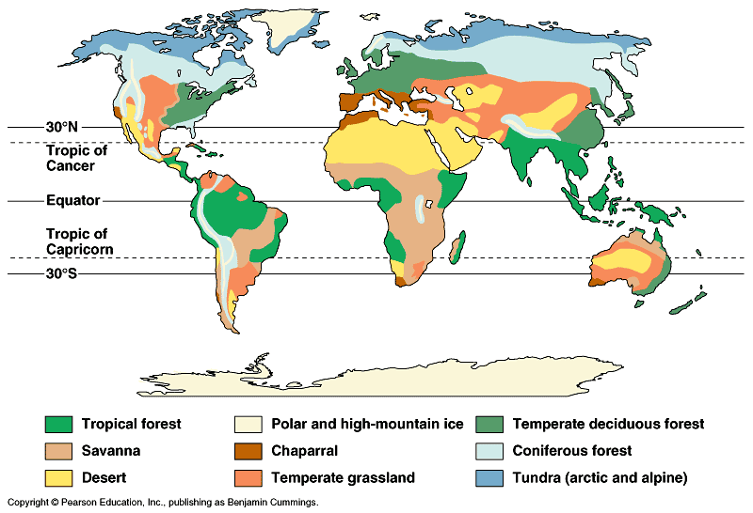
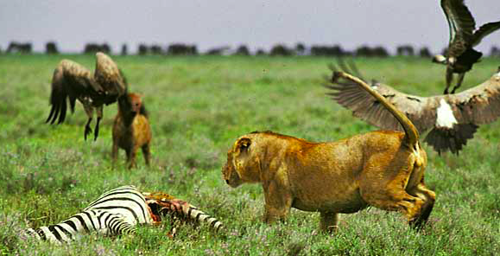
Factors that affect Population Size
Abiotic factors
  sunlight & temperature
  precipitation / water
  soil / nutrients
Biotic factors
  other living organisms
    prey (food)
    competitors
    predators, parasites,
    disease
Intrinsic factors
  adaptations

Slide 6
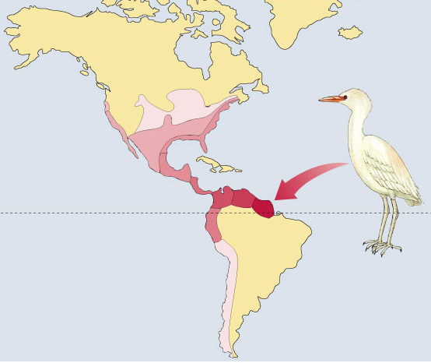
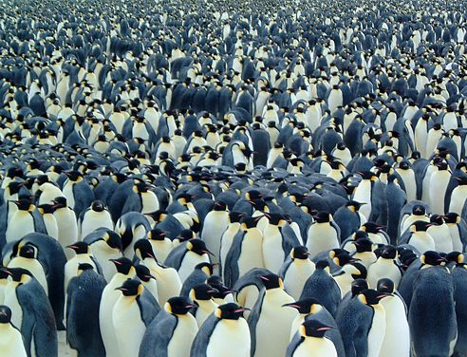
Characterizing a Population
Describing a population
  population range
  pattern of spacing
    density
  size of population
1966
1970
1964
1965
1960
1961
1951
1943
Equator
1958
1937
1956
Immigration
from Africa
~1900
1970
range
density
Notes:
Density is the number of individuals per unit area or volume
Dispersion is the pattern of spacing among individuals within the boundaries of the population

Slide 7
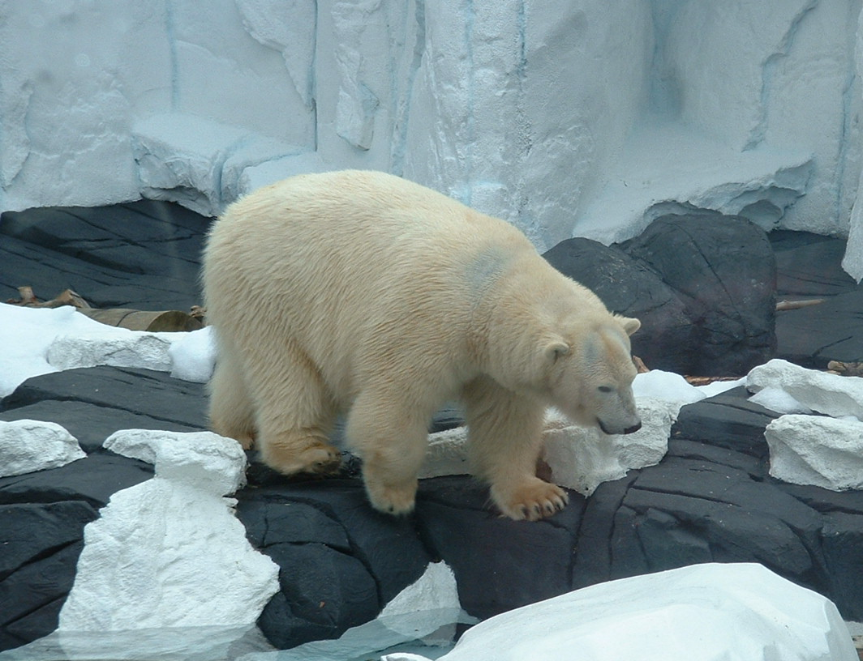
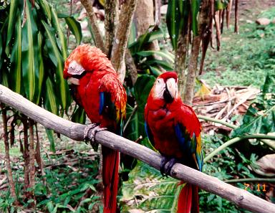
Population Range
Geographical limitations
  abiotic & biotic factors
    temperature, rainfall, food, predators, etc.
  habitat
adaptations to
polar biome
adaptations to
rainforest biome

Slide 8
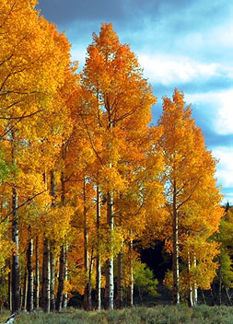
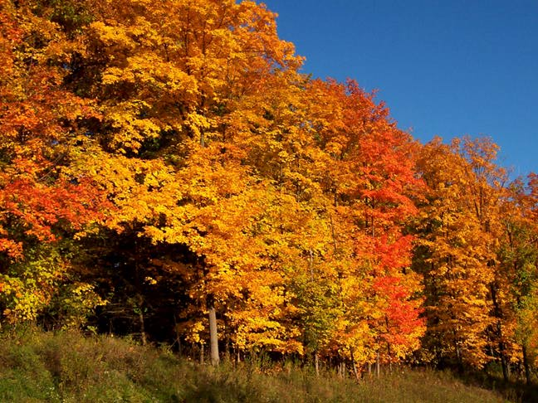
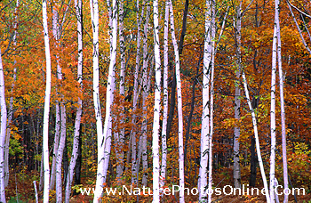
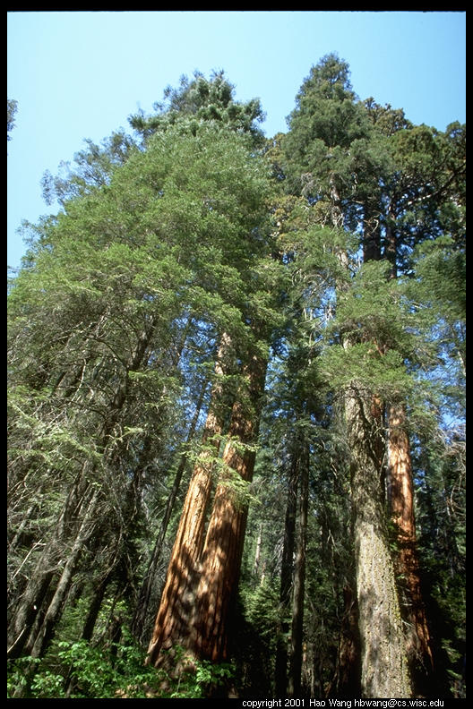
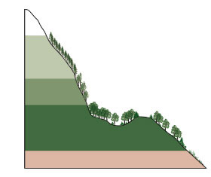
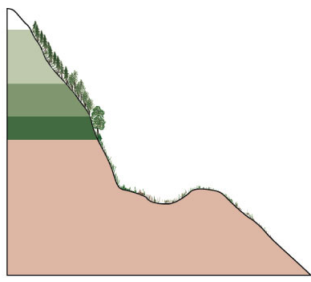
Changes in range
Range expansions & contractions
  changing environment
aspen
oak, maple
white birch
sequoia
15,000 years ago
glacial period
Present
Alpine tundra
Alpine tundra
Spruce-fir forests
3 km
Spruce-fir forests
Mixed conifer forest
2 km
Woodlands
Elevation (km)
Mixed conifer forest
1 km
Grassland,
chaparral, and
desert scrub
Woodlands
0 km
Grassland, chaparral,
and desert scrub
result of competition

