Slide 1
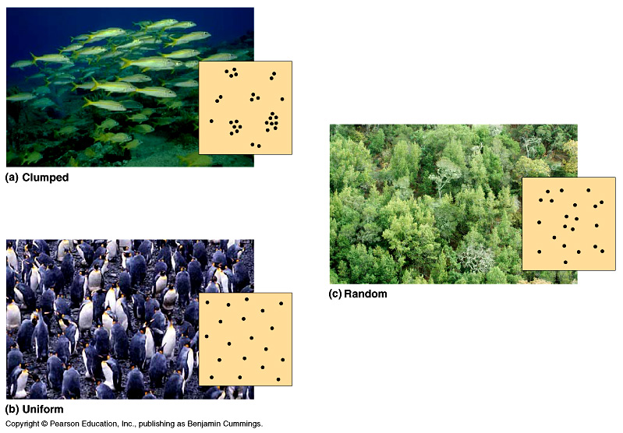
Population Spacing
Dispersal patterns within a population
Provides insight into the environmental associations & social interactions of individuals in population
clumped
random
uniform
Notes:
Environmental and social factors influence spacing of individuals in a population
Within a population’s geographic range, local densities may vary substantially. Variations in local density are among the most important characteristics that a population ecologist might study, since they provide insight into the environmental associations and social interactions of individuals in the population. Environmental differences—even at a local level—contribute to variation in population density; some habitat patches are simply more suitable for a species than are others. Social interactions between members of the population, which may maintain patterns of spacing between individuals, can also contribute to variation in population density.
In a clumped dispersion, individuals aggregate in patches
A clumped dispersion may be influenced by resource availability and behavior
uniform dispersion is one in which individuals are evenly distributed
It may be influenced by social interactions such as territoriality
In a random dispersion, the position of each individual is independent of other individuals
It occurs in the absence of strong attractions or repulsions

Slide 2
Population growth rates
Factors affecting population growth rate
sex ratio
how many females vs. males?
generation time
at what age do females reproduce?
age structure
how females at reproductive age in cohort?

Slide 3
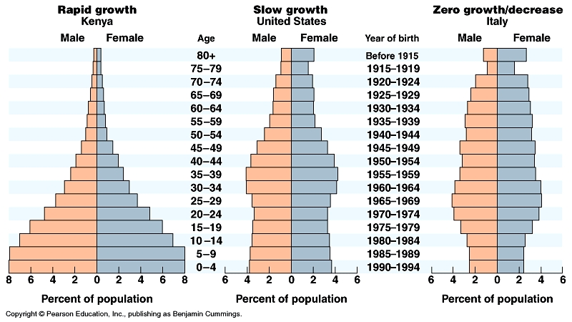
Age structure
Relative number of individuals of each age
What do these data imply about population growth in these countries?
Notes:
One important demographic factor in present and future growth trends is a country’s age structure
Age structure is the relative number of individuals at each age
Age structure diagrams can predict a population’s growth trends
They can illuminate social conditions and help us plan for the future

Slide 4
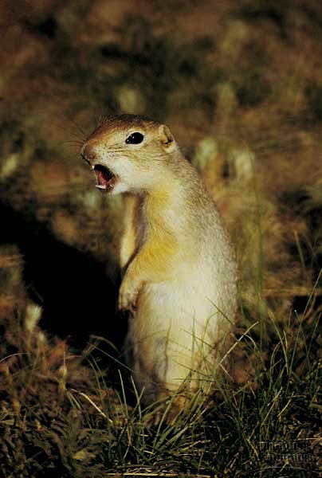
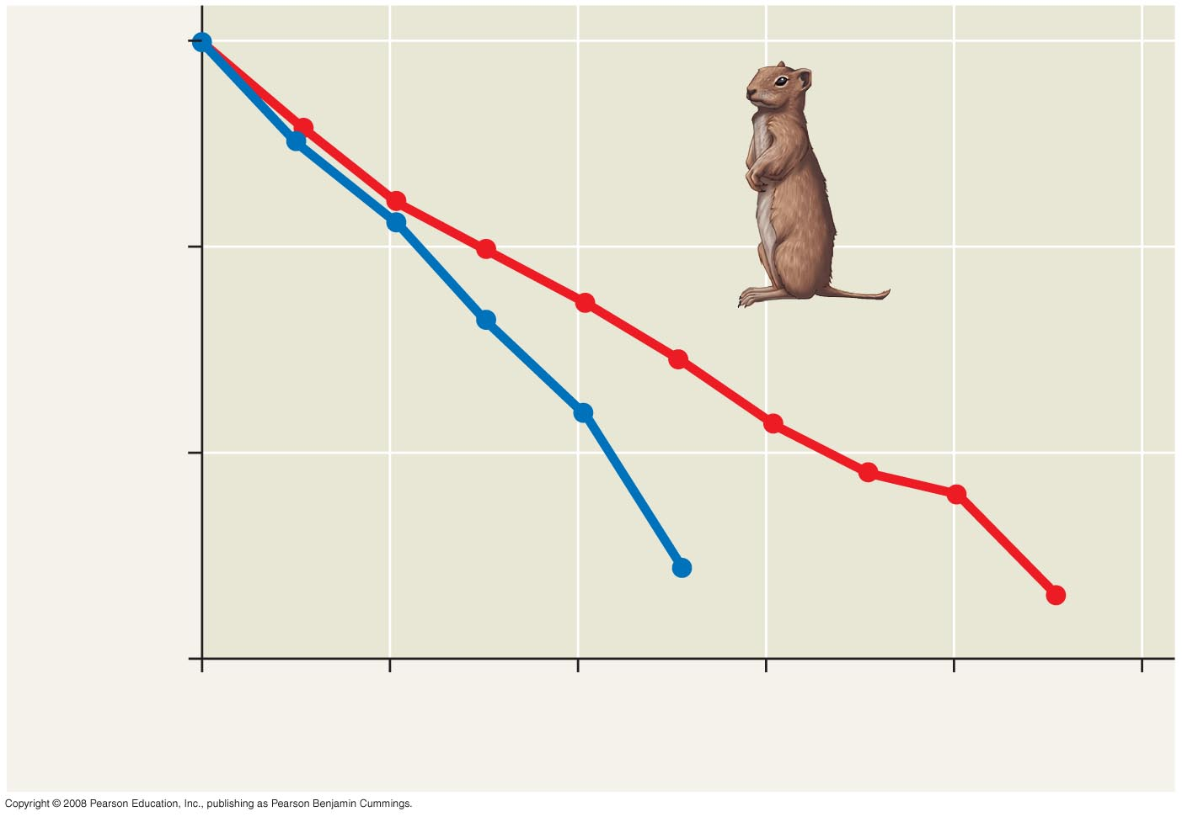
Survivorship curves
Graphic representation of life table
The relatively straight lines of the plots indicate relatively constant rates of death; however, males have a lower survival rate overall than females.
Belding ground squirrel
1,000
100
Number of survivors (log scale)
Females
Males
10
1
0
2
4
6
8
10
Age (years)
Notes:
A survivorship curve is a graphic way of representing the data in a life table
The survivorship curve for Belding’s ground squirrels shows a relatively constant death rate
Survivorship curves can be classified into three general types:
Type I: low death rates during early and middle life, then an increase among older age groups
Type II: the death rate is constant over the organism’s life span
Type III: high death rates for the young, then a slower death rate for survivors

Slide 5
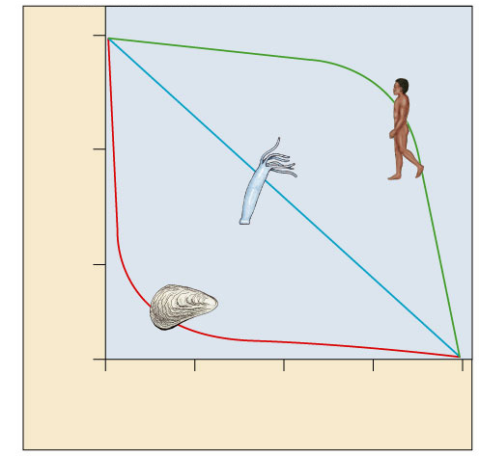
Survivorship curves
What do these graphs tell about survival & strategy of a species?
Generalized strategies
1000
Human
(type I)
I. High death rate in post-reproductive years
Hydra
(type II)
100
II. Constant mortality rate throughout life span
Survival per thousand
Oyster
(type III)
10
III. Very high early mortality but the few survivors then live long (stay reproductive)
1
0
25
50
75
100
Percent of maximum life span
Notes:
A Type I curve is flat at the start, reflecting low death rates during early and middle life, then drops steeply as death rates increase among older age groups. Humans and many other large mammals that produce few offspring but provide them with good care often exhibit this kind of curve. In contrast, a Type III curve drops sharply at the start, reflecting very high death rates for the young, but then flattens out as death rates decline for those few individuals that have survived to a certain critical age. This type of curve is usually associated with organisms that produce very large numbers of offspring but provide little or no care, such as long–lived plants, many fishes, and marine invertebrates. An oyster, for example, may release millions of eggs, but most offspring die as larvae from predation or other causes. Those few that survive long enough to attach to a suitable substrate and begin growing a hard shell will probably survive for a relatively long time. Type II curves are intermediate, with a constant death rate over the organism’s life span. This kind of survivorship occurs in Belding’s ground squirrels and some other rodents, various invertebrates, some lizards, and some annual plants.
For species with sexual reproduction, demographers often concentrate on females in a population
A reproductive table, or fertility schedule, is an age-specific summary of the reproductive rates in a population
It describes reproductive patterns of a population

Slide 6
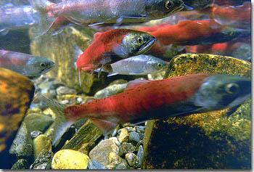
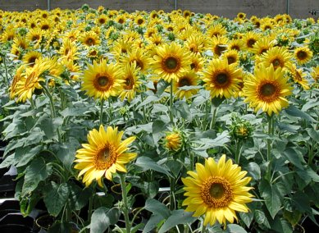
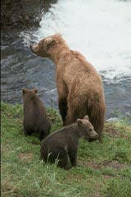
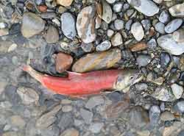
Trade-offs: survival vs. reproduction
The cost of reproduction
increase reproduction may decrease survival
age at first reproduction
investment per offspring
number of reproductive cycles per lifetime
Natural selection favors a life history that maximizes lifetime reproductive success
Notes:
An organism’s life history comprises the traits that affect its schedule of reproduction and survival:
The age at which reproduction begins
How often the organism reproduces
How many offspring are produced during each reproductive cycle
Life history traits are evolutionary outcomes reflected in the development, physiology, and behavior of an organism
Life histories are very diverse
Species that exhibit semelparity, or big-bang reproduction, reproduce once and die
Species that exhibit iteroparity, or repeated reproduction, produce offspring repeatedly
Highly variable or unpredictable environments likely favor big-bang reproduction, while dependable environments may favor repeated reproduction
Organisms have finite resources, which may lead to trade-offs between survival and reproduction

Slide 7
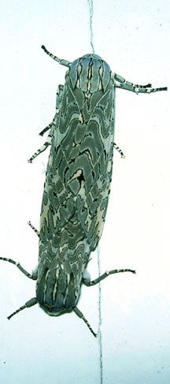
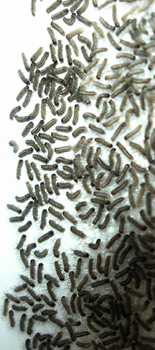
Reproductive strategies
K-selected
late reproduction
few offspring
invest a lot in raising offspring
primates
coconut
r-selected
early reproduction
many offspring
little parental care
insects
many plants
K-selected
r-selected
Notes:
Life history traits favored by natural selection may vary with population density and environmental conditions
K-selection, or density-dependent selection, selects for life history traits that are sensitive to population density
r-selection, or density-independent selection, selects for life history traits that maximize reproduction
The concepts of K-selection and r-selection are oversimplifications but have stimulated alternative hypotheses of life history evolution

Slide 8
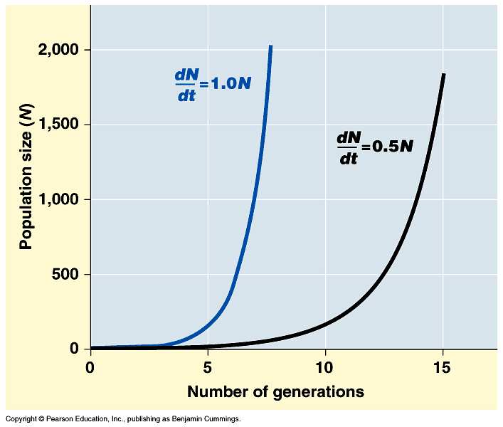
Population growth
change in population = births – deaths
Exponential model (ideal conditions)
dN = r_{i}N
dt
growth increasing at constant rate
N = # of individuals
r = rate of growth
r_{i} = intrinsic rate
t = time
d = rate of change
every pair has 4 offspring
every pair has 3 offspring
intrinsic rate = maximum rate of growth
Notes:
It is useful to study population growth in an idealized situation
Idealized situations help us understand the capacity of species to increase and the conditions that may facilitate this growth
If immigration and emigration are ignored, a population’s growth rate (per capita increase) equals birth rate minus death rate
Zero population growth occurs when the birth rate equals the death rate
Most ecologists use differential calculus to express population growth as growth rate at a particular instant in time:
where N = population size, t = time, and r = per capita rate of increase = birth – death
Exponential population growth is population increase under idealized conditions
Under these conditions, the rate of reproduction is at its maximum, called the intrinsic rate of increase
Exponential population growth results in a J-shaped curve
The J-shaped curve of exponential growth characterizes some rebounding populations

Slide 9
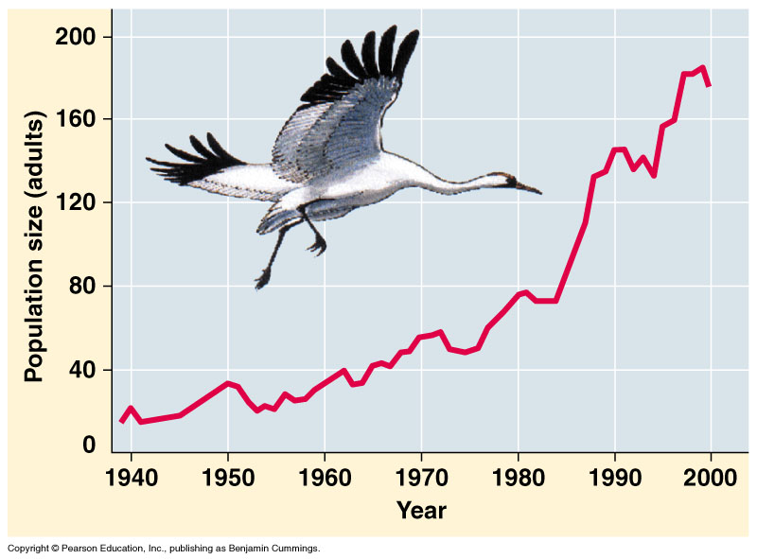
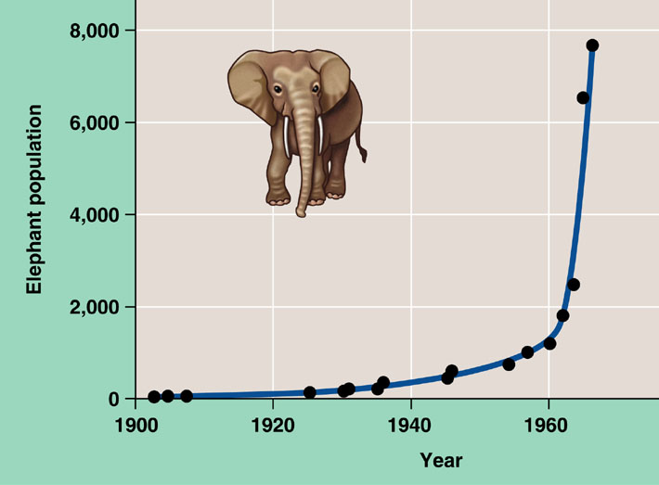
Exponential growth rate
Characteristic of populations without limiting factors
introduced to a new environment or rebounding from a catastrophe
Whooping crane
coming back from near extinction
African elephant
protected from hunting
Notes:
The J–shaped curve of exponential growth is characteristic of some populations that are introduced into a new or unfilled environment or whose numbers have been drastically reduced by a catastrophic event and are rebounding. The graph illustrates the exponential population growth that occurred in the population of elephants in Kruger National Park, South Africa, after they were protected from hunting. After approximately 60 years of exponential growth, the large number of elephants had caused enough damage to the park vegetation that a collapse in the elephant food supply was likely, leading to an end to population growth through starvation. To protect other species and the park ecosystem before that happened, park managers began limiting the elephant population by using birth control and exporting elephants to other countries.

