Slide 1
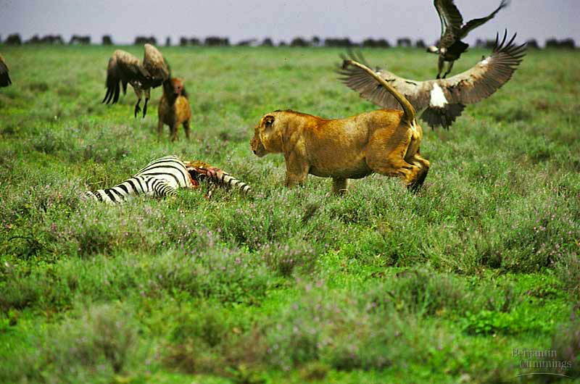
organism
population
Community Ecology
community
ecosystem
biosphere

Slide 2
Community Ecology
Community
  all the organisms that live together in a place
    interactions
Community Ecology
  study of
  interactions
  among all
  populations
  in a common
  environment
To answer:
In what way do the populations interact?
Notes:
A biological community is an assemblage of populations of various species living close enough for potential interaction

Slide 3
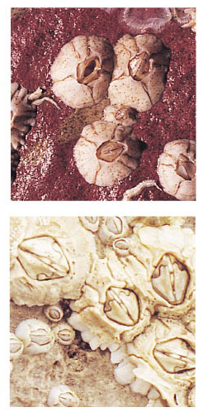
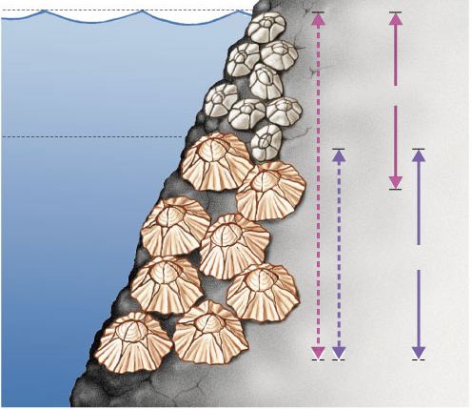
Niche
An organism’s niche is its ecological role
  habitat = address vs. niche = job
High tide
Competitive Exclusion
If Species 2 is removed, then Species 1 will occupy whole tidal zone. But at lower depths Species 2 out-competes Species 1, excluding it from its potential (fundamental) niche.
Species 1
Low tide
Chthamalus sp.
Species 2
Fundamental
niches
Realized
niches
Semibalanus sp.
Notes:
The total of a species’ use of biotic and abiotic resources is called the species’ ecological niche
An ecological niche can also be thought of as an organism’s ecological role
Ecologically similar species can coexist in a community if there are one or more significant differences in their niches
Strong competition can lead to competitive exclusion, local elimination of a competing species
The competitive exclusion principle states that two species competing for the same limiting resources cannot coexist in the same place

Slide 4
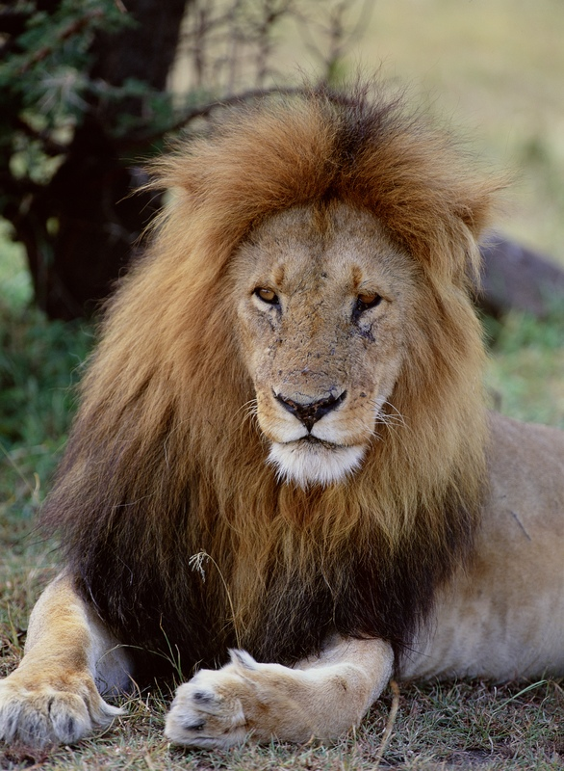
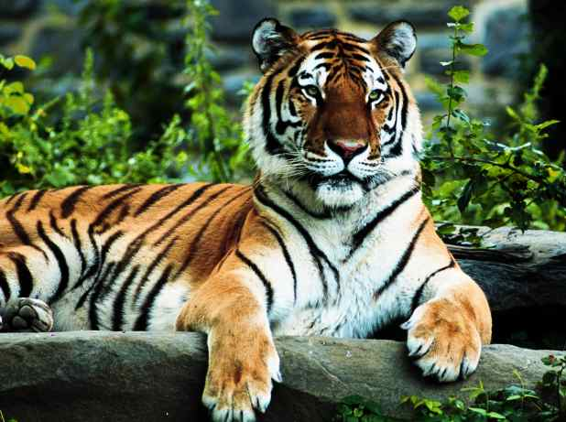
Niche & competition
Competitive Exclusion
  No two similar species can occupy the same niche at the same time

Slide 5

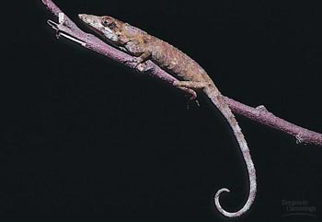
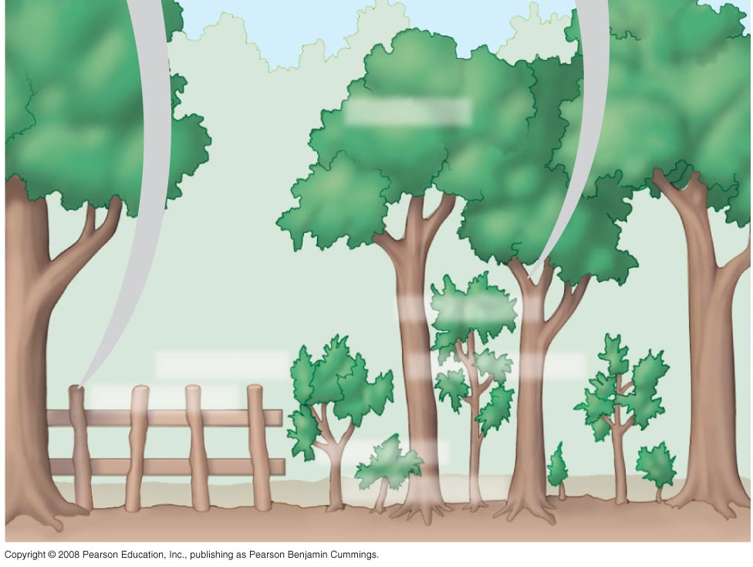
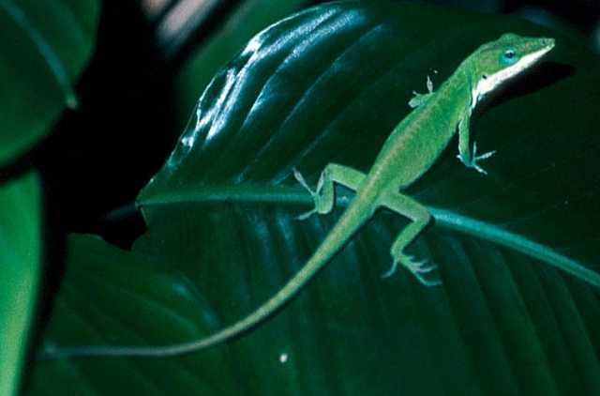
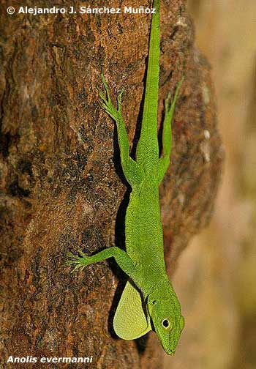
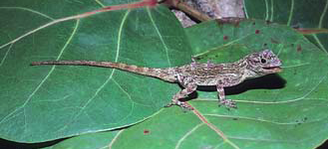
Resource partitioning
Reduce competition through microhabitats
“the ghost of competition past”
A. ricordii
A. insolitus
A. aliniger
A. christophei
A. distichus
A. cybotes
A. etheridgei
Notes:
Resource partitioning is differentiation of ecological niches, enabling similar species to coexist in a community
Resource partitioning among Dominican Republic lizards. Seven species of Anolis lizards live in close proximity, and all feed on insects and other small arthropods. However, competition for food is reduced because each lizard species has a different perch, thus occupying a distinct niche.
Sympatric species often partition available resources, reducing competition between them.
A. insolitus usually perches
on shady branches.
A. distichus perches on fence
posts and other sunny surfaces
As a result of competition, a species’ fundamental niche may differ from its realized niche

Slide 6
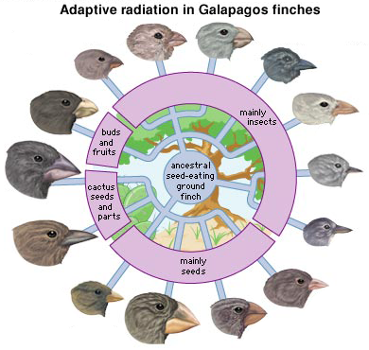
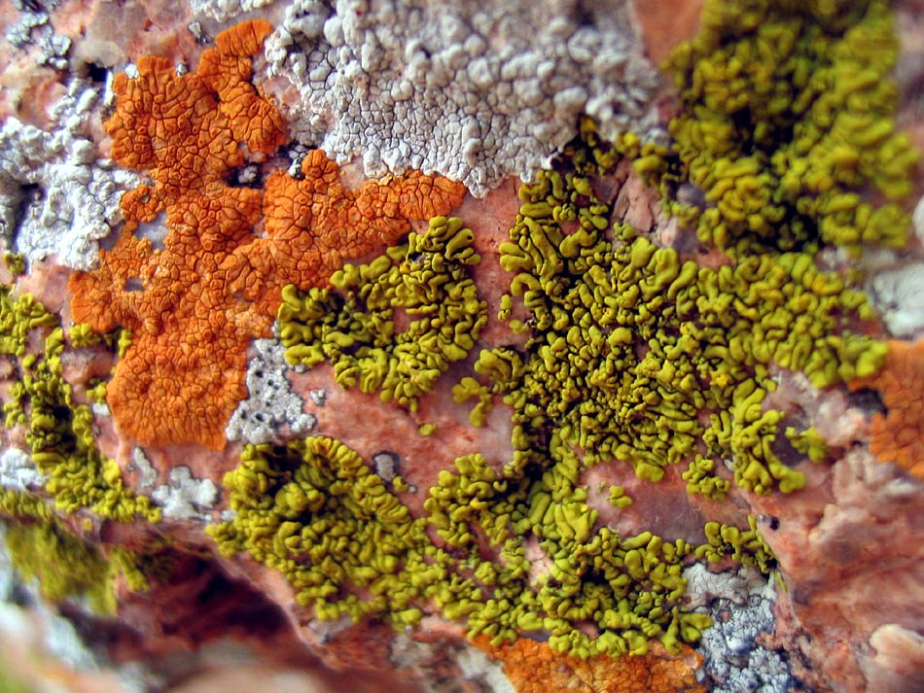
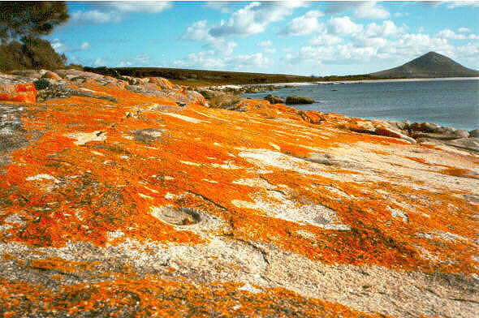
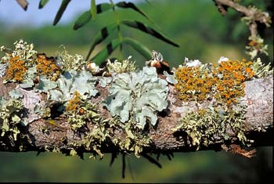
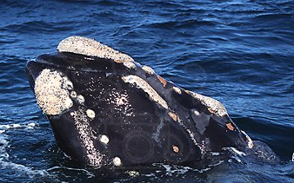
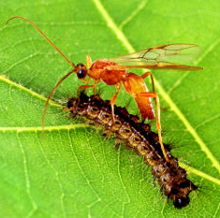
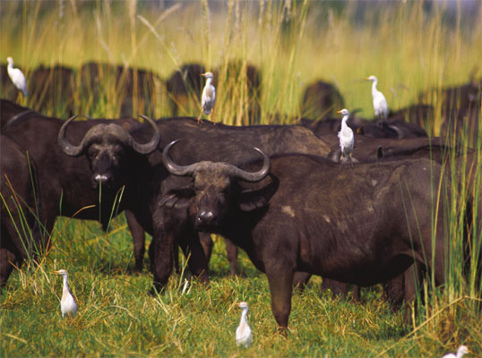
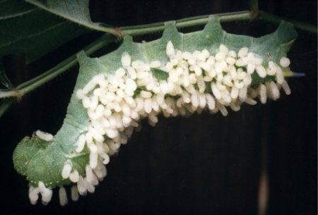
Interspecific interactions
Symbiotic interactions
  competition (-/-)
    compete for limited resource
    competitive exclusion!
  predation / parasitism (-/+)
  mutualism (+/+)
    lichens (algae & fungus)
  commensalism (+/0)
    barnacles attached
    to whale
Notes:
Ecologists call relationships between species in a community interspecific interactions
Examples are competition, predation, herbivory, and symbiosis (parasitism, mutualism, and commensalism)
Interspecific interactions can affect the survival and reproduction of each species, and the effects can be summarized as positive (+), negative (–), or no effect (0)
Interspecific competition (–/– interaction) occurs when species compete for a resource in short supply
Symbiosis is a relationship where two or more species live in direct and intimate contact with one another
In parasitism (+/– interaction), one organism, the parasite, derives nourishment from another organism, its host, which is harmed in the process
Parasites that live within the body of their host are called endoparasites; parasites that live on the external surface of a host are ectoparasites
Many parasites have a complex life cycle involving a number of hosts
Some parasites change the behavior of the host to increase their own fitness
Herbivory (+/– interaction) refers to an interaction in which an herbivore eats parts of a plant or alga
It has led to evolution of plant mechanical and chemical defenses and adaptations by herbivores
Mutualistic symbiosis, or mutualism (+/+ interaction), is an interspecific interaction that benefits both species
A mutualism can be
Obligate, where one species cannot survive without the other
Facultative, where both species can survive alone
In commensalism (+/0 interaction), one species benefits and the other is apparently unaffected
Commensal interactions are hard to document in nature because any close association likely affects both species

