Slide 1
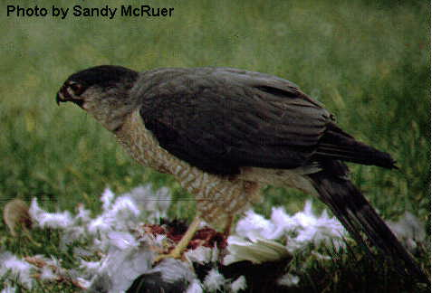
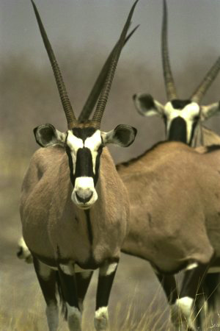
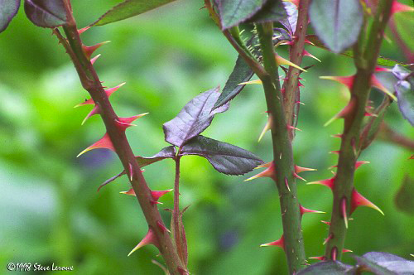
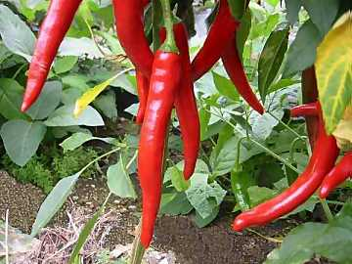
Predation drives evolution
Predators adaptations
locate & subdue prey
Prey adaptations
elude & defend
Predation provides a strong selection pressure on both prey & predator
horns, speed, coloration
spines, thorns, toxins
Notes:
Predation provides a strong selective pressure on prey populations. Ay feature that would decrease the probability of capture should be strongly favored.
Predation (+/– interaction) refers to interaction where one species, the predator, kills and eats the other, the prey
Some feeding adaptations of predators are claws, teeth, fangs, stingers, and poison

Slide 2
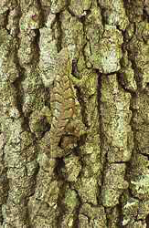
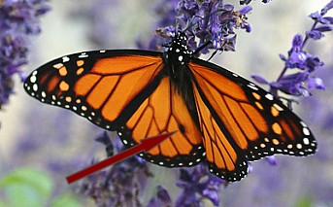
Anti-predator adaptations
Hide from predators
avoid detection
camouflage
Warn predators
advertise how undesirable you are as prey
aposematic coloration
apo = away & sematic = sign/meaning
Batesian mimicry
Mullerian mimicry
Notes:
Prey display various defensive adaptations
Behavioral defenses include hiding, fleeing, forming herds or schools, self-defense, and alarm calls
Animals also have morphological and physiological defense adaptations
Cryptic coloration, or camouflage, makes prey difficult to spot
Animals with effective chemical defense often exhibit bright warning coloration, called aposematic coloration
Predators are particularly cautious in dealing with prey that display such coloration

Slide 3
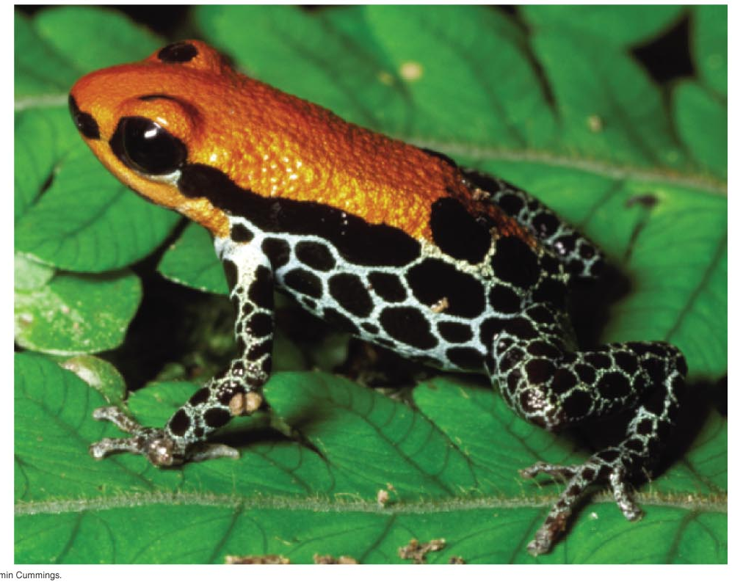
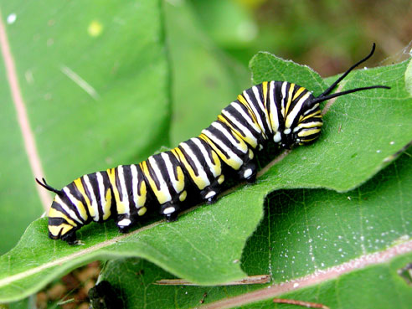
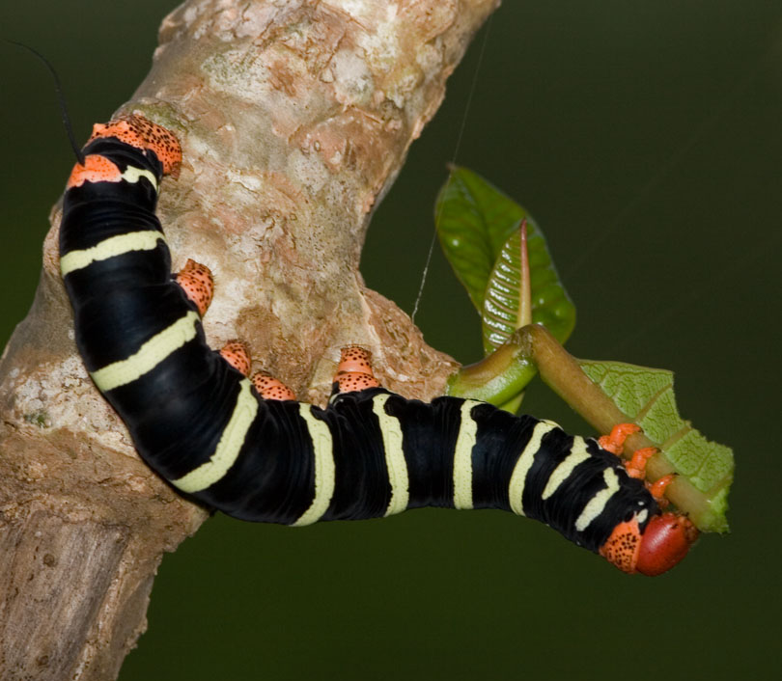
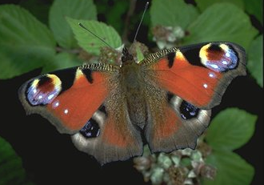
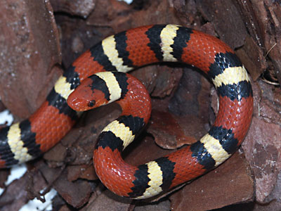
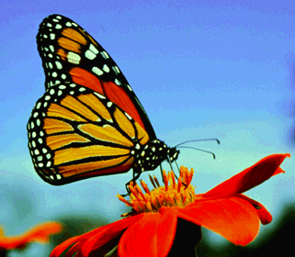
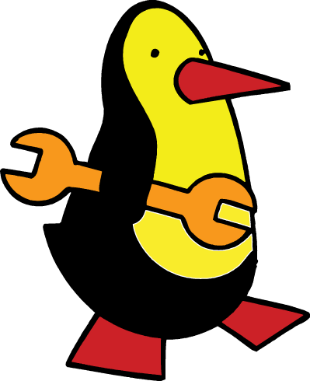
Common warning coloration
Aposematic species come to resemble each other
black, red, orange & yellow means: DON’T EAT ME!
Notes:
Animals with effective chemical defense often exhibit bright warning coloration, called aposematic coloration
Predators are particularly cautious in dealing with prey that display such coloration

Slide 4
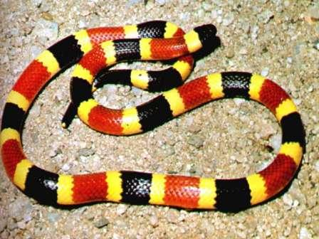
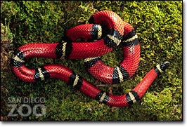
What kind of mimicry?
Coral snake is poisonous
King snake is not
Red on yellow, poison fellow; red on black, safe from attack

Slide 5
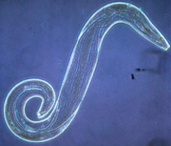
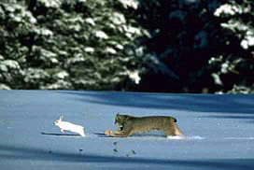
Coevolution in Community
Predator-prey relationships
Parasite-host relationships
Flowers & pollinators
Long term evolutionary adjustments between species

Slide 6
Concept 54.2: Dominant and keystone species exert strong controls on community structure
In general, a few species in a community exert strong control on that community’s structure
Two fundamental features of community structure are species diversity and feeding relationships

Slide 7
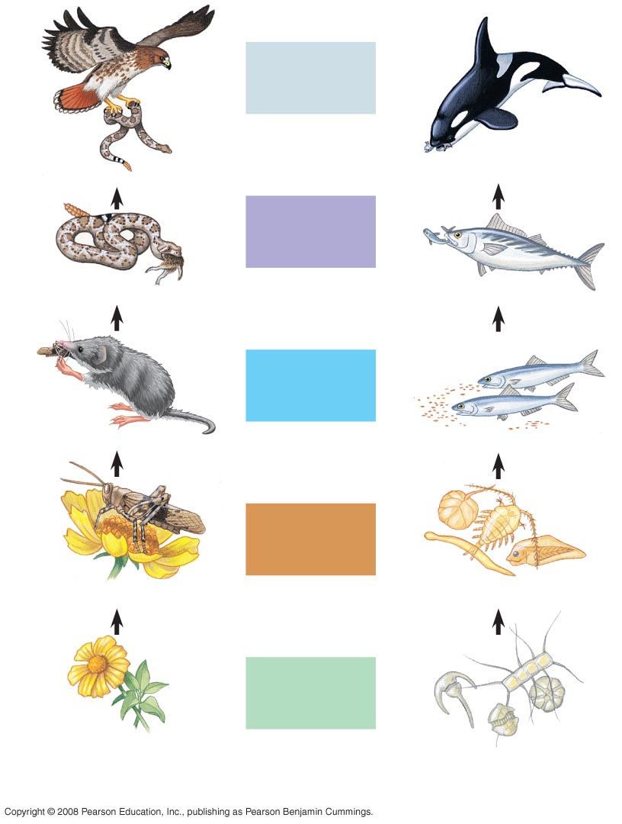
Fig. 54-11
Quaternary
consumers
Carnivore
Carnivore
Tertiary
consumers
Carnivore
Carnivore
Secondary
consumers
Carnivore
Carnivore
Primary
consumers
Herbivore
Zooplankton
Primary
producers
Plant
Phytoplankton
A terrestrial food chain
A marine food chain
Notes:
Figure 54.11 Examples of terrestrial and marine food chains
Trophic structure is the feeding relationships between organisms in a community
It is a key factor in community dynamics
Food chains link trophic levels from producers to top carnivores

Slide 8
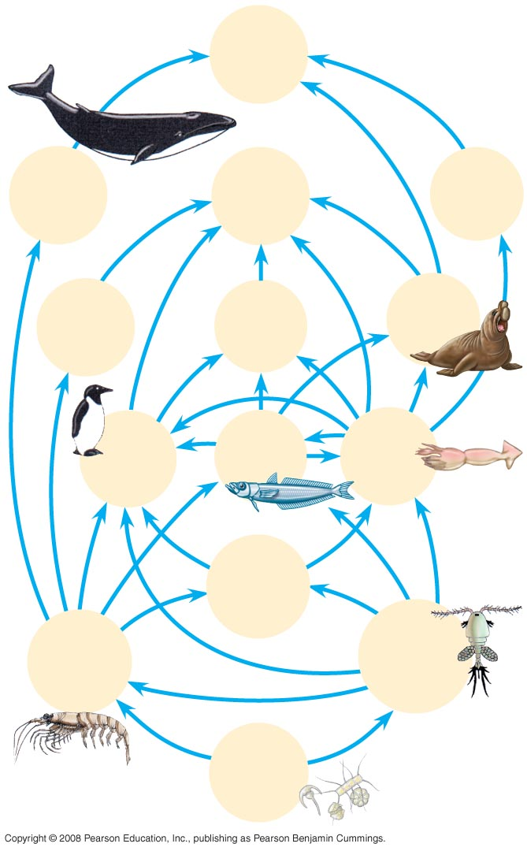
Fig. 54-12
Humans
A food web is a branching food chain with complex trophic interactions
Baleen
whales
Smaller
toothed
whales
Sperm
whales
Crab-eater
seals
Leopard
seals
Elephant
seals
Birds
Fishes
Squids
Carnivorous
plankton
Euphausids
(krill)
Copepods
Phyto-
plankton
Notes:
Figure 54.12 An antarctic marine food web
Species may play a role at more than one trophic level
Food webs can be simplified by isolating a portion of a community that interacts very little with the rest of the community
Each food chain in a food web is usually only a few links long
Two hypotheses attempt to explain food chain length: the energetic hypothesis and the dynamic stability hypothesis
The energetic hypothesis suggests that length is limited by inefficient energy transfer
The dynamic stability hypothesis proposes that long food chains are less stable than short ones
Most data support the energetic hypothesis

