Slide 1
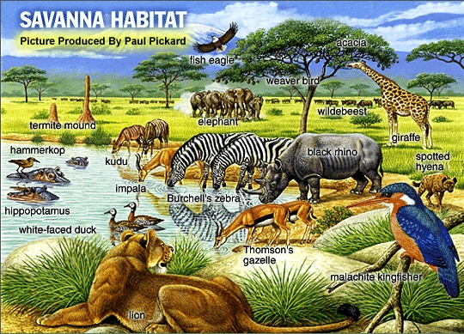
4-2What Shapes an Ecosystem?
Notes:
Photo Credit: ©Michael Fogden/DRK PHOTO

Slide 2
Biotic and Abiotic Factors
Ecosystems are influenced by . . .
Biotic factors
Living things
Abiotic factors
Nonliving things
temperature
precipitation
humidity
Wind
nutrient availability
soil type
sunlight
Notes:
Biotic and abiotic factors determine the survival and growth of an organism and the productivity of the ecosystem in which the organism lives.

Slide 3
Abiotic Factors
Climate
Average yearly temperature and precipitation
Weather
day-to-day condition of Earth's atmosphere at a particular time and place.
Terrain
describes the overall landscape
Mountains, hills, rocky soil, flat land, occasional fires etc.
Latitude
areas found at same latitudes on the earth tend to have the same climates, due to the amount of sunlight received.
Notes:
Weather
day-to-day condition of Earth's atmosphere at a particular time and place.
Climate
average year-after-year conditions of temperature and precipitation in a particular region.

Slide 4
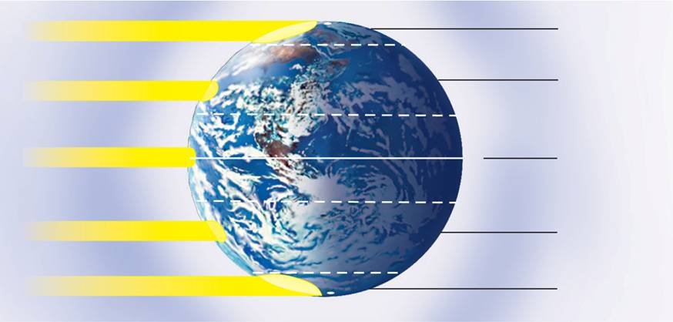
Main Climate Zones
Earth has three main climate zones:
Polar – cold areas
Temperate – ranges from hot to cold, depending on the season.
Tropical – almost always warm
90°N North Pole
Sunlight
Polar
Arctic Circle
66.5°N
Temperate
Sunlight
Tropic of Cancer
23.5°N
Equator
Most direct sunlight
0°
Tropical
Tropic of Capricorn
23.5°S
Sunlight
Temperate
Antarctic Circle
Sunlight
66.5°S
Polar
90°S South Pole
Notes:
Earth has three main climate zones. These climate zones are caused by the unequal heating of Earth's surface. Near the equator, energy from the sun strikes Earth almost directly. Near the poles, the sun's rays strike Earth's surface at a lower angle. The same amount of solar energy is spread out over a larger area, heating the surface less than at the equator.
Polar zones are located in the areas around the North and South poles, between 66.5° and 90° North and South latitudes. sun's rays strike Earth at a very low angle.
The temperate zones sit between the polar zones and the tropics. Affected by the changing angle of the sun over the course of a year.
Tropical zones: near the equator; receive direct or nearly direct sunlight year-round, making the climate almost always warm.

Slide 5
Habitat
Habitat
The area where an organism lives.
Includes both biotic and abiotic factors.
Its like an organism’s address or town.
Niche
the way in which the organism uses the things around it
The role an organism plays
Notes:
The range of temperatures that an organism needs to survive and its place in the food web are part of its niche.
No two species can share the same niche in the same habitat.
Different species can occupy niches that are very similar.
This leads to interactions between different species.

Slide 6
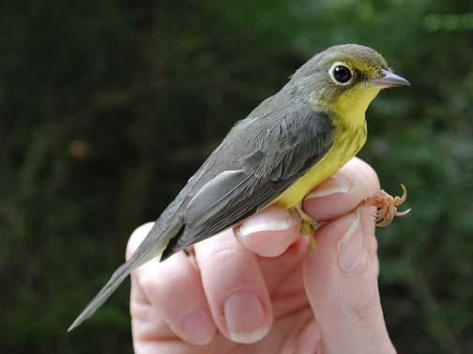
No two species can share the same niche in the same habitat.
Many species of warblers live in the same tree (habitat), but they do not occupy the same niche. How can this be?

Slide 7
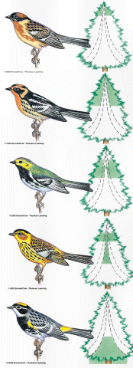
Each warbler lives in a different section of the tree.
In short, a “NICHE” is a way of life, and includes all aspects
-where it lives
-how it builds a nest -when it mates -what it eats
-how it hunts

Slide 8
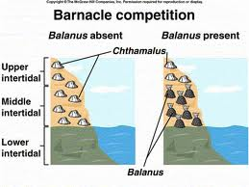
Interactions in the Ecosystem
Competition: fighting for resources
Occurs when organisms of the same or different species attempt to use a resource at the same place and time.
The competitive exclusion principle: no two species can occupy the same niche in the same habitat at the same time.
One species will out-compete the other
Drive the other species to extinction
Cause the other species to move to a different habitat occupy a different niche
Notes:
Resource is any necessity of life: water, nutrients, light, food, or space.
The competitive exclusion principle states that no two species can occupy the same niche in the same habitat at the same time.
Direct competition often results in a winner and a loser—with the losing organism failing to survive.
The distribution of these warblers avoids direct competition, because each species feeds in a different part of the tree.

Slide 9
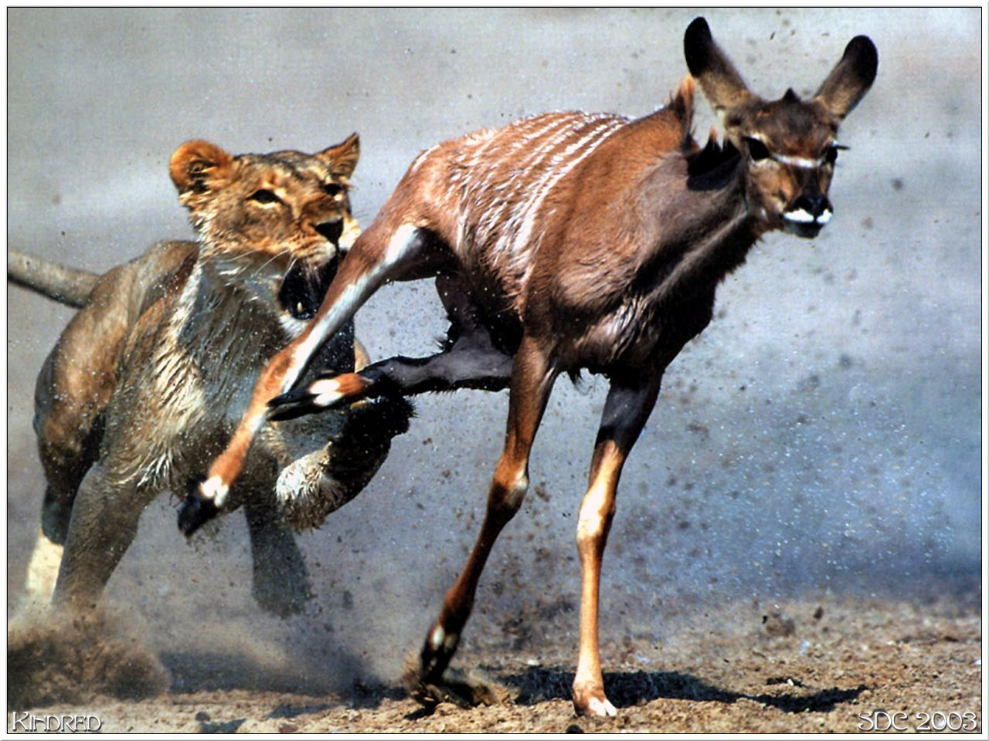
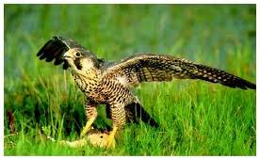
Interactions in the Ecosystem
Predation
An interaction when one organism captures and feeds on another.
Predator: the organism that does the killing and eating
Prey: the food organism
Notes:
When organisms live together in ecological communities, they interact constantly.

Slide 10
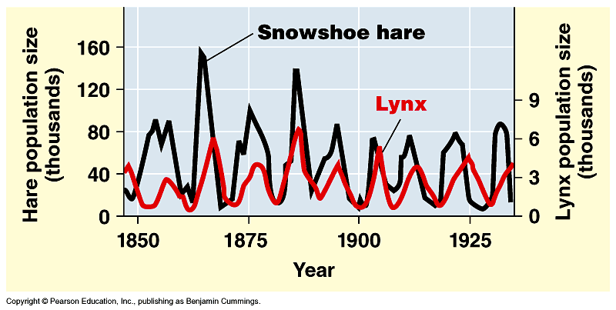
Population cycles
predator – prey interactions
Notes:
Some populations undergo regular boom-and-bust cycles
Lynx populations follow the 10 year boom-and-bust cycle of hare populations
Three hypotheses have been proposed to explain the hare’s 10-year interval
Hypothesis: The hare’s population cycle follows a cycle of winter food supply
If this hypothesis is correct, then the cycles should stop if the food supply is increased
Additional food was provided experimentally to a hare population, and the whole population increased in size but continued to cycle
No hares appeared to have died of starvation
Hypothesis: The hare’s population cycle is driven by pressure from other predators
In a study conducted by field ecologists, 90% of the hares were killed by predators
These data support this second hypothesis
Hypothesis: The hare’s population cycle is linked to sunspot cycles
Sunspot activity affects light quality, which in turn affects the quality of the hares’ food
There is good correlation between sunspot activity and hare population size
The results of all these experiments suggest that both predation and sunspot activity regulate hare numbers and that food availability plays a less important role

Slide 11
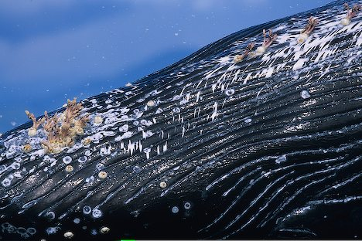
Interactions in the Ecosystem
Any relationship in which two organisms live closely together is called symbiosis.
Types of symbiosis:
Mutualism
Both species benefit
Commensalism
One species benefits the other is neither helped or harmed
Parasitism
One organism is helped the other is harmed
Notes:
Mutualism
Both species benefit
Bees and a flower.
Commensalism
One species benefits the other is neither helped or harmed
Barnacles on a whale.
Parasitism
One organism is helped the other is harmed
Tick on a animal

Slide 12
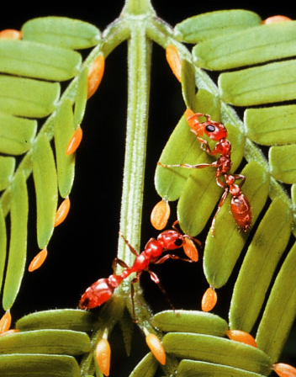
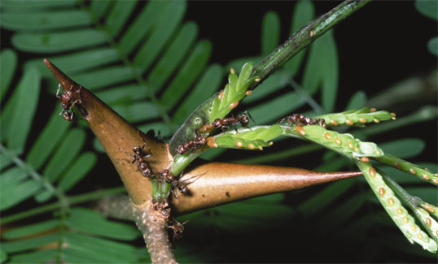
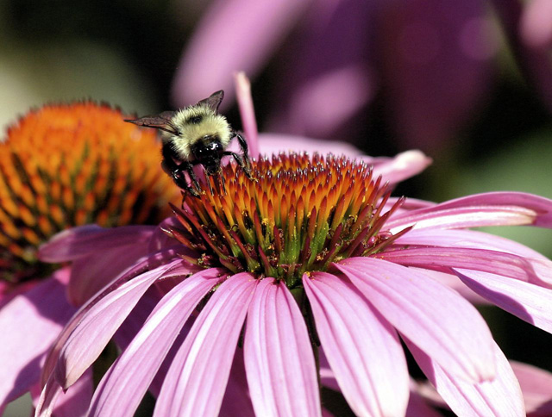
What relationship is this?
Notes:
clown fish & sea anemone: commensalism
ants & acacia: ants protect the tree, acacia provides food for ant: mutualism
impala & oxpeckers: oxpeckers remove ticks from impala Mutualism
Lion and zebra: predation
Bee and flower: mutualism

Slide 13
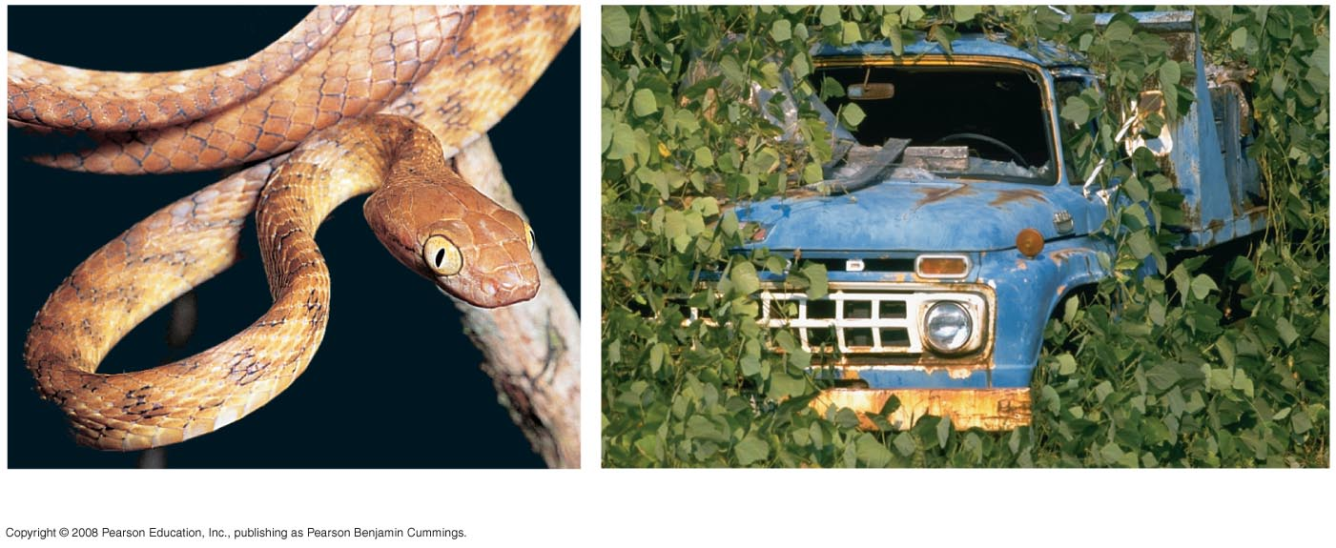
Introduced Species
Introduced species: species that humans move from native locations to new geographic regions
Without their native predators, parasites, and pathogens, introduced species may spread rapid and disrupt their adopted community
(a) Brown tree snake
(b) Kudzu
Notes:
Sometimes humans introduce species by accident, as in case of the brown tree snake arriving in Guam as a cargo ship “stowaway”
Site and Date of Introduction: The brown tree snake was introduced into Guam in the 1950s. The snake was first sighted inland from the seaport and became conspicuous throughout central Guam by the 1960s. By 1968, brown tree snakes had successfully dispersed throughout the island.
Threat(s): The brown tree snake is responsible for an incredible decline in Guam's biodiversity. Over the past two decades, this arboreal predator has caused the disappearance of nearly all of the native forest birds on Guam, including the extinction of the Guam rail and the Micronesian kingfisher. Nine of the eleven avifauna species present at the time of the brown tree snake's introduction have since been extirpated. Of the species that have become extinct, five were endemic at the species or subspecies level.
The abundance of the brown tree snake has also caused far-reaching secondary ecological impacts. The snake is responsible for the decline of the flying fox, a crucial species for the pollination and seed dispersal of tropical trees. Also, without the presence of certain avian insectivores, the insect population may experience a population boom and therefore negatively impact local agriculture. The cultural fabric of the island communities are negatively impacted by the brown tree snake as well. Fruit bats, an important part of indigenous rituals and celebrations on the Mariana Islands, have shown great declines since the introduction of the brown tree snake. The lower abundance of bats on the islands have not only limited this cultural practice but encouraged the exploitation of other areas in the Pacific for bat harvesting.
Humans have deliberately introduced some species with good intentions but disastrous effects
An example is the introduction of kudzu in the southern United States
Kudzu is a highly aggressive, invasive plant that is extremely difficult to control once established. Kudzu is so aggressive it covers and smothers all other plants in its path resulting in solid stands that eliminate native species. Kudzu may cover trees, killing them by blocking out light for photosynthesis, or damaging tree limbs with the weight of the vines. Once established, kudzu can render lands unusable for growing trees or agriculture. The weight of the vines can bring down power lines and collapse buildings.

Slide 14
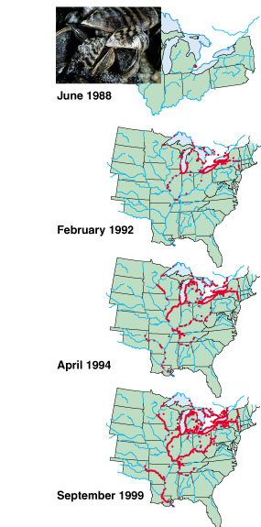
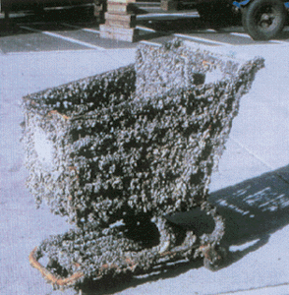
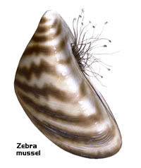
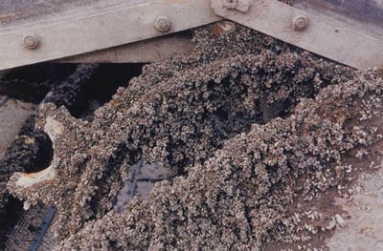
Zebra mussel
~2 months
reduces diversity
loss of food & nesting sites for animals
economic damage
ecological & economic damage

Slide 15
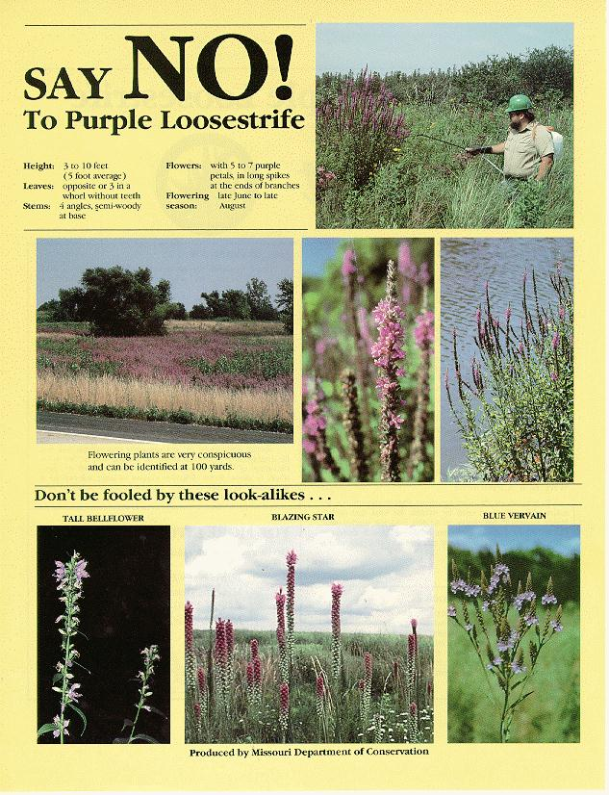
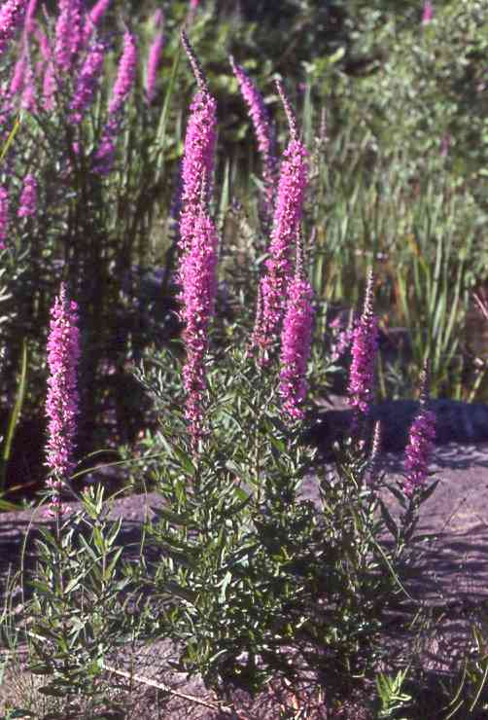
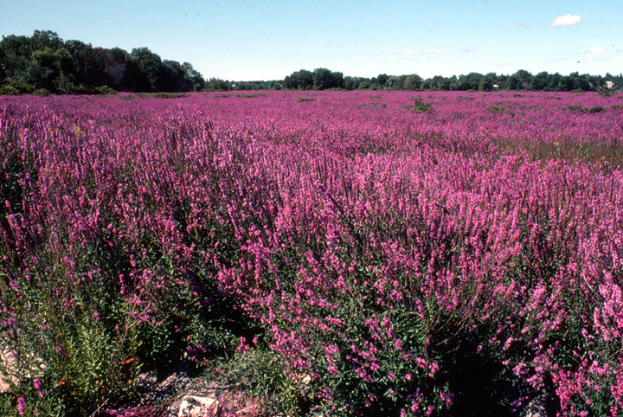
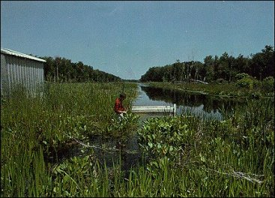
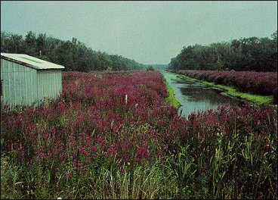
Purple loosestrife
1968
1978
reduces diversity
loss of food & nesting sites for animals

Slide 16
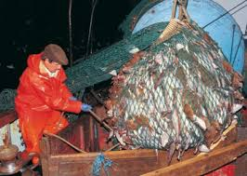
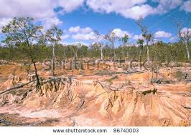
Overexploitation
Overexploitation is human harvesting of wild plants or animals at rates exceeding the ability of populations of those species to rebound
Overexploitation by the fishing industry has greatly reduced populations of some game fish, such as bluefin tuna

Slide 17
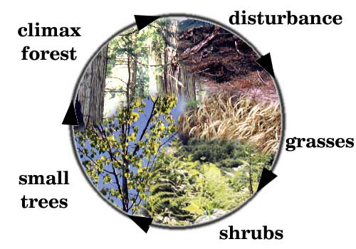
Ecological Succession
What is ecological succession?
Natural, gradual changes in the types of species that live in an area: One community replaces another over time.
Two types of ecological succession:
Primary
Secondary
Notes:
Succession occurs in response to a natural or human disturbances in the ecosystem.
climate change
geological changes
Lava flow: forms new bare rock
Landslide: exposes new rock
fire: either man made or natural
extinction of a dominate plant or wildlife

Slide 18
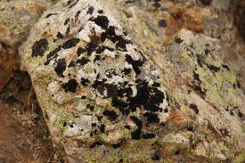
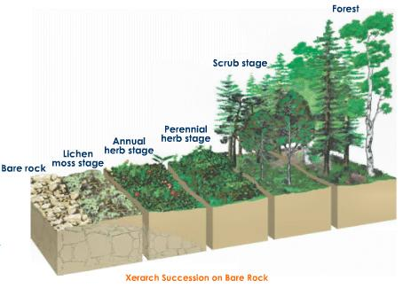
Primary Succession
Longest type of succession.
Begins in a place without any soil
Volcanic rock/ash after lava flow
Bare rocks after glacier recedes
Pioneer species (first organisms to live there): living things such as lichens that do not need soil to survive
lichens and the forces of weather and erosion help break down rocks into smaller pieces
Notes:
Volcanic rock/ash after lava flow
Bare rocks after glacier recedes
Lichens die, adding small amounts of organic matter to the broken down rock to make soil
Simple plants like mosses and ferns can grow in the new soil
The simple plants die, the soil layer thickens, and grasses, wildflowers, and other plants take over
These plants die, and add more nutrients to the soil, shrubs and trees take over
Insects, small birds, and mammals begin to move in

Slide 19
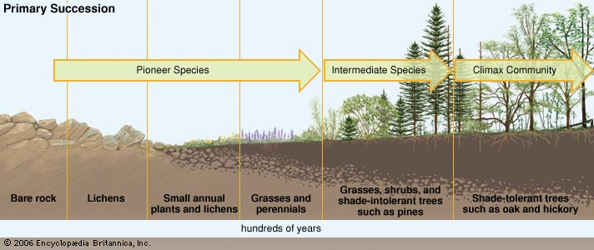
Primary Succession
Notes:
Primary succession occurs on newly exposed surfaces, such as this newly deposited volcanic rock and ash.

Slide 20
Secondary Succession
Faster than primary succession
Begins in a place that already has soil
Example: after forest fires
Pioneer species: grasses, wild flowers, and seedling trees are first to populate the disturbed area
Primary and Secondary succession both eventually produce mature Climax Communities (stable mature communities that change very little)
Notes:
Seeds, plants, & animals might already be there, or in undisturbed areas nearby.

Slide 21
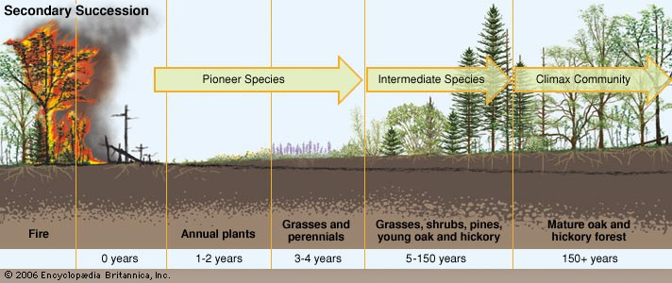
Secondary Succession

Slide 22
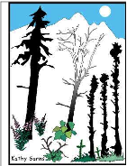
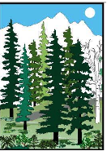
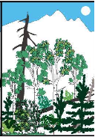
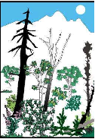
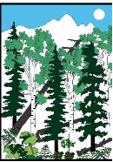
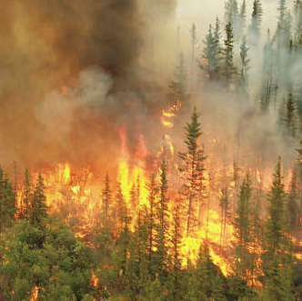
B
A
C
D
F
E
Notes:
Type? Secondary
How do you know?
Order? F B D C E A
How do you know the order?
Pioneer species? grasses

Slide 23
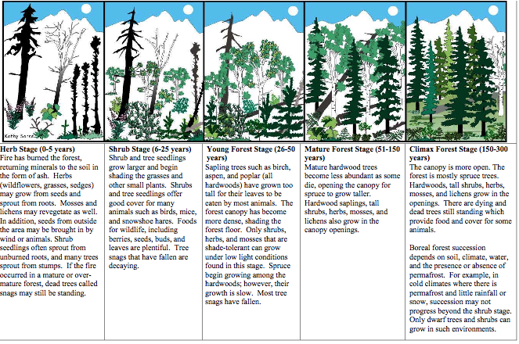
Secondary Succession

Slide 24
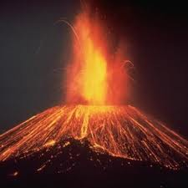
B
D
A
C
E
Notes:
Type? Primary
How do you know?
Order? D B E C A
How do you know the order?
Pioneer species? Lichen or some other organism that can create soil

Slide 25
Primary Succession
Notes:
In this example, a volcanic eruption has destroyed the previous ecosystem.
The first organisms to appear are lichens.
Mosses soon appear, and grasses take root in the thin layer of soil.
Eventually, tree seedlings and shrubs sprout among the plant community.

Slide 26
Primary vs. Secondary Succession
Complete the Venn diagram about succession using these terms:
Caused by events like forest fires
Caused by events like lava flow
Forms a climax community
Pioneer species are plants
Pioneer species create soil
Root systems may be left over
Root systems not left over
Starts with bare rock (no soil)
Starts with soil
Takes less time to form climax community
Takes a long time to form climax community
Type of succession
Primary
Secondary
both

