Slide 2
Introduction Activity:
At your lab station, you will find a real life case scenario and two envelopes
Read the case scenario FIRST
Then look at the contents of the envelope and make observations
Return to your desk and be ready to discuss

Slide 3
You may not think that fibers can be useful to a Forensic investigator; however, many cases have been solved through fiber analysis
Fiber: the smallest indivisible unit of a textile
Textile: a flexible, flat material made by interlacing yarns (threads)
Fibers often fall off and are picked up during normal activities. (Locard’s Principle)
Very small fibers easily shed from most textiles and can become trace evidence.
Fiber evaluation can show such things as the type of fiber, its color, the possibility of violence, location of suspects, and point of origin.

Slide 4
The Transfer of Fibers:
Direct transfer: fibers are transferred directly from victim to suspect or suspect to victim
Ex. A jacket fiber from a suspect is transferred to the body of a victim
Secondary Transfer: fibers are transferred from a source, to the suspect and then to a victim (or from a source, to a victim and then to the suspect)
Ex. Carpet fibers from suspects’ house is transferred to the suspect who then transfers those fibers to the victim’s clothing

Slide 5
Collecting Fibers:
Fibers can be collected by:
Vacuuming
Adhesive removal
Forceps

Slide 6
Classifying Fibers:
Natural: derived from animals, plants and minerals
Synthetic: man-made fibers produced in a laboratory. The fibers are produced by joining many monomers together to form polymers

Slide 7
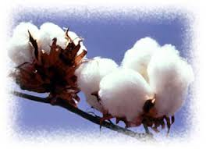
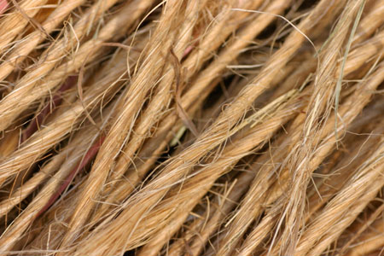
Plant Fibers
can absorb water.
are insoluble in water.
are very resistant to damage from harsh chemicals.
can only be dissolved by strong acids.
can be common at crime scenes because they become brittle over time.
Examples:
Cotton
Coir
Hemp

Slide 8
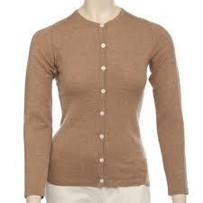
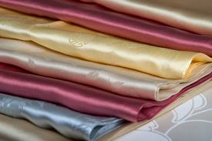
Animal Fibers
Wool from sheep
Cashmere
Angora from rabbits
Shimmering silk from caterpillar cocoons
wool
silk
cashmere

Slide 9
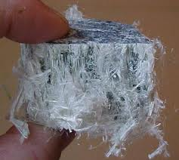
Mineral Fibers
Fiberglass is a fibrous form of glass.
Asbestos is a naturally occurring mineral with a crystalline structure.

Slide 10
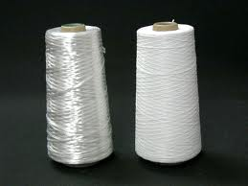
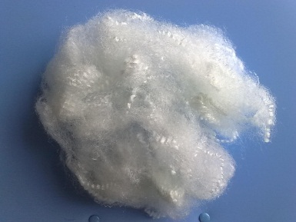
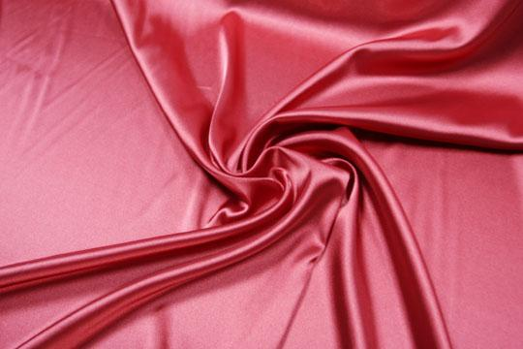
Synthetic Fibers
Polyester—found in “polar fleece,” wrinkle-resistant, and not easily broken down by light or concentrated acid; added to natural fibers for strength.
Nylon—easily broken down by light and concentrated acid; otherwise similar to polyester.
Acrylic—inexpensive, tends to “ball” easily, and used as an artificial wool or fur.
Acetate-silky luxurious appearance. It dries easily and resists absorbing moisture.
Rayon/Viscose- semi-synthetic with a high luster and bright sheen
nylon
rayon
polyester
Acetate

Slide 11
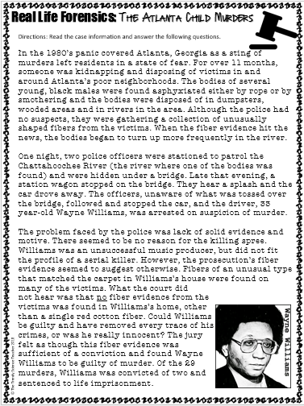
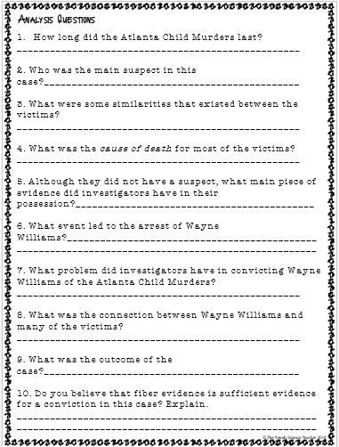
Today, we will learn about a case that was solved via fiber analysis.
Assignment: Complete the “Real Life Forensics: Atlanta Child Murders” worksheet.

Slide 12
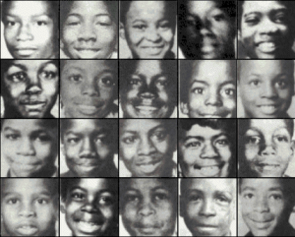
Case Study Video Analysis: The Atlanta Child Murders
Video Link: https://www.youtube.com/watch?v=M9k4G6YbB3s

