Slide 2
Review:
We have learned about different types of fibers
Today, we will learn how investigators use fibers to solve crimes

Slide 3
Review:
Fiber evidence is gathered with special vacuums, adhesives and forceps
It is important to be very accurate in recording the location of fiber evidence
The first task in fiber analysis is to identify the fiber and its characteristics
Next, the investigator attempts to match fibers to a suspect/source (ex. Home, car, clothing)

Slide 4
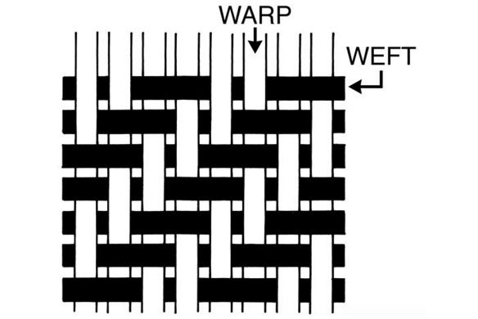
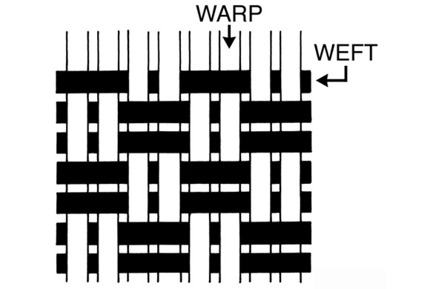
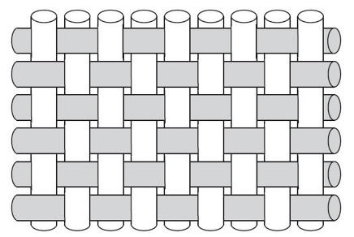
Review:
Textiles can be characterized by weave pattern
Here are a few common weave patterns
A thread count can help to identify fibers
Horizontal: the number of threads running side to side
Vertical: the number of threads running up and down.
TWILL
BASKET WEAVE
PLAIN

Slide 5
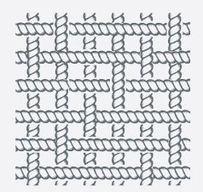
Horizontal Thread Count: ?
Vertical Thread Count:?

Slide 6
Horizontal Thread Count: 6
Vertical Thread Count:6

Slide 7
Horizontal Thread Count: ?
Vertical Thread Count:?

Slide 8
Horizontal Thread Count: 8
Vertical Thread Count:8

Slide 9
Sampling and Testing Fibers:
If there isn’t a sufficient amount of fiber evidence, investigators will use one of two methods that can analyze fibers without damaging them
Polarizing light microscopy
Infrared spectroscopy

Slide 10
Sampling and Testing Fibers:
If there is a sufficient amount of fiber evidence, investigators can subject fibers to a destructive test called a fiber burn analysis.
Unknown fibers are burned and the burning characteristics are compared to a dichotomous key to identify the fibers.

Slide 11
Synthetic Fibers (burn analysis characteristics)
Tend to melt
Solidify when cooled
Give off a “chemical” odor

Slide 12
Natural Fibers (burn analysis characteristics)
Shrinks away from a flame
Burns to ash (brittle)
Smells like singed hair

Slide 13
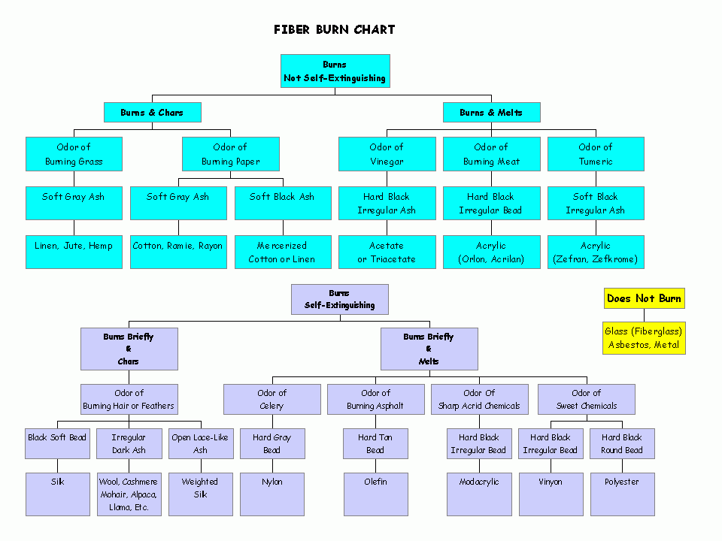
Chart extracted from: DitzyPrints.com

Slide 14
Today, you will conduct a FIBER BURN ANALYSIS to identify unknown fibers
Then, you will use your data to compare and match fiber evidence found at a crime scene to the known fibers that you burned.

Slide 15
FIBER BURN ANALYSIS LAB
Essential Question: Can you identify types of fibers based on a forensic test called a “burn analysis?”
Background: A burn test can be used to identify unknown fibers found at the scene of a crime.
Once the identity of a fiber is known, it can be linked to a specific location or source.

Slide 16
Video Link: http://www.youtube.com/watch?v=4rvC7E4iaUY
This video will explain the procedures for the lab

Slide 17
Lab Safety:
Open flame: use fire/heat safety
Goggles must be worn when working with fire.
Be sure NOT to be careless! Pay attention at all times.

Slide 18
Procedures:
Follow the instructions on the lab sheet provided to you. Be sure to use the same techniques that were outlined in the video.
Record your observations
Use the Burn Chart (dichotomous key) provided to identify the fibers
Have your teacher check your work before moving on to Step 2 of the lab investigation.

