Slide 1
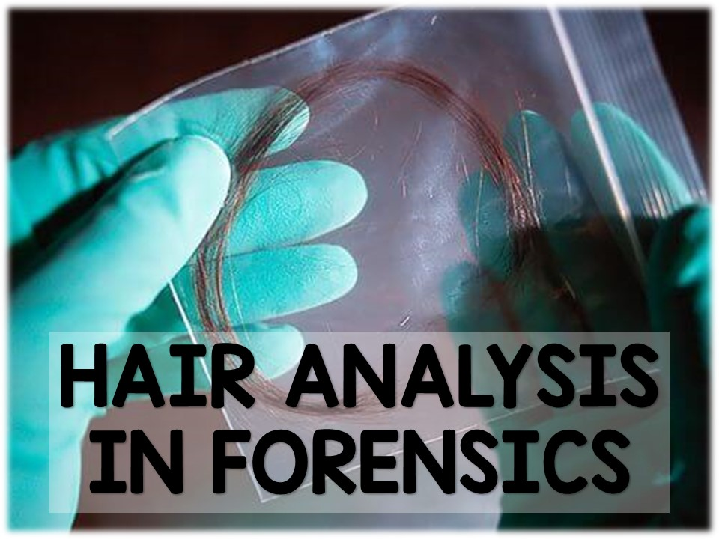

Slide 2
Fun Fact:
The average person loses 40-125 hairs per day

Slide 3
Introduction:
Hair’s main function is to:
  Regulate temperature
  Act as a sensory organ
  Protects
Careful analysis of hair can provide important clues in an investigation.
Hair can be considered class evidence or individual evidence, depending on how the hair was found.
If the hair follicle is attached, DNA analysis can be performed(individual evidence)
Without the follicle, the hair is considered class evidence.

Slide 4
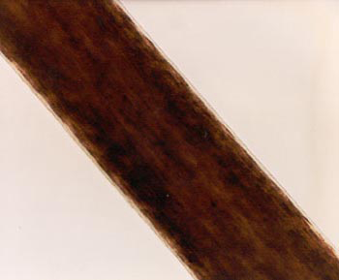
Introduction:
Cases cannot be solved solely on the basis of hair analysis, unless DNA analysis can be performed.
Hair can be collected from a crime scene by plucking, shaking, scrapping surfaces.
If hair is collected as class evidence (no hair follicle), forensic scientists can make observations about the macroscopic and microscopic features of the hair.
Based on these observations, the hair may be narrowed down to a CLASS of suspects.
Ex. This hair belongs to an Asian female.

Slide 5
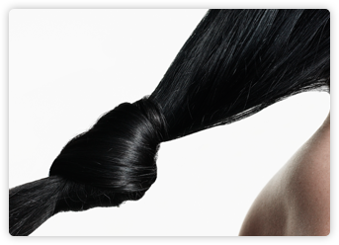
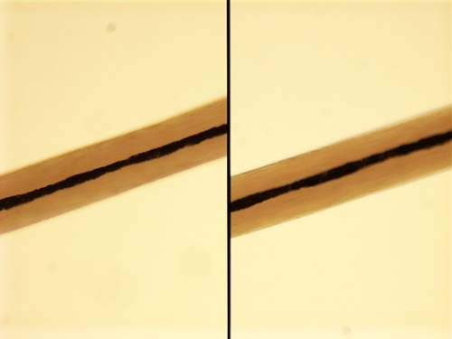
Introduction:
Hair can be observed in two ways.
Macroscopic:
  Length
  Color
  Curliness
Microscopic:
  Pattern of the medulla
  Pigmentation of the cortex
  Types of scales on the cuticle.
The best microscope to view hair is a comparison microscope that can allow a scientist to view two hair samples at the same time.

Slide 6
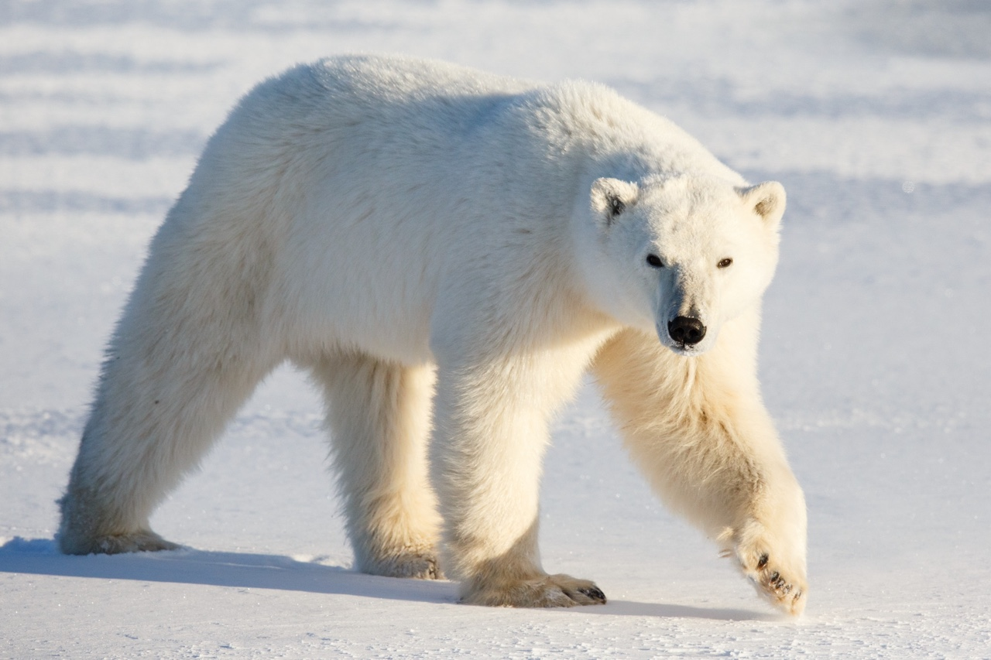
Function of Hair:
Regulates temperature
Protects skin
Acts as a sensory organ

Slide 7
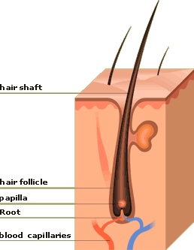
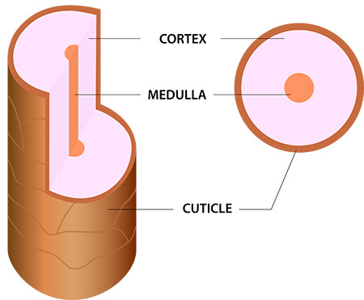
Structure of Hair:
All hair has the same basic structure.
2 parts:
  Follicle
  Shaft
3 layers:
      Cuticle (outer layer)
      Cortex (middle layer)
      Medulla (inner core of shaft)

Slide 8
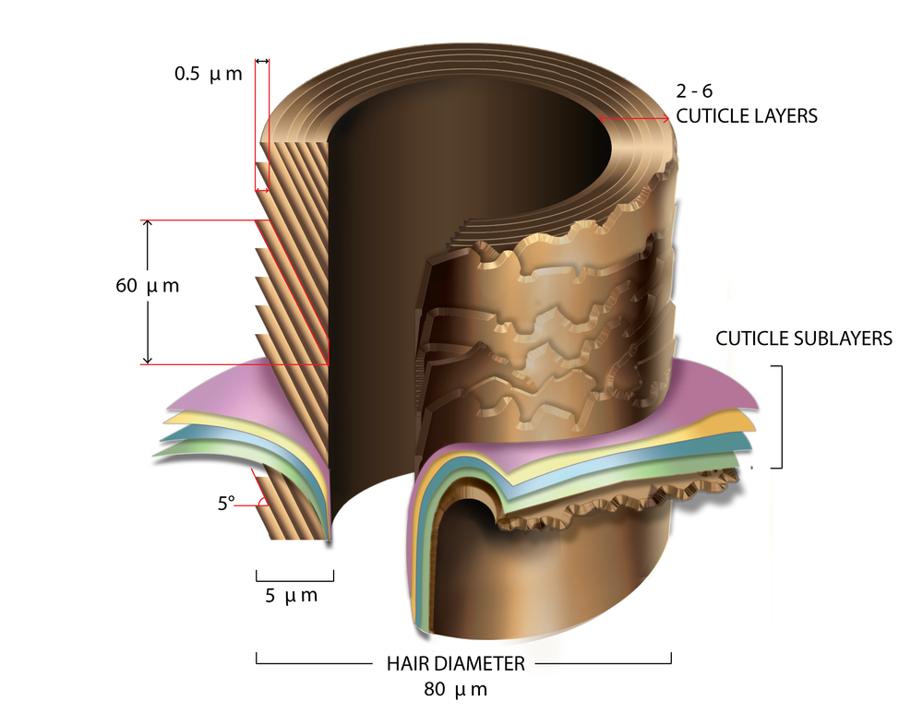
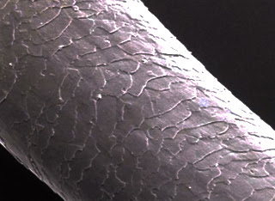
The Cuticle:
A transparent outer layer of the hair shaft.
Made of scales that overlap
Function: to protect the inner layer of the shaft.
The scales move from the scalp to the end of the shaft.
Why would this information be important?
Answer: when examining a section of hair, the part of the shaft closest to the scalp is the youngest part of the hair. This end can be used to test for the presence of toxins, drugs, or metals in the body (with a specific time period)

Slide 9
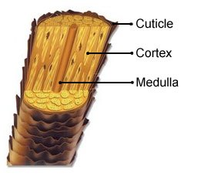
The Cortex:
Middle part of the shaft
Makes up the largest part (what you will most likely see under our microscopes)
Contains most of the pigment (melanin) that give hair its color.

Slide 10
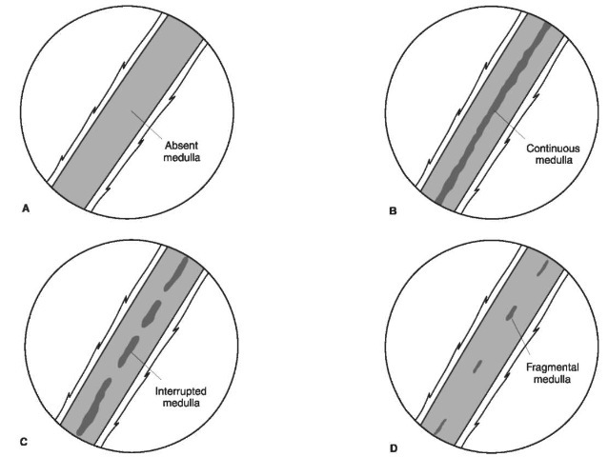
The Medulla:
The center of the hair shaft
Difficult to see with a cheap microscope
4 different classifications of the medulla:

Slide 11
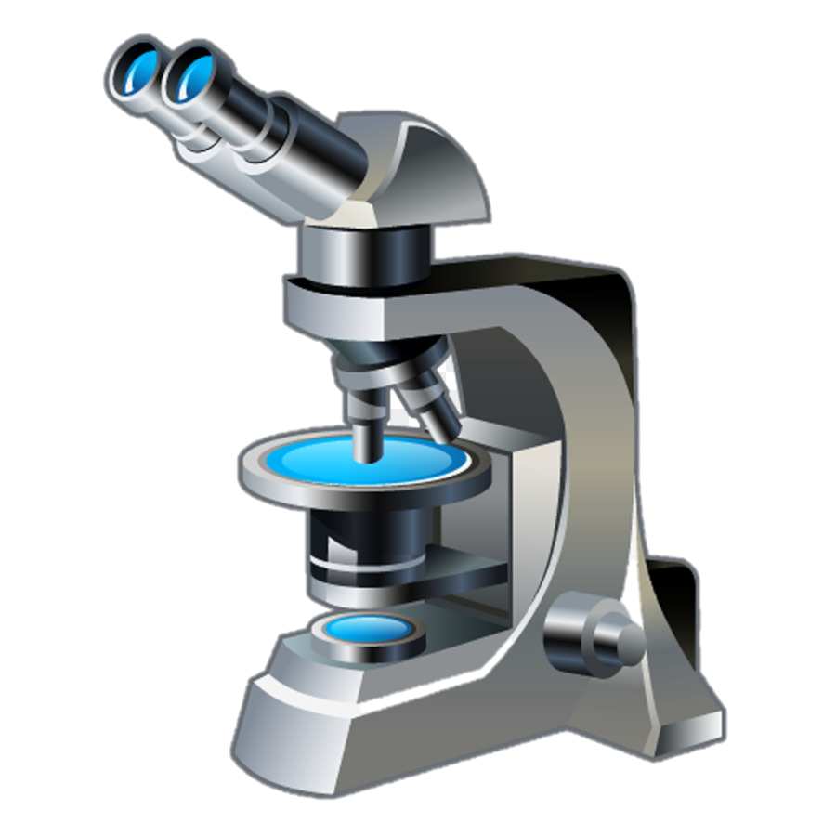
Lab Investigation
Essential Question:
What are some characteristics of the hair’s cuticle?
Task:
You will observe a sample of your own hair under the microscope to observe the cuticle of the hair.
Be sure to sketch your observations on your notes sheet.

Slide 12
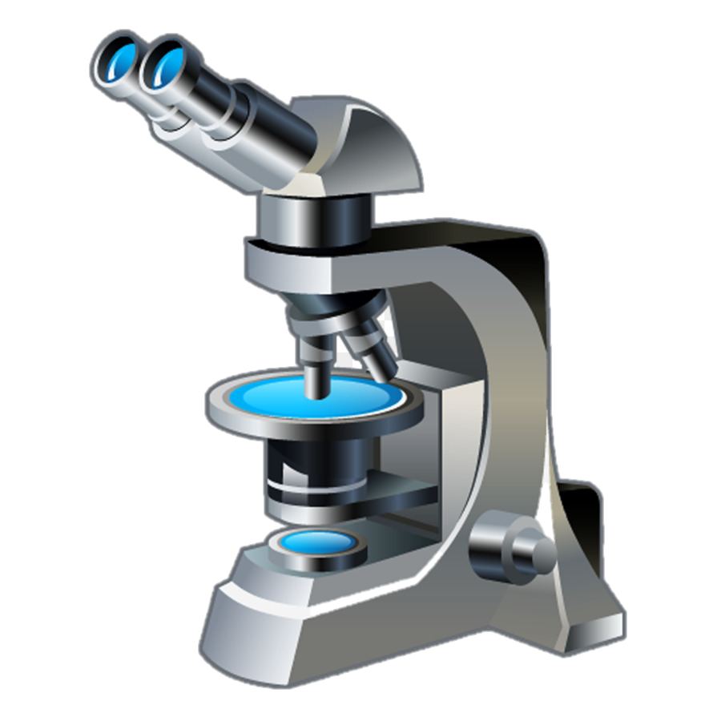
Things to Know:
Carry the microscope by arm and base
Always begin by viewing the specimen on the low powered objective.
Once focused, then switch to the medium objective (use only the fine adjustment knob to fine-tune)
Switch to the high powered objective (use only the fine adjustment know to fine-tune)
Be patient! There is only one of ME!!! ☺
Observations will be made in your forensics notebook.
Make sure microscope stage is lowered and low objective is in place before storing the microscope.

