Slide 1
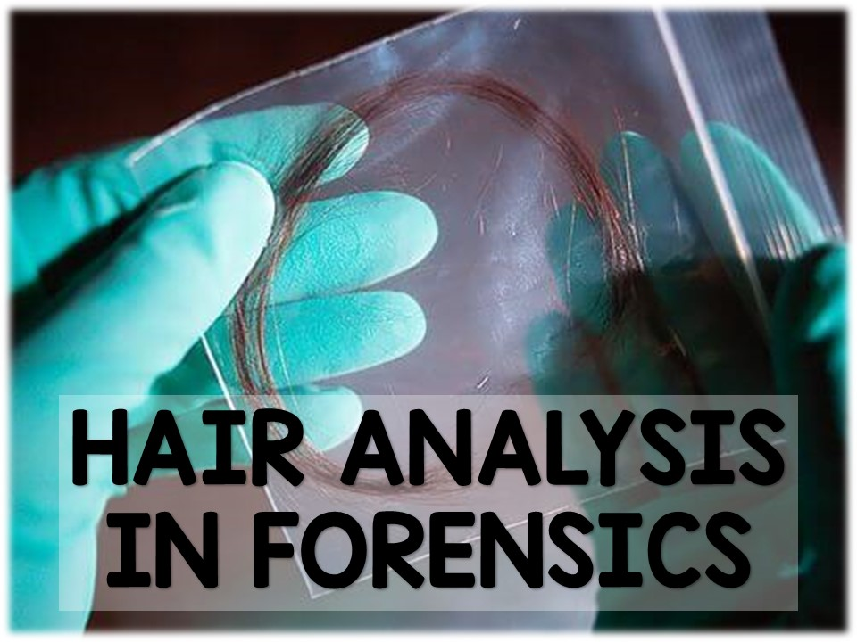

Slide 2
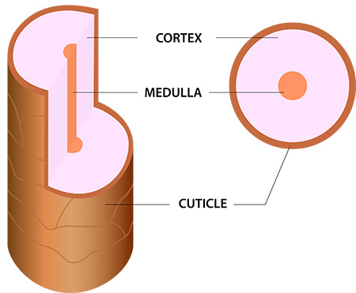
Recap:
Hair can be considered both class and individual evidence depending on if the follicle is present.
The follicle is the part of the hair that contains DNA.
The other part of the hair is called the shaft and is composed of 3 layers:
    Cuticle
    Cortex
    Medulla

Slide 3
Recap:
Macroscopic properties of hair include characteristics that can be seen with the naked eye. What are some macroscopic properties?
Microscopic properties of hair include characteristics that must be seen with the aid of a microscope. What are some microscopic properties of hair?

Slide 4
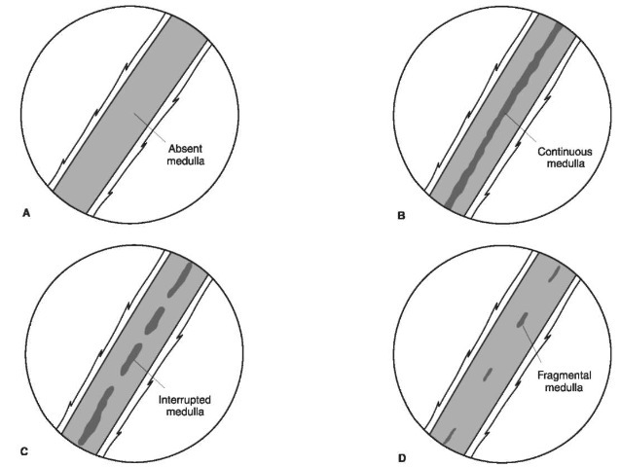
Recap:
There are 4 possible medulla patterns:

Slide 5
Introduction:
Today, we will be discussing other properties of hair as well as how the medulla can be used to match suspect hair samples to evidence hair samples.

Slide 6

Hair Regions:
Human hairs can vary from region to region on the body of the same person.
Hairs originate from:
  Head
  Eyebrow/lash
  Beard
  Pubic area
  Body
  Underarm

Slide 7
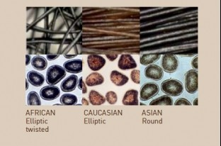
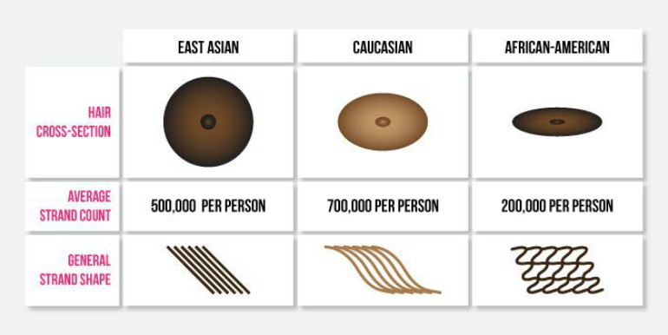
Hair Differences:
Hairs can vary from one source to another.
For example, different ethnic groups have unique characteristics in the properties of their hair.
Hair examiners have identified some key physical characteristics that are associated with hair of different ancestral groups: European, Asian, and African.

Slide 8
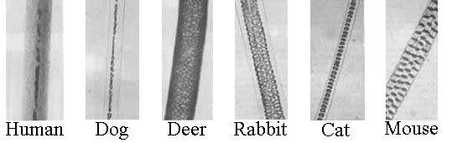
Hair Differences:
Animal hair and human hair have several differences as well.
  Pigmentation
  Medullary index (we’ll discuss this at the end of the lesson)
  Cuticle type

Slide 9
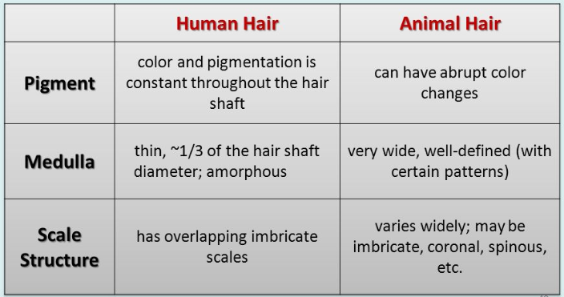
Hair Differences:

Slide 10
Medullary Index:
The ratio of the diameter of the medulla to the diameter of the entire hair is known as the medullary index.
If the medullary index is 0.5 or greater, the hair most likely is animal hair
If the medullary index is 0.33 or less, the hair most likely is human hair
MI= Width of Medulla
Diameter of Hair

Slide 11
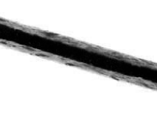
Practice:
Suppose this sample of hair has a diameter of 110 microns and has a medulla that measures 58 microns.
What is the medullary index of hair?
Is it human or animal?
MI= Width of Medulla
Diameter of Hair
MI= 58
110
MI= 0.53
Animal
Hair

Slide 12
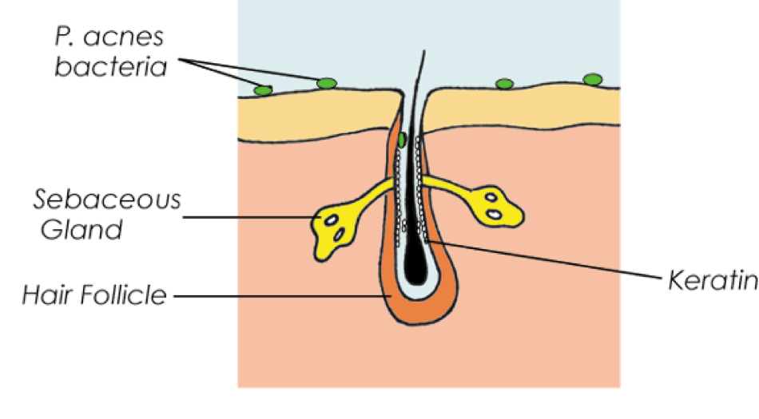
Structure of Hair:
Hair is incredibly strong, thanks to the protein that comprises it (keratin)
Keratin is a chain of amino acids that forms a spiral or helix.
Keratin helices are connected by strong bonds between the amino acids.
These bonds also make hair resistant to decomposition, which is extremely useful to forensic investigators.

Slide 13
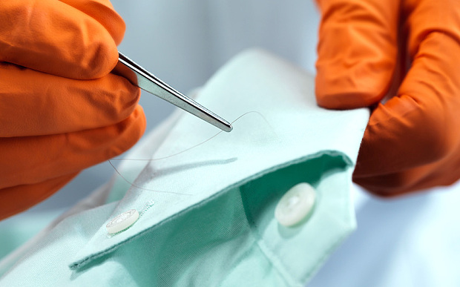
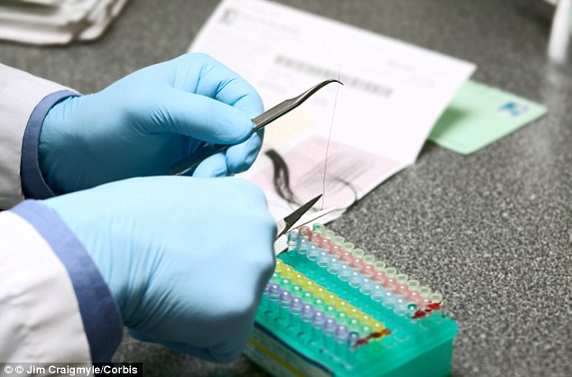
Hair Analysis in Forensics:
Forensic lab analysts use a variety of methods for analyzing hair.
Hair is collected by plucking, shaking and scraping surfaces.
Adhesives are also used to collect hairs from victims or objects.
The hair can then be analyzed using microscopy (microscope) or chemical testing.

Slide 14
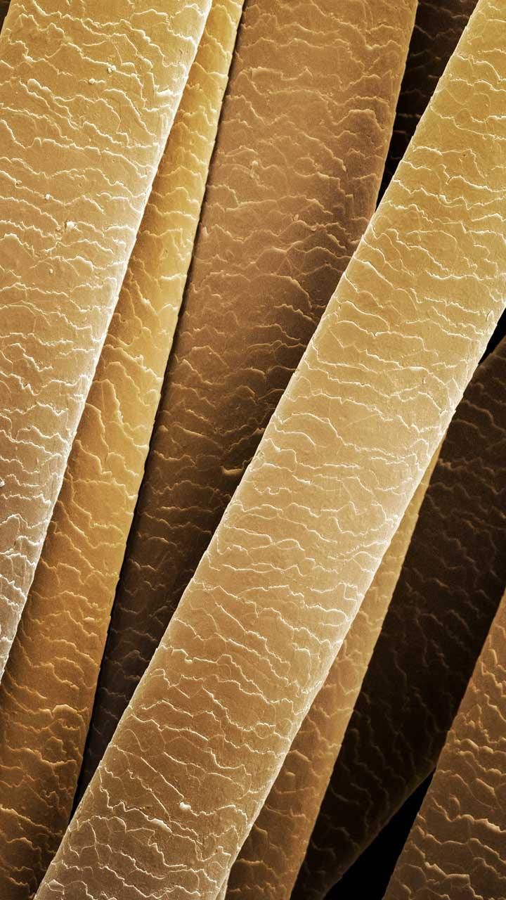
Hair Analysis in Forensics:
When using microscopy, investigators use a comparison microscope to make comparisons between the medullary index of a suspect hair and evidence hair.
Electron microscopes provide remarkably detailed views of a hair sample by magnifying up to 50,000 times.

Slide 15
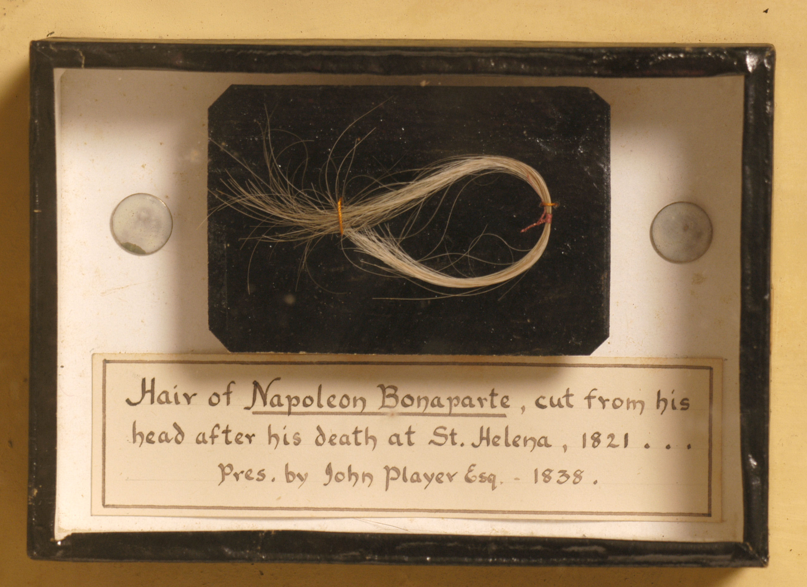

Hair Analysis in Forensics:
Anything ingested or absorbed through your skin becomes part of your hair.
This has proven to be beneficial for forensic investigators.
Since hair does not readily decompose, tests can help establish a timeline of a suspect’s or victim’s exposure to toxins or drugs.
  Ex. Napoleon Bonaparte

Slide 16
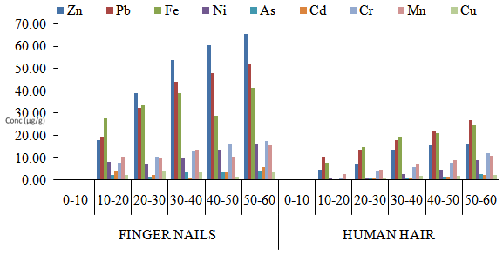
Hair Analysis in Forensics:
A test called Neutron Activation Analysis can be used to detect toxins/chemicals within the hair
This test can provide links between hair evidence and the circumstances surrounding the hair
NAA was the nuclear test that was performed on Napoleon Bonaparte’s hair

Slide 17
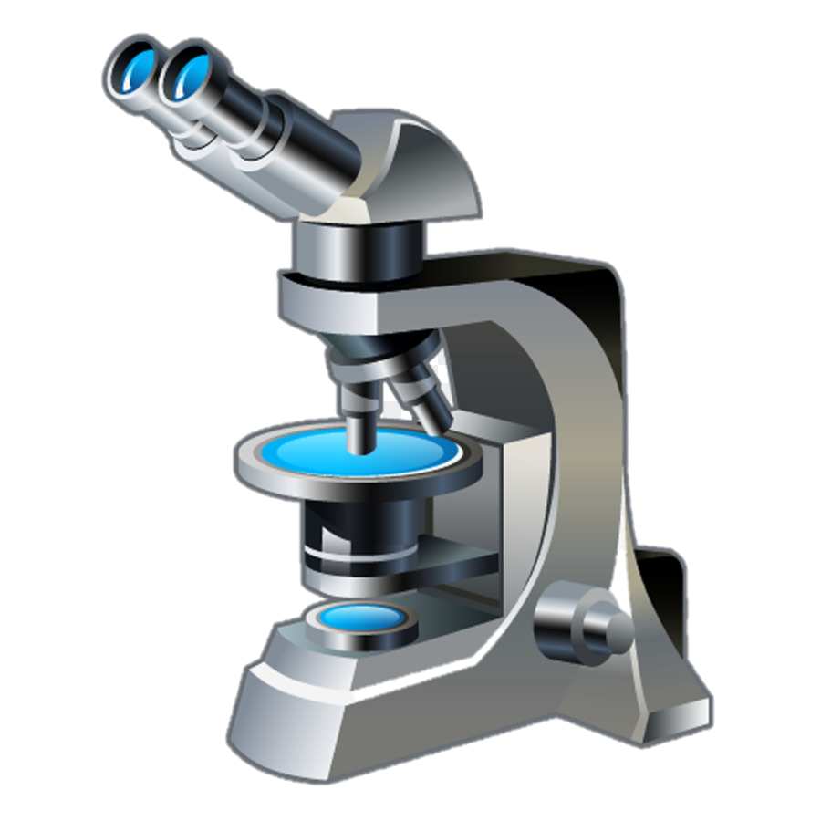
Review & Reinforcement
Complete the Hair Review Worksheet

