Slide 1

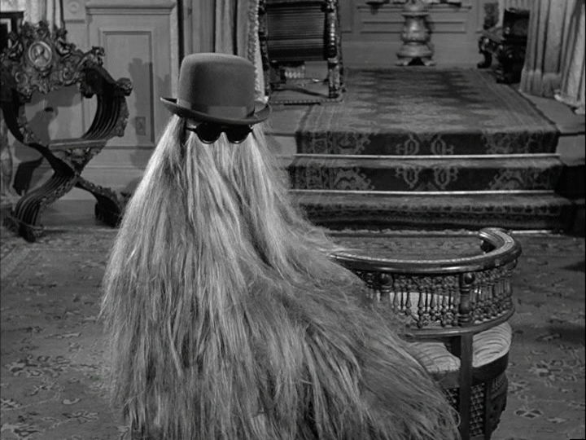
Trace Evidence: Hair

Slide 2
Hair
Hair is
A slender threadlike outgrowth from the follicles of the skin of mammals
Found all over our bodies
  Head
  Face
  Chest
  Limbs (arms and legs)
  Pubic region

Slide 3
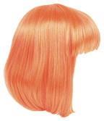
Structure (continued)
Major constituents
  Keratin is a protein that makes up most of the hair shaft.
  Melanin is a pigment that gives hair its color.
  Redheads have pheomelanin instead of melanin.

Slide 4
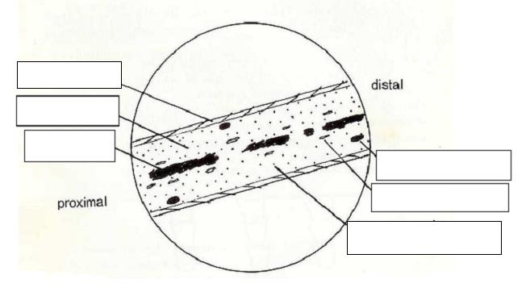
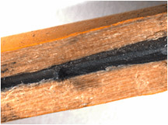
Structure (continued)
Cortex – the main body (wooden portion)
Medulla – the central cell of the cortex that is not always present in every hair (lead)
Cuticle – a layer of scales covering the hair shaft (yellow paint)
Pencil vs. Hair
Cuticle
Cortex
Medulla
Ovoid Body
Cortical Fusi
Pigment Granule

Slide 5
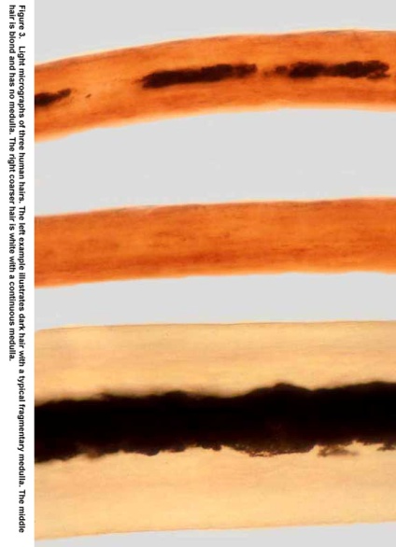
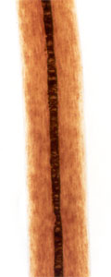
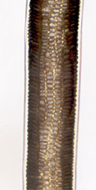
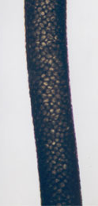
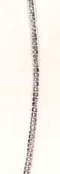
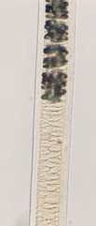
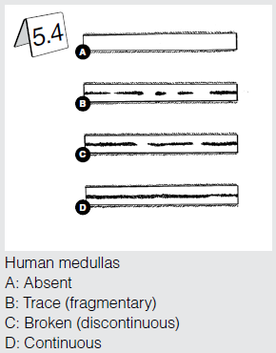
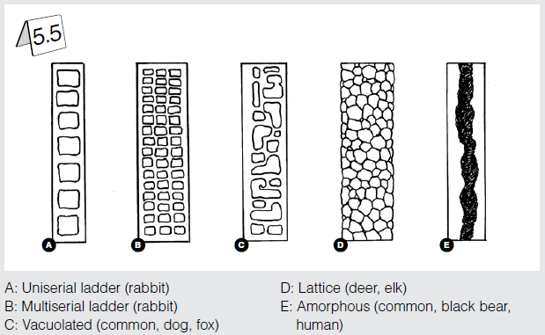
Medullar Variation

Slide 6
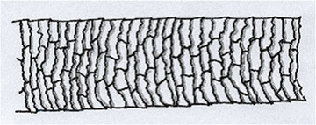
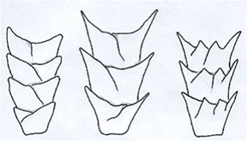
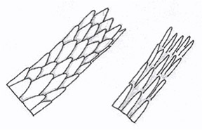
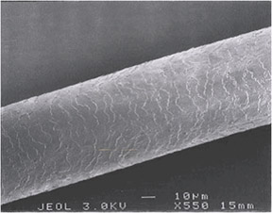
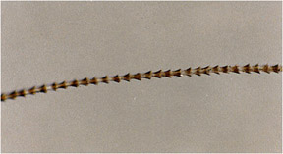
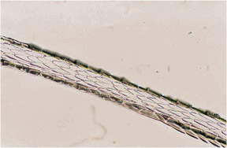
Scales
Imbricate Scales | Coronal Scales Diagram | Spinous Scales Diagram
Human Hair | Bat Hair | Mink hair

Slide 7
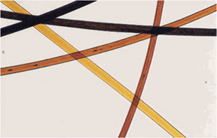
Characteristics
Pigment
  Colors – light, medium, dark; reddish-brown, brown, black, etc.
  Sizes – fine, moderate, large
  Density – light, moderate, heavy
  Distribution – random, peripheral, even, central, one-sided
Dyed Human Hair

Slide 8
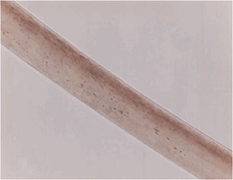
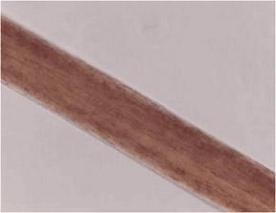
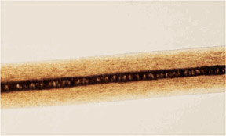
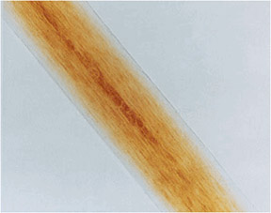
Characteristics (continued)
Various Pigment Distributions
Peripheral in
Human Hair
One-Sided
Random in
Animal Hair
Central in Red
Human Hair

Slide 9
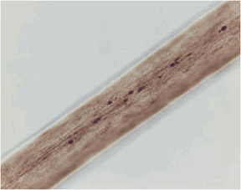
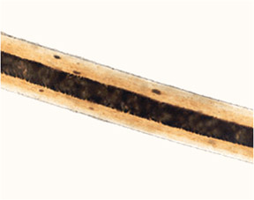
Characteristics (continued)
Ovoid bodies – spherical to oval solid structures found mostly in cattle and dog hairs, but present in some human hairs
Ovoid Bodies
in human hair
Ovoid Bodies
in dog hair

Slide 10
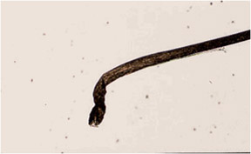
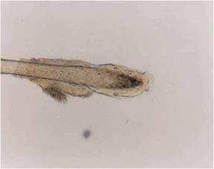
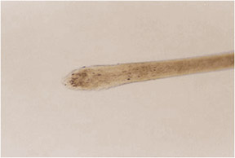
3 stages of growth determined by the root (proximal end)
Anagen root – an active growth stage, often found with a ribbon-like tip and a follicular tag (a soft tissue from the follicle)
Catagen root – the intermediate stage of growth
Telogen root – a resting stage, has a bulb-like shape. Often found with very little pigment and an abundance of cortical fusi.

Slide 11
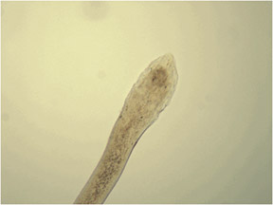
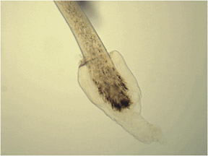
Roots (continued)
Hairs that are forcibly removed often end up with a follicular tag (a soft tissue from the follicle) attached to the roots.
The follicular material may be suitable for nuclear DNA analysis.
telogen root without
follicular tag
telogen root with
follicular tag

Slide 12
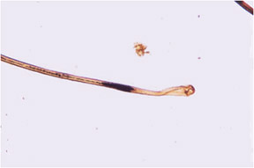
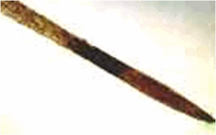
Roots (continued)
Postmortem Root Band (aka "Dead man's root”) a dark band that may appear near the root of the hair originating from a decomposing body

Slide 13
Differences Between Human & Animal Hair
Human pigment tends to be denser towards the cuticle. Animal hair tends to be in ovoid bodies closer to medulla.
The medulla is generally larger in animals (medullary index). >.5 is animal, <.33 is human.
Humans have imbricate cuticles, while animals have spinous or coronal cuticles.
Human
Animal

Slide 14
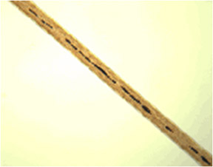
Racial Origin
Caucasian
  moderate diameter with very little variation
  light to moderate pigment density with fairly even distribution
  oval-shaped cross-section

Slide 15
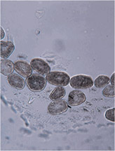
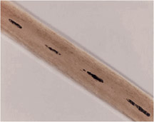
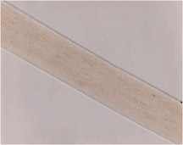
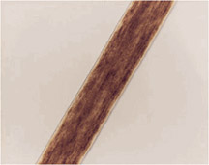
Racial Origin (continued)
Caucasian Head
Hair cross-section
Caucasian
Head hairs

Slide 16
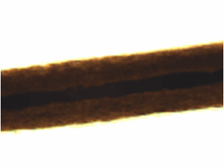
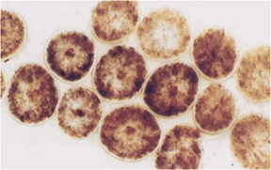
Racial Origin (continued)
Asian
  coarse shaft diameter
  streaky pigments with heavy density
  thick cuticle
  round cross-section

Slide 17
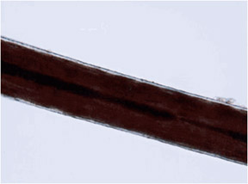
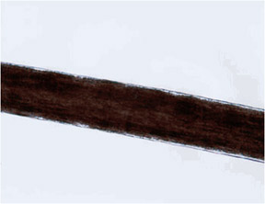
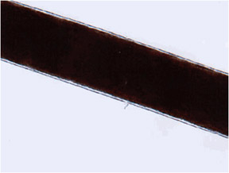
Racial Origin (continued)
Asian Head Hairs

Slide 18
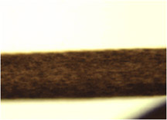
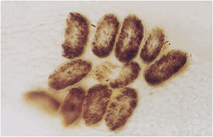
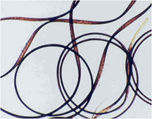
Racial Origin (continued)
African
  fine to moderate shaft diameter
  considerable variation throughout the hair shaft with prominent twists and curls
  heavy pigment density with aggregate pigment clumpings
  flat cross-section

Slide 19
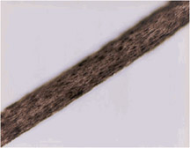
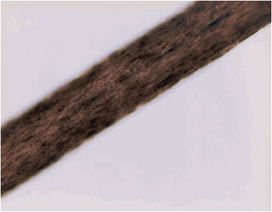
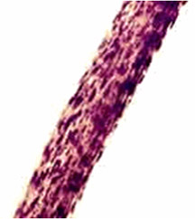
Racial Origin (continued)
African head hairs

Slide 20
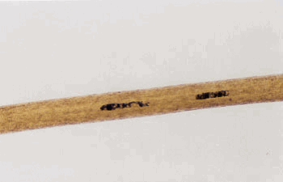
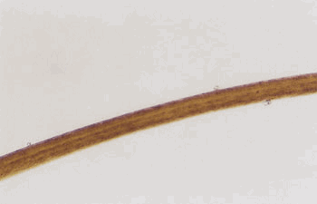



Variations
Why do we need to examine each hair sample from root to tip?
Five Regions of a single head hair

Slide 21


Variations (continued)
One person's
head hair
One person
of multiple race

Slide 22









Distal Ends
Scissor-cut
Abraded
Razor-cut
Rounded
Burnt hair
Broken

Slide 23

Somatic Origin
Hairs from different parts of the body exhibit different characteristics:
Head hairs
  Typically much longer than other hairs on the body
  Generally soft and most likely to have artificial treatment (bleaching, dyes)
Pubic hairs
  Typically coarse in diameter with wide variations
  Buckling is a special characteristic found in pubic hairs

Slide 24


Somatic Origin (continued)
Limb hairs (arm or leg)
  Fine diameter with little variation
  Arc-like, gross appearance
  Tips are usually tapered, often blunt and abraded, rounded scale ends due to wear
  Soft texture
Facial hairs (beard/mustache)
  Very coarse diameter with irregular or triangular cross-sections
  Very broad and continuous medulla
  Medulla may be double
  Stiff texture
Beard hair

Slide 25
Hair Comparisons (continued)
3 basic conclusions that can be reached in hair comparisons:
Similar microscopical characteristics – the questioned hairs could have originated from the source of the known hair standards
Dissimilar microscopical characteristics – the questioned hairs did not originate from the source represented by the known hair standards
Both similar and slightly different microscopical characteristics – inconclusive

Slide 26
Significance of Hair Evidence
The frequency of contact between a victim and a suspect, as well as the crime scene, is a big factor in interpreting the significance of hair evidence.
Examples
  The pubic hair of a recent ex-boyfriend found at the scene of a sexual assault
  A husband who is suspected of murdering his wife at home
  A missing child's hair in the backseat of a former nanny's car
  A missing child's hair in the backseat of a cleaning lady's car
  A stepfather's head hair found on a little girl's underwear
  A stepfather's pubic hair found in the crotch area of a little girl's underwear

Slide 27

Hair and DNA
  Recent major breakthroughs in DNA profiling have extended this technology to the individualization of human hair.
  The probability of detecting DNA in hair roots is more likely for hair being examined in its anagen or early growth phase as opposed to its catagen (middle) or telogen (final) phases.
FORENSIC SCIENCE: An Introduction by Richard Saferstein
27

Slide 28
Hair and DNA
  Often, when hair is forcibly removed a follicular tag, a translucent piece of tissue surrounding the hair’s shaft near the root may be present.
  This has proven to be a rich source of nuclear DNA associated with hair.
FORENSIC SCIENCE: An Introduction by Richard Saferstein
28

Slide 29
Hair and Mitochondrial DNA
  Mitochondrial DNA can be extracted from the hair shaft.
  Mitochondrial DNA is found in cellular material located outside of the nucleus and it is transmitted only from the mother to child.
  As a rule, all positive microscopic hair comparisons must be confirmed by DNA analysis.
FORENSIC SCIENCE: An Introduction by Richard Saferstein
29

