Slide 1
Introduction to graphs

Slide 2
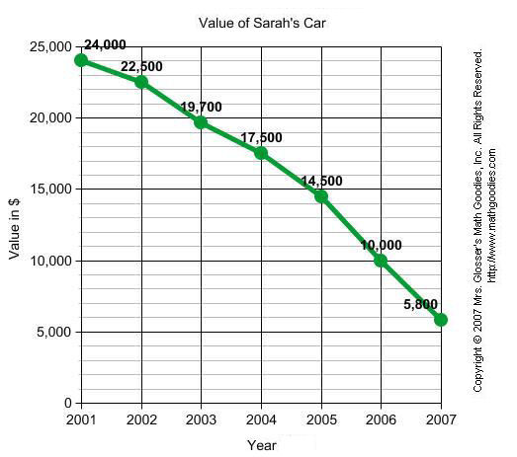
Graphs
What makes a good graph??
Title
Axes
Labeled
What is it
Units measured in
Numbers evenly spaced
Scale appropriate for data
Start with a reasonable number for data
Squiggly line
Key
Y axis
X axis

Slide 3
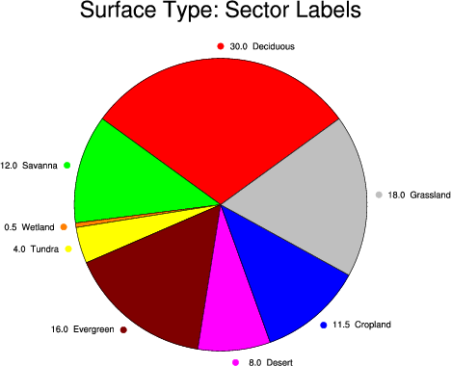
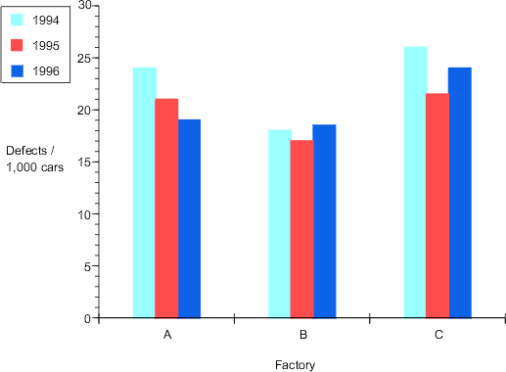
Types of graphs
Bar graph
Making comparisons for data at one point in time
Data includes ranges (scores)
Line graph
Making comparisons over time
Most commonly used
Pie graph
Making comparisons with percentages

Slide 4
Identify the variables
Independent/Manipulated Variable
Changed by the experimenter
What causes the outcome you are trying to observe
Goes on the X axis (horizontal)
Should be on the left side of a data table

Slide 5
Identify the variables
Dependent/Responding Variable
Changes in response to independent/manipulated variable
The outcome you are trying to observe
Goes on the Y axis (vertical)
Should be on the right side of a data table

Slide 6
Identify the variables
What effect does studying with music have on student test scores?
What is the independent/manipulated variable?
Which is the dependent/responding variable?

Slide 7
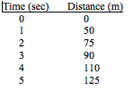
Determine the variable range
Subtract the lowest data value from the highest data value
Do each variable separately

Slide 8
Determine the scale of the graph
Scale = what each line on each axis is worth
Count the number of lines you want to use (could be all of the lines on your axis)
Divide the range by the number of lines you want to use
Round up
Write the rounded numbers for the lines on the axis
Figure out which number you want to start with
Around the lowest data point?
Squiggly line?
Do each axis separately

Slide 9
Determine the scale of the graph

Slide 10
Number and Label each axis
Independent/Manipulated on X axis
What is it
What units is it measured in
Use scale you calculated
(number the lines not the boxes)
Dependent/Responding on Y axis
What is it
What units is it measured in
Use scale you calculated
(number the lines not the boxes)

Slide 11
Plot the data points
Plot each data value on the graph with a dot.
Find the number for your independent variable on the X axis and the number for your dependent variable on your Y axis and put a dot where they meet.

Slide 12
Draw the graph
Connect all of the dots

Slide 13
Title the Graph
Your title should clearly tell what the graph is about
Independent Variable vs. Dependent Variable
If your graph has more than one set of data, provide a “key” to identify the different lines.

Slide 14
Ask yourself these questions after you made your graph . . .
Can you read the data easily?
Can you see patterns and trends?
Do you know what the graph is about?
Do you know what is being graphed on each axis?

Slide 15
Interpreting your graph
Look at the patterns/trends
Can you extrapolate the data
If the graph were to continue, what would the next point be?
Does the data support your hypothesis?
How?
Why?

Slide 19
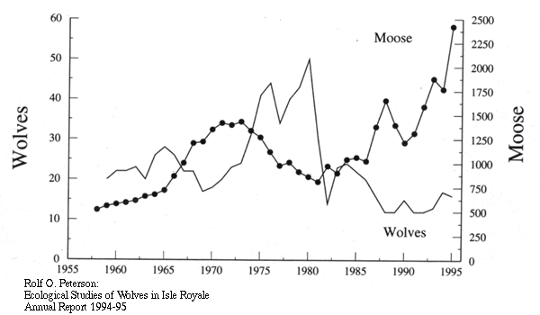

Slide 20
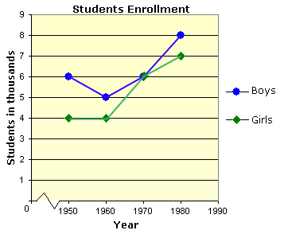

Slide 21
