Slide 1
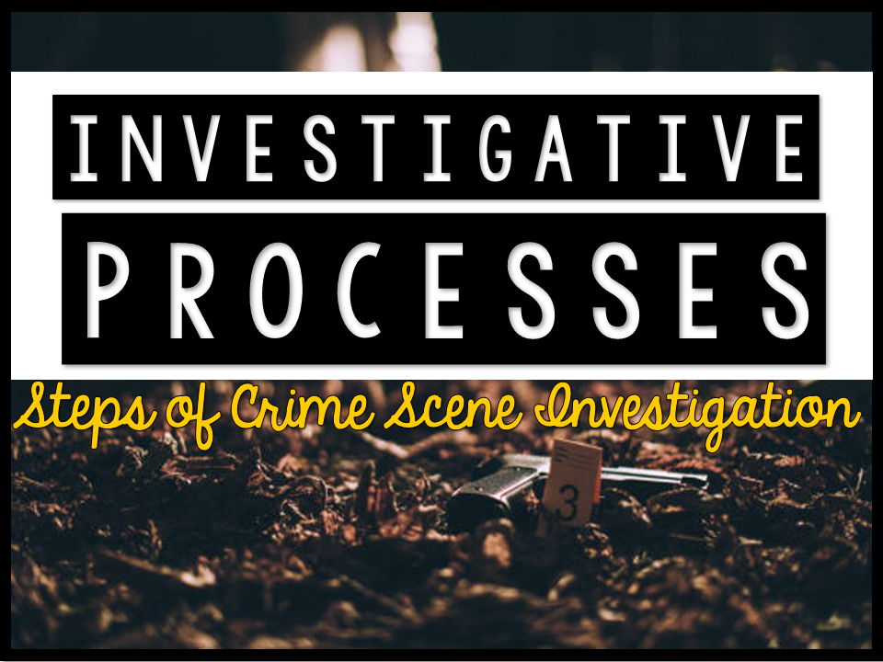

Slide 2
Just as a car needs fuel to run, criminal laboratories also need EVIDENCE to run.
Evidence can be what MAKES or BREAKS a criminal case
Evidence can be used to convict, exonerate or prove a defendant to be not guilty of an accused crime
Before evidence can be used, its presence must be recognized at the crime scene.
Forensic Science begins at the crime scene
If the investigator cannot recognize evidence or cannot properly preserve it for laboratory examination, it is of no use
With proper training, police agencies and investigators can ensure competent performance at crime scenes.

Slide 3
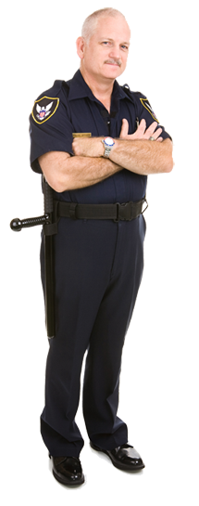
Who is at the crime scene?
Police and possibly a district attorney.
(DA may be present to issue warrants)
Crime scene investigators.
(document scene in detail and collect evidence)
Medical examiners.
(aka: coroners determine COD)
Detectives.
(look for leads/interview witnesses/talk to CSI)
Specialists.
(entomologists, psychologists, anthropologists, etc)

Slide 4
Investigators are trained to follow certain steps to ensure that evidence is found, secured and collected so that it maintains its integrity as it travels from the crime scene to the court room.
The chronological documentation or paper trail that records the sequence of custody, control, transfer, analysis, and disposition of physical or electronic evidence is known as the chain of custody.
So, what are the steps that crime scene investigators follow?
Securing the Scene
Separating Witnesses
Scanning the Scene
Seeing the Scene
Sketching the Scene
Searching the Scene
Securing and Collecting Evidence

Slide 5
Today, you will participate in a Jigsaw activity, where you will research one of the 7 steps of CSI
As you research, your goal is to become an “expert” on this topic.
You will then be placed in a group where you will teach the other members of the group about your step.
Group 1: Securing the Scene
Group 2: Separating Witnesses
Group 3: Scanning the Scene
Group 4: Seeing the Scene
Group 5: Sketching the Scene
Group 6: Searching the Scene
Group 7: Securing and Collecting Evidence

Slide 6
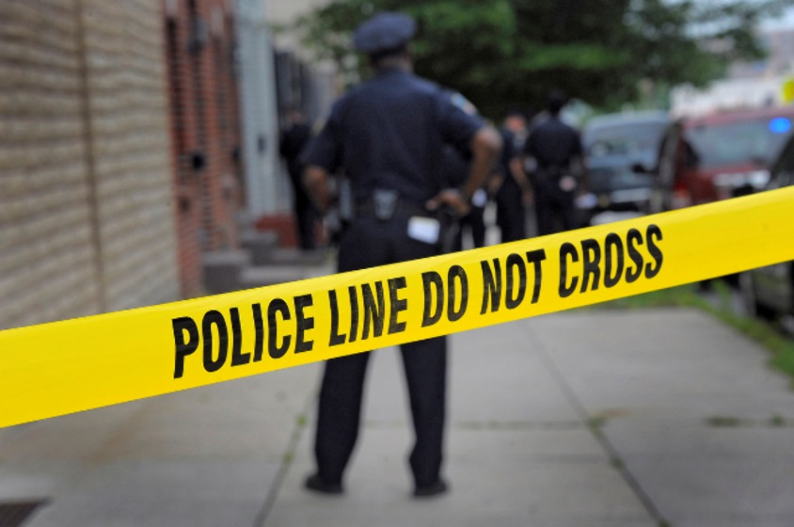
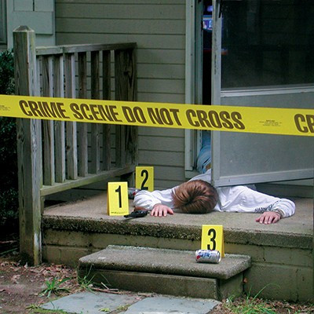
SECURING THE CRIME SCENE
The first officer arriving on the scene of a crime must preserve and protect the area as much as possible
However, first priority should be given to obtaining medical assistance for individuals in need AND to arresting the perpetrator
Once everyone is safe, extensive efforts must be made to exclude all unauthorized persons from the scene
Ropes or barricades along with strategic positioning of guards will prevent unauthorized access to the scene.

Slide 7
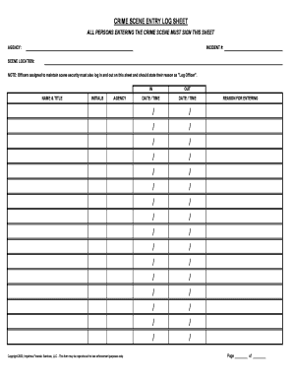
SECURING THE CRIME SCENE
Every individual who enters the scene must be documented (crime scene logs) as well as the time and date that they entered and exited the scene.

Slide 8
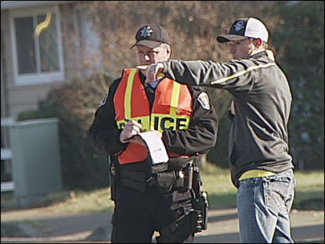
SEPARATING THE WITNESSES
Separating the witnesses is the next priority
Witnesses must not be allowed to talk to one another
Investigators will compare their accounts
Witnesses are separated to avoid working together as well as to avoid one witness to be influenced by another
The following are questions that are usually asked of the witnesses:
What did you see?
Where were you when you made this observation?
Did you see anyone else?
Do you have any information that may be helpful in our investigation?

Slide 9
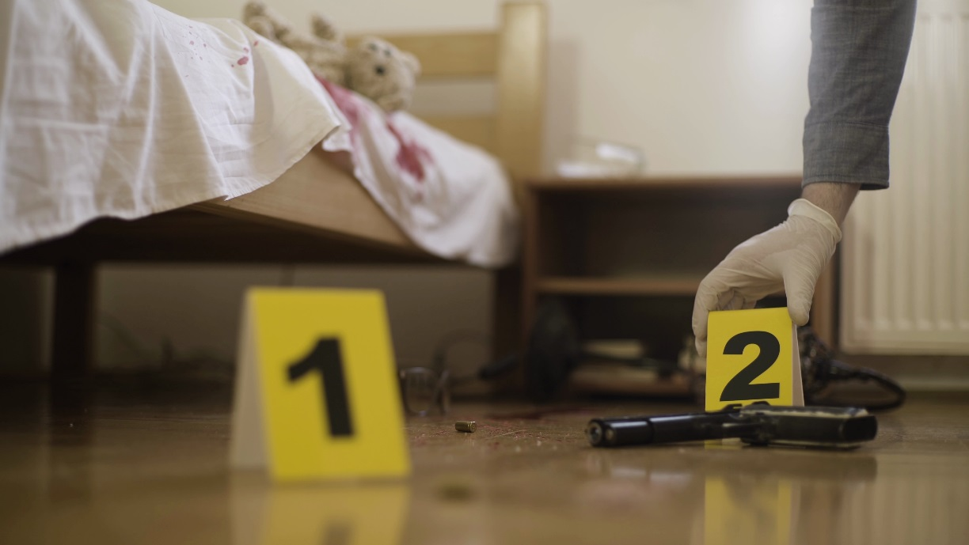
SCANNING THE CRIME SCENE
Next, investigators and first responding officers will do a quick scan of the scene and will mark evidence with evidence markers.
A more thorough search is done at a later time.
The purpose of this step is to allow records of the scene to be made quickly and efficiently.

Slide 10
SEEING THE CRIME SCENE
During this step, a trained forensic photographer photographs the evidence that has been marked.
Any time new evidence is marked, photographs will be made.
We will look at the procedures for taking photographs at a crime scene at a later date.

Slide 11
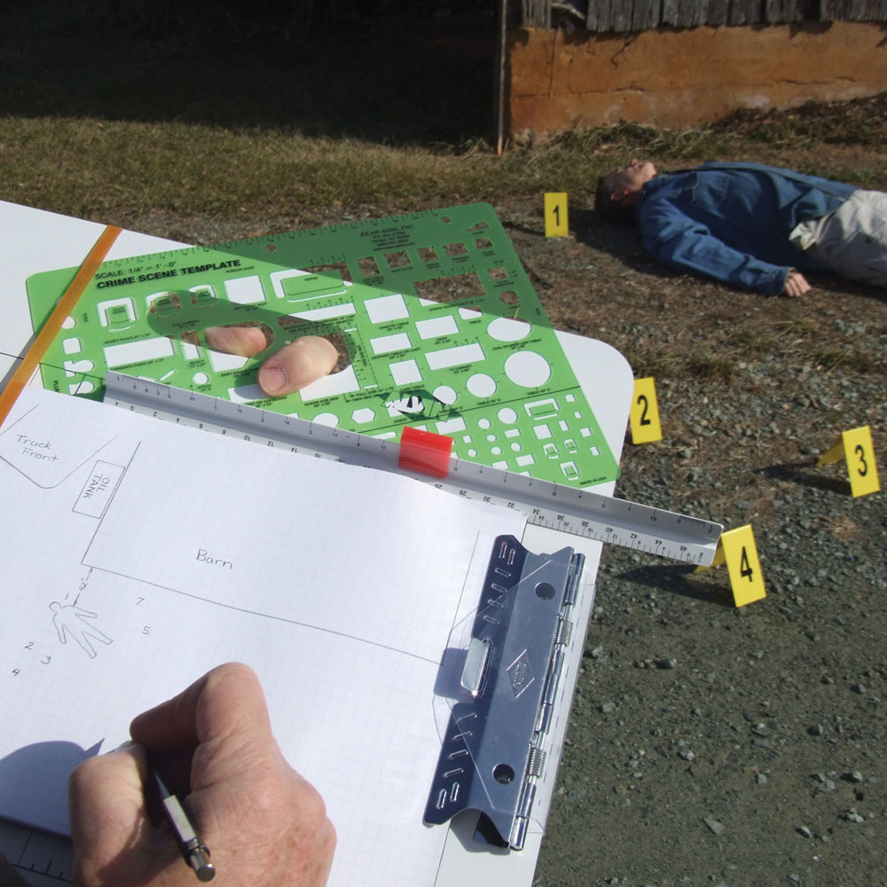
SKETCHING THE SCENE
Once photographs have been taken, the crime scene investigator will sketch the scene.
This is a rough sketch that depicts the dimensions of the scene and shows the location of all evidence
The sketch should match the photographs and evidence markers in the sketch should align with evidence markers in the photographs.
We will also look more deeply at crime scene sketches at a later time.

Slide 12
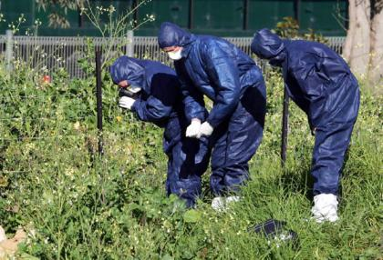
SEARCHING THE SCENE
During this step, investigators really focus on finding all evidence and a more detailed search is performed.
A search pattern is declared and investigators work together to ensure that no part of the crime scene has been left unsearched.
If new evidence is found, it is marked with evidence markers, photographed and documented in the sketch.
We will also look more deeply into search patterns at a later date.

Slide 13
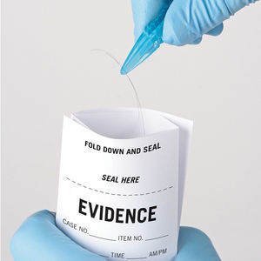
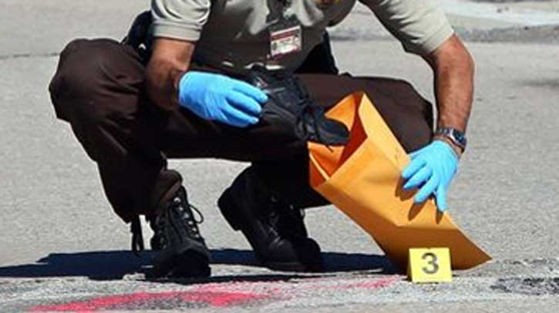
SECURING AND COLLECTING EVIDENCE
Physical evidence can be anything from massive objects to microscopic traces.
Each piece of evidence (no matter how big or small) must be preserved in its original state (as much as possible) and its integrity maintained.
Each item should be handled carefully and wrapped separately to avoid cross contamination.
The search for evidence is not limited to the crime scene (ex. Evidence can be found on the body during an autopsy)

Slide 14
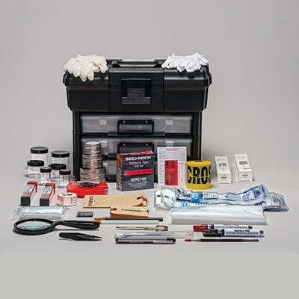
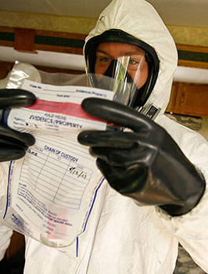
SECURING AND COLLECTING EVIDENCE
Investigators must handle and process evidence in a way that prevents any change from taking place from the crime scene to the crime lab.
The use of disposable gloves is vital during handling of evidence.
Evidence should remain unmoved until investigators have documented its location and appearance in notes, sketches and photographs.
Crime scene investigators have a large assortment of packaging materials and tools, ready to package a diverse array of evidence.

Slide 15
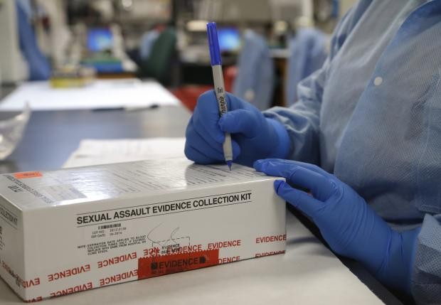
SECURING AND COLLECTING EVIDENCE
The chain of custody is the process of protecting evidence from the crime scene to the lab.
According to the chain of custody, evidence should be packaged in the following way:
Appropriate packaging should be used
Packaging should be sealed with evidence tape
The signature of the collecting officer should appear on the evidence tape.
The seal must never be broken
If evidence must be processed, the evidence must be removed without puncturing the signed evidence label
A chain of custody log must be filled out.
The signatures on the log must match the signatures on the evidence labels.

Slide 16
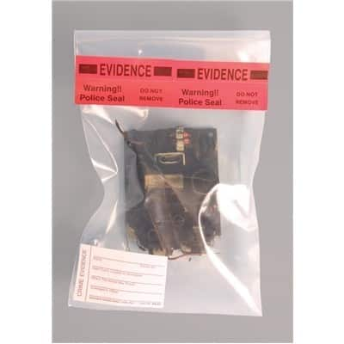
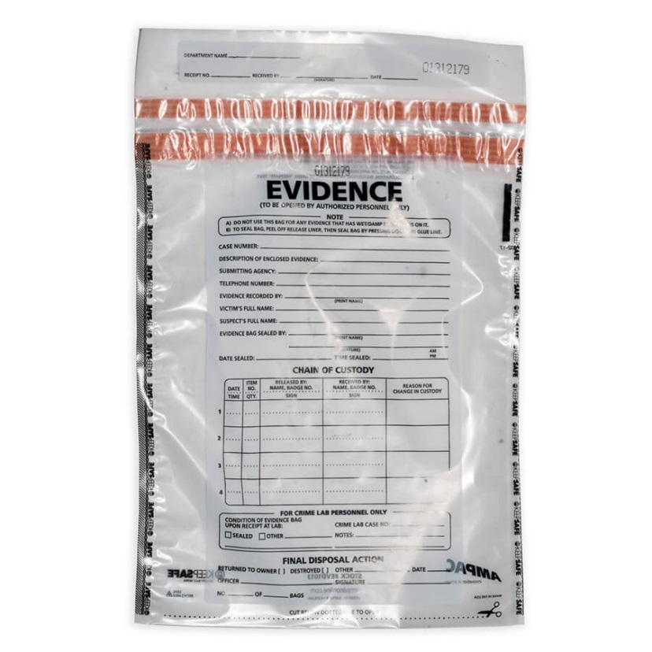
SECURING AND COLLECTING EVIDENCE
Evidence tape must be signed
Chain of Custody log must travel with evidence and
should reflect anyone that had contact with evidence

Slide 17
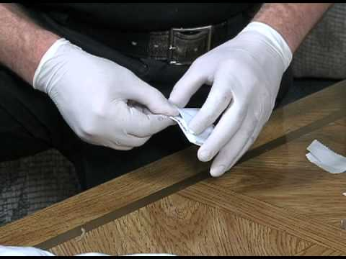
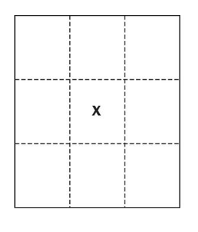
SECURING AND COLLECTING EVIDENCE
In the event that evidence is found that is REALLY tiny,
Investigators will use a bindle to secure the evidence.
Sometimes referred to as a druggist’s fold, a bindle ensures that evidence isn’t lost.

Slide 18
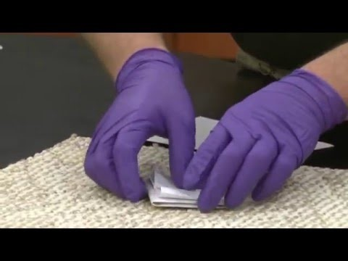
Packaging Evidence
Notes:
Bindle Explanation Video Clip: https://www.youtube.com/watch?v=cfWsgS0ID-s

Slide 19
NEXT STEPS
Once evidence is collected, it can be transferred to a crime lab for further analysis.
However, each person that handles the evidence must be included on the chain of custody log.
They must also place the evidence in a new package with a new evidence seal, so that the integrity of the evidence is maintained.
Failure to do so will result in the inadmissibility of the evidence in court.

Slide 20
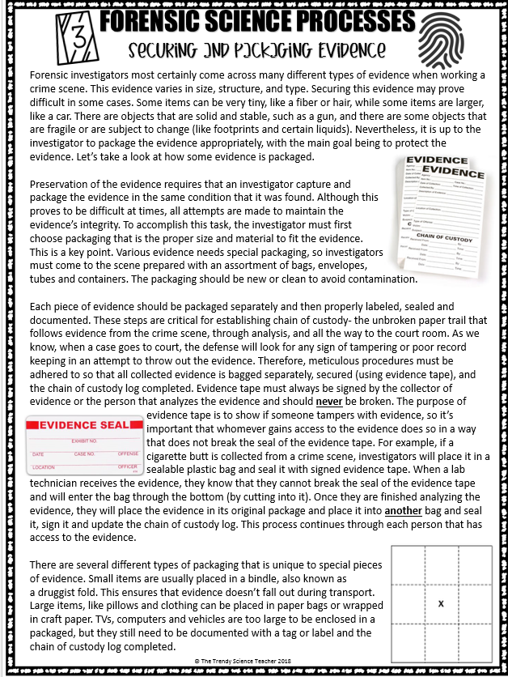
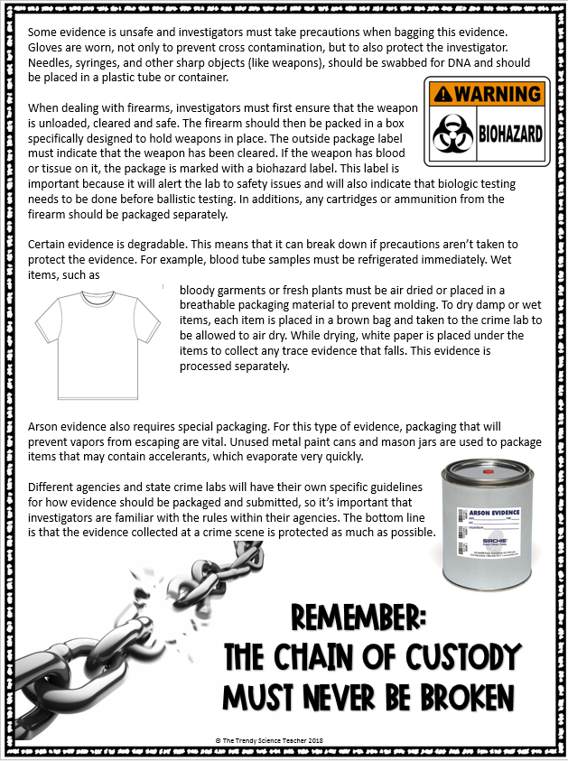
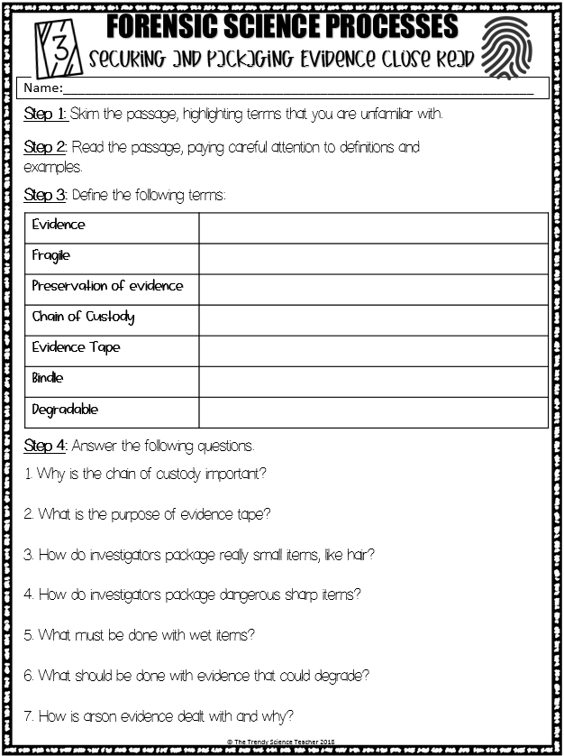
Practice
Complete the Securing and Packaging Evidence Close Reading Assignment.

