Slide 1
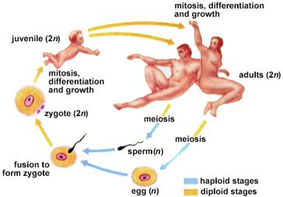
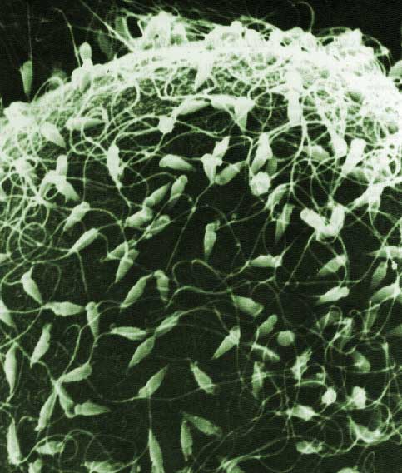
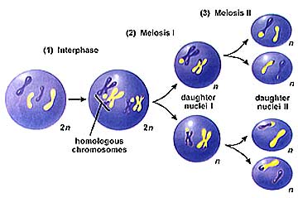
Meiosis:
Cell Division to create
Gametes (sex cells)

Slide 2
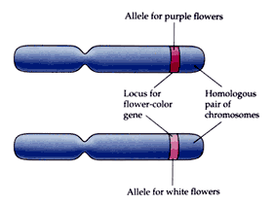
Human body cells have 46 chromosomes arranged into 23 pairs
  The paired chromosomes are called homologous chromosomes
      almost identical copies
      Code for the same gene (trait)
      But may have different versions of that gene
        Alleles: versions of a gene
Homologous Chromosomes
Same trait: Flower Color
Different alleles: purple vs white

Slide 3
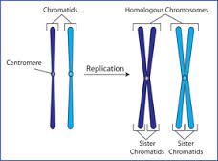
homologous chromosomes: almost identical
Code for same trait may be different or the same versions
Sister chromatids: Copies, Identical
Code for same
versions of same
traits
Flower color
(Purple)
Flower color
(White)
White
White
Purple
Purple
S phase

Slide 4
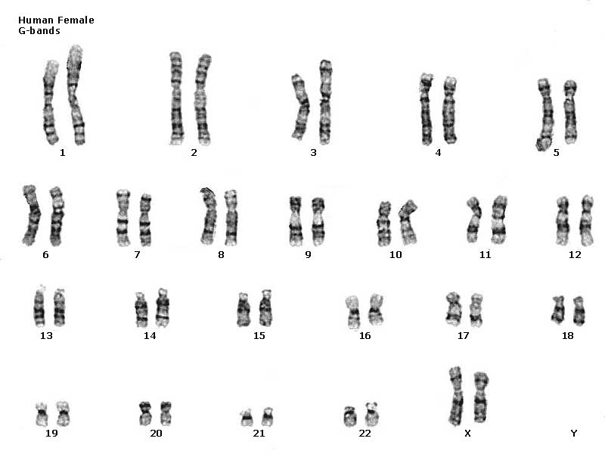
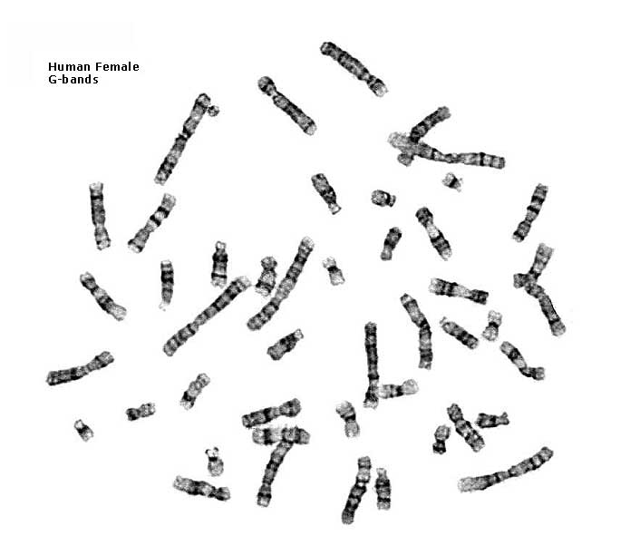
Human female karyotype
diploid = 2 copies
2n
46 chromosomes
23 pairs
XX

Slide 5
Chromosome Number
Diploid cell: A cell that contains 2 sets of chromosomes
  Have homologous chromosomes (pairs)
  Symbol = 2N; where N = # of chromosomes
For humans
  diploid number = 46
  2N = 46.
46

Slide 6
Why are there pairs of chromosomes?
We get 1 set from each parent
  Each chromosome from dad has a matching chromosome from mom
    the matching chromosomes are called homologous chromosomes
from Dad
from Mom
Sperm
+
Egg
Zygote
Notes:
Each cell has 2 copies of each chromosome because we inherit one copy from each parent.

Slide 7
Chromosome Number
Sperm
Egg
Haploid Cell: A cell that contains only one set of chromosomes
    Do not have homologous chromosomes (no pairs)
  Symbol = N
For humans
  Haploid number = 23
  N = 23
23
23

Slide 8
Human female karyotype
haploid = 1 copy
n
diploid = 2 copies
2n
46 chromosomes
23 pairs
23 chromosomes
0 pairs

Slide 9
How can we inherit only one set from each parent?
Gametes: sex cells
  Male gamete: sperm
  Female gamete: egg
Gametes are haploid cells
  formed by separating the homologous chromosomes to form cells with just one set
Sperm
Egg

Slide 10
How do we make sperm & eggs?
Must reduce 46 chromosomes → 23
  must half the number of chromosomes
  Haploid = 1 copy (n)
23
zygote
46
23
egg
46
meiosis
23
46
23
fertilization
sperm
gametes

Slide 11
Why must we reduce the number of chromosomes in our sex cells?
If we didn’t, then….



46
+
46
92
egg
sperm
zygote
Doesn’t work!
Notes:
meiosis keeps chromosome number same from generation to generation
In order for every member of a species to have the same number of chromosomes, changing the amount of chromosomes changes the amount of DNA and would ‘confuse’ our cells
All organisms have different numbers of chromosomes (eg the adult fruit fly has 8 chromosomes; 4 pairs)

Slide 12
How do we reduce the chromosome number?
Meiosis
  Special cell division in sexually reproducing organisms
  Separates matching chromosomes to form cells with one set of chromosomes
  Reduces Chromosome Number
  by half
    Diploid Haploid
  Makes gametes
2 copies
diploid
2n
1 copy
haploid
1n

Slide 13
Phases of Meiosis
Haploid ( 1 set)
Meiosis involves one replication and two divisions, meiosis I and meiosis II.
  Makes 4 haploid cells from 1 diploid cell
Haploid ( 1 set)
DNA Replication
1st Division
2nd Division
Meiosis II
Haploid ( 1 set)
Interphase
Meiosis I
Diploid (2 sets)
Haploid ( 1 set)
Notes:
Why do the chromosomes look like an X after DNA Replication? What are those called? – sister chromatids
What kind of chromosomes separate in Meiosis 1? – Homologous chromosomes
What kind of cells are made in Meisosis 1? – haploid
What kind of chromosomes separate in Meiosis 2? – sister chromatids

Slide 14
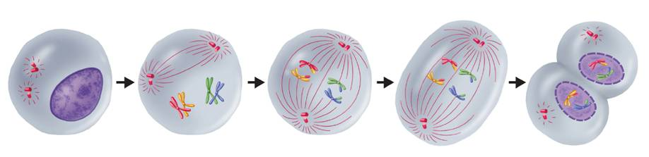
Meiosis I
  Meiosis I
Interphase
Prophase I
Metaphase I
Anaphase I
Telophase I and
Cytokinesis
Notes:
During meiosis, the number of chromosomes per cell is cut in half through the separation of the homologous chromosomes. The result of meiosis is 4 haploid cells that are genetically different from one another and from the original cell.

Slide 15
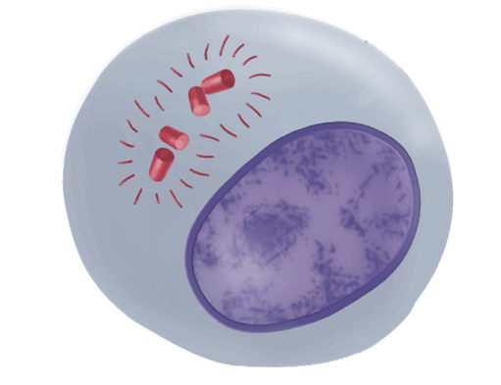
Interphase
Similar to mitosis interphase
DNA is replicated (S phase), forming sister chromatids
Centriole pairs replicate
Notes:
Interphase I - Cells undergo a round of DNA replication, forming duplicate chromosomes.

Slide 16
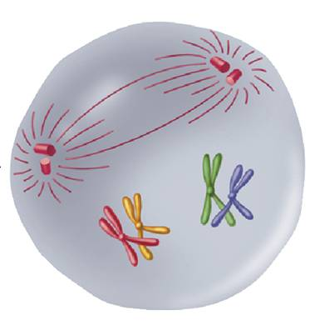
Meiosis I: Prophase I
(same as mitosis)
Chromosomes condense
Centrioles separate
Spindle Fibers form
Nuclear Envelop dissolves
(different from mitosis)
Homologous chromosome match up to form a tetrad.
Notes:
MEIOSIS I Prophase I - Each chromosome pairs with its corresponding homologous chromosome to form a tetrad.
Nuclear envelopes disappear
Spindles fibers form
Centrioles move to opposite sides of nucleus

Slide 17
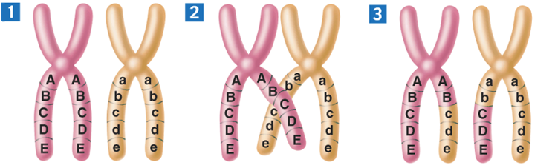
Meiosis I: Prophase I
When tetrads form, crossing-over can happen.
  Exchange parts of the non-sister chromatids
  makes new combinations of alleles
Movie: vacrossi
Paternal
Maternal
Notes:
Crossing-over occurs during meiosis. (1) Homologous chromosomes form a tetrad. (2) Chromatids cross over one another. (3) The crossed sections of the chromatids are exchanged.
(some of the ‘mom’ chromosome switches with the ‘dad’ chromosome)

Slide 18
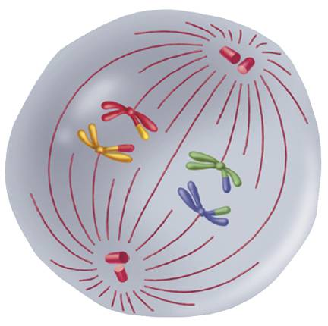
Meiosis I: Metaphase I
Homologous chromosomes line up in the middle of the cell
How chromosomes line up is random (independent assortment)
  Leads to genetic variability
Or
Notes:
MEIOSIS I Metaphase I - Spindle fibers attach to the chromosomes.

Slide 19
Sexual reproduction lifecycle
2 copies
diploid
2n
1 copy
haploid
1n
1 copy
haploid
1n
fertilization
meiosis
In the next
generation…
We’re mixing
things up here!
A good thing?
gametes
gametes

Slide 20
Question:
In terms of Independent Assortment, how many different combinations of sperm could a human male produce?

Slide 21
Answer
Formula: 2^{n}
Human chromosomes:
2n = 46
n = 23
2²³ = ~8 million combinations

Slide 22
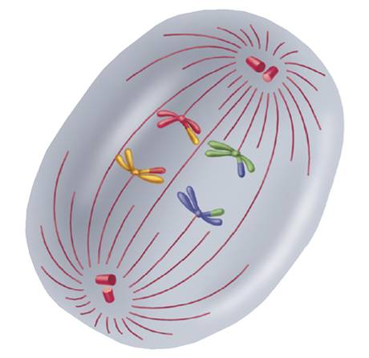
Meiosis I: Anaphase I
The fibers pull the homologous chromosomes apart.
Sister chromatids remain attached at their centromeres
Notes:
MEIOSIS I Anaphase I - The fibers pull the homologous chromosomes toward opposite ends of the cell.

Slide 23
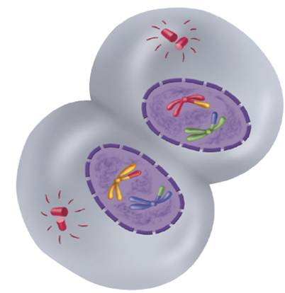
Meiosis I: Telophase I and Cytokinesis
Telophase I
Each side of the cell now has 1 set of replicated chromosomes (haploid)
Nuclear membranes reform
Cytokinesis
The cell separates into two cells
Notes:
MEIOSIS I Telophase I and Cytokinesis - Nuclear membranes form. The cell separates into two cells.

Slide 24
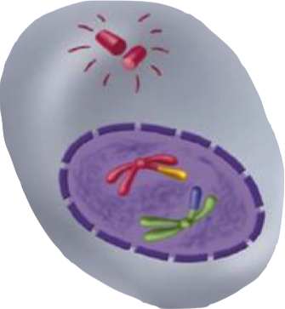
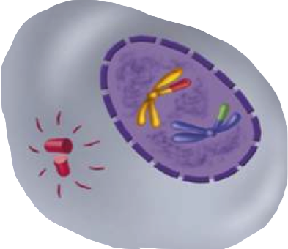
Meiosis I: Telophase I and Cytokinesis
Meiosis I results in two haploid (N) daughter cells
  each with half the number of chromosomes as the original cell.
Notes:
MEIOSIS I Telophase I and Cytokinesis - Nuclear membranes form. The cell separates into two cells. The end products of meiosis I have chromosomes and alleles that are different from each other and from the diploid cell that entered meiosis I.

Slide 25
Meiosis I: Telophase I and Cytokinesis
Why are they different from each other?
Why are they different from the original diploid cell?
Notes:
MEIOSIS I Telophase I and Cytokinesis - Nuclear membranes form. The cell separates into two cells.

Slide 26
Meiosis I: Telophase I and Cytokinesis
Why are they different from each other?
  Crossing over occurred
  Have 1 of each pair, which were similar, but not identical
Why are they different from the original diploid cell?
  Only have 1 set of chromosomes
Notes:
MEIOSIS I Telophase I and Cytokinesis - Nuclear membranes form. The cell separates into two cells.

Slide 27
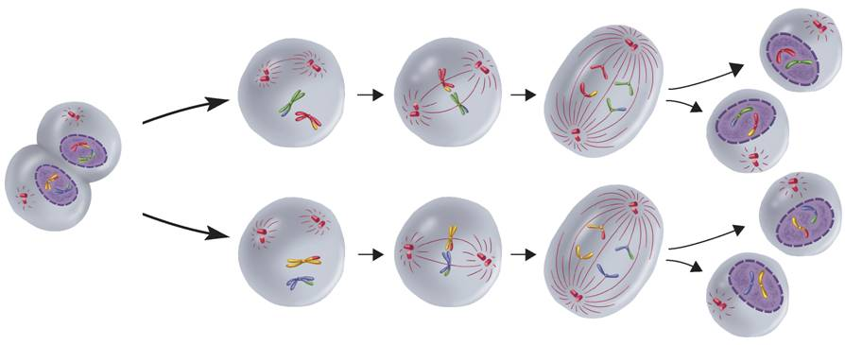
Phases of Meiosis
Meiosis II
The two cells produced by meiosis I now enter a second meiotic division.
Unlike meiosis I, neither cell goes through DNA replication.
Meiosis II
Anaphase II
Telophase II and
Cytokinesis
Telophase I and
Cytokinesis I
Prophase II
Metaphase II
Notes:
During meiosis, the number of chromosomes per cell is cut in half through the separation of the homologous chromosomes. The result of meiosis is 4 haploid cells that are genetically different from one another and from the original cell.

Slide 28
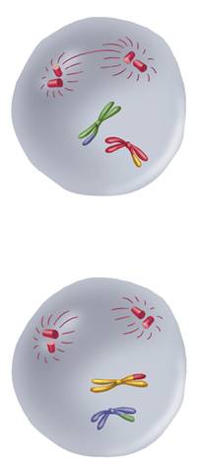
Meiosis II: Prophase II
(same as mitosis)
Chromosomes condense
Centrioles separate
Spindle Fibers form
Nuclear Envelopes dissolve
Tetrads DO NOT form
Notes:
MEIOSIS II Prophase II - Meiosis I results in two haploid (N) daughter cells, each with half the number of chromosomes as the original cell. The two haploid (N) daughter cells, from Meiosis I enter Meiosis II.
Why don’t tetrads form? – because there are no homologous chromosomes to pair up

Slide 29
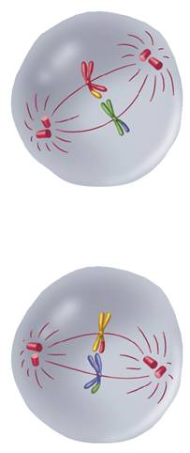
Meiosis II: Metaphase II
The sister chromatids line up in the center of cell.
Notes:
MEIOSIS II Metaphase II - The chromosomes line up in a similar way to the metaphase state of mitosis.

Slide 30
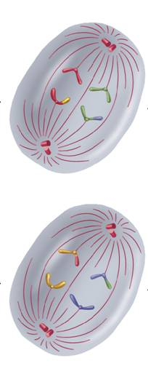
Meiosis II: Anaphase II
The sister chromatids separate and move toward opposite ends of the cell.
Notes:
MEIOSIS II Anaphase II - The sister chromatids separate and move toward opposite ends of the cell.

Slide 31
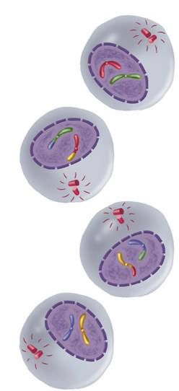
Meiosis II: Telophase II and Cytokinesis
Telophase II
Unreplicated chromosomes gather at opposite ends
Nuclear envelopes reform
Cytokinesis
Cytoplasm is divided
results in four haploid (N) daughter cells
Notes:
MEIOSIS II Telophase II and Cytokinesis - Meiosis II results in four haploid (N) daughter cells.

Slide 32
Question:
A diploid cell containing 20 chromosomes (2n = 20) at the beginning of meiosis would, at its completion, produce cells containing how many chromosomes?

Slide 33
Answer:
10 chromosomes (haploid)
1n = 10

Slide 34
Question:
A cell containing 40 sister chromatids at the beginning of meiosis would, at its completion, produce cells containing how many chromosomes?

Slide 35
Answer:
Four cells with 10 chromosomes each

Slide 36
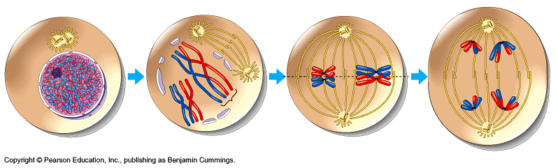
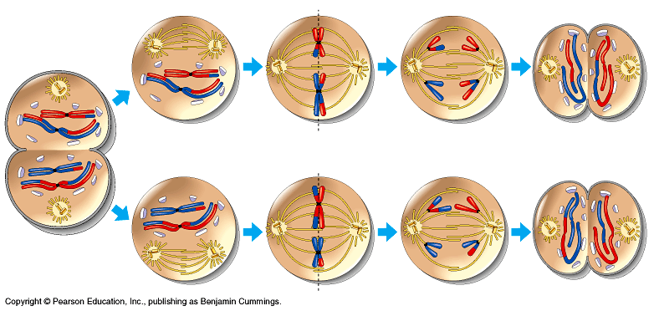
Overview of meiosis
2n = 4
interphase 1
prophase 1
metaphase 1
anaphase 1
n = 2
n = 2
prophase 2
metaphase 2
anaphase 2
telophase 2
n = 2
telophase 1

Slide 37
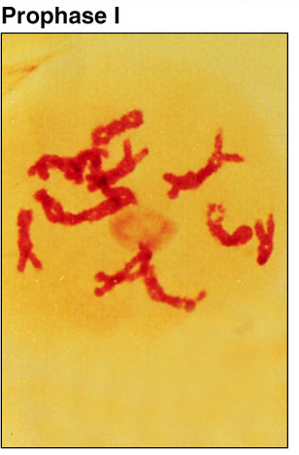
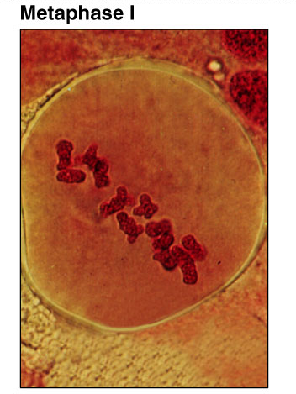
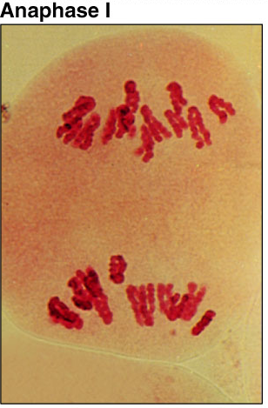
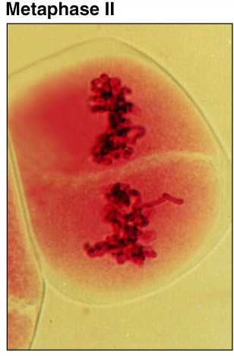
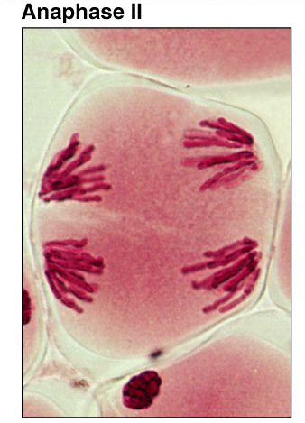
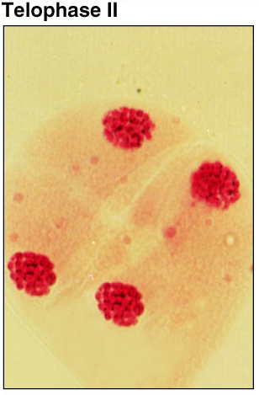
Meiosis 1 & 2

Slide 38
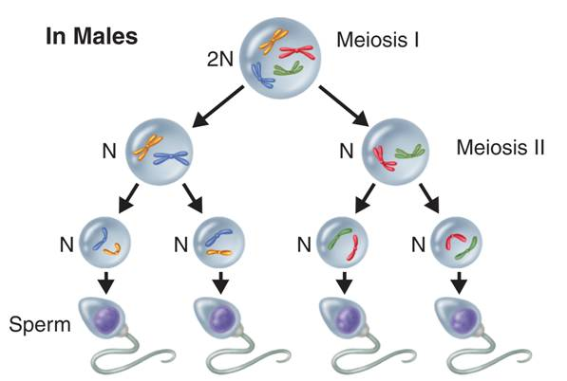
Gamete Formation
Gamete Formation
  In male animals, meiosis results in four equal-sized gametes called sperm.
Notes:
Meiosis produces four genetically different haploid cells. In males, meiosis results in four equal-sized gametes called sperm.

Slide 39
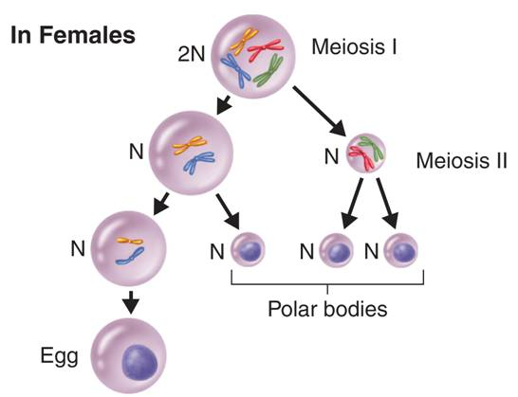
Gamete Formation
In many female animals, only one egg results from meiosis. The other three cells, called polar bodies, are usually not involved in reproduction.
Notes:
Active art
www.phschool.com
Cbp-4114
Meiosis produces four genetically different haploid cells. In females, only one large egg cell results from meiosis. The other three cells, called polar bodies, usually are not involved in reproduction.

Slide 40
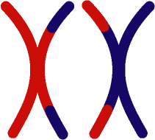
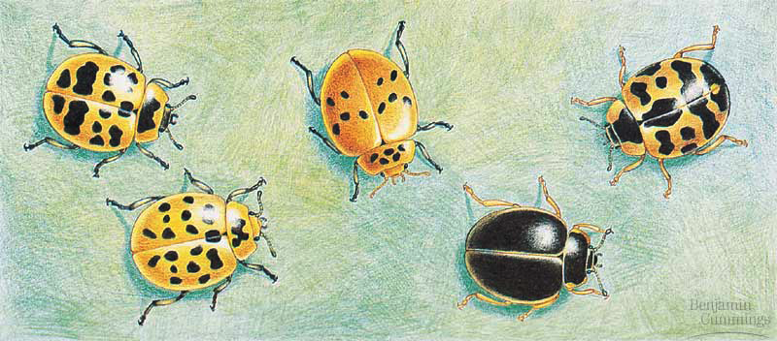
The value of sexual reproduction
Sexual reproduction introduces genetic variation
  genetic recombination
    independent assortment of chromosomes
      random alignment of homologous chromosomes in Metaphase 1
  crossing over
    mixing of alleles across homologous chromosomes
  random fertilization
    which sperm fertilizes which egg?
Driving evolution
  providing variation for natural selection
metaphase1

Slide 41
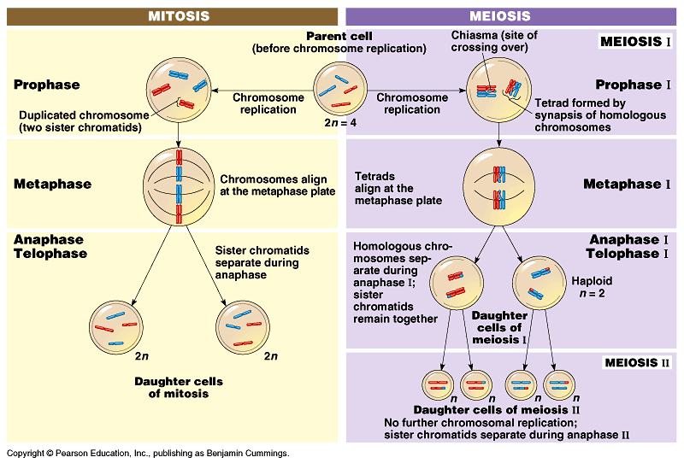
Mitosis vs. Meiosis

Slide 42
Comparing Mitosis and Meiosis
Mitosis
End product is 2 genetically identical diploid cells.
  exact copies
    clones
  same number of chromosomes
Mitosis makes body cells
Mitosis allows an organism to grow and make repairs
Aaaargh!
I’m seeing
double!

Slide 43
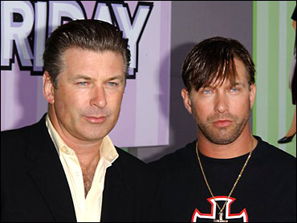
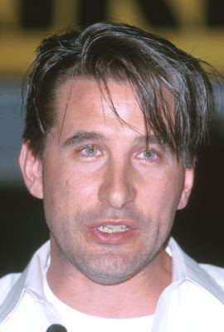

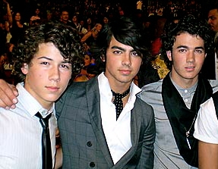
Comparing Mitosis and Meiosis
  Meiosis
  End product is 4 genetically different haploid cells.
    have half the number of chromosomes as the parent cell
    genetically different from the diploid cell and from each other
  Meiosis is how sexually reproducing organisms produce gametes (sex cells).
Baldwin brothers
Jonas
Brothers

Slide 44
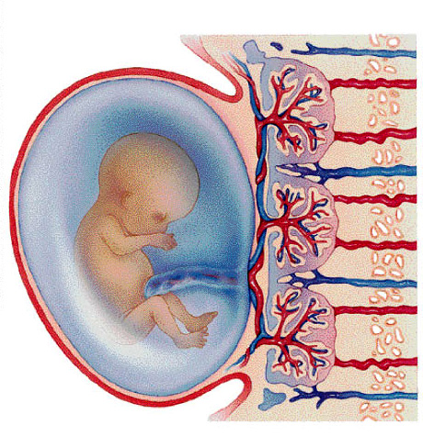
Putting it all together…
meiosis → fertilization → mitosis + development
gametes
46
23
46
23
46
46
46
46
46
meiosis
egg
46
46
23
46
46
23
zygote
fertilization
mitosis
sperm
development

Slide 45
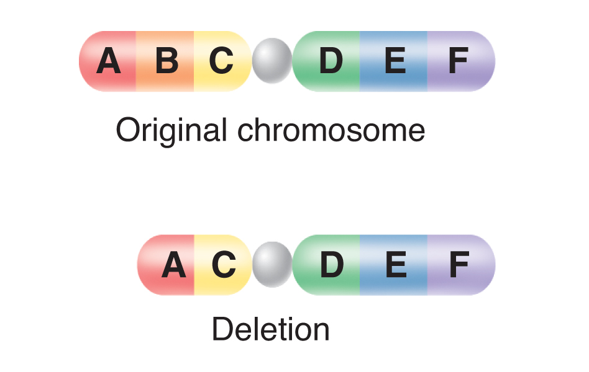
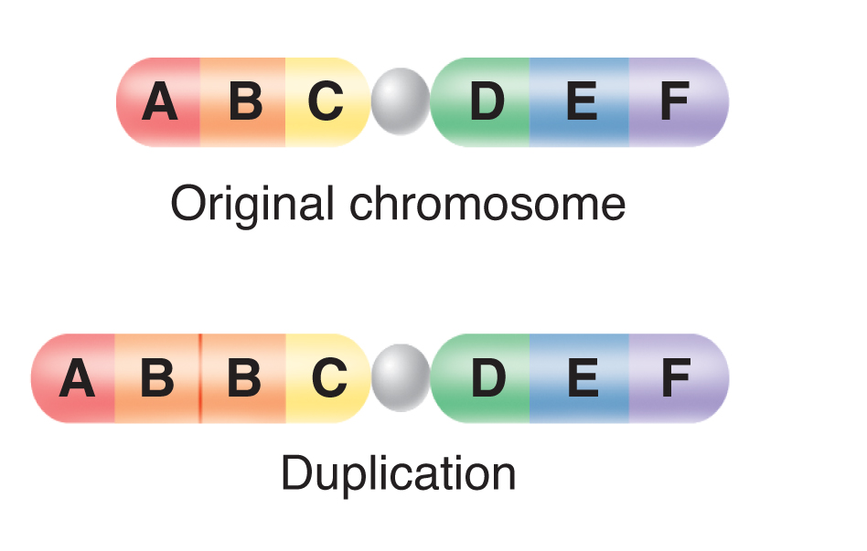
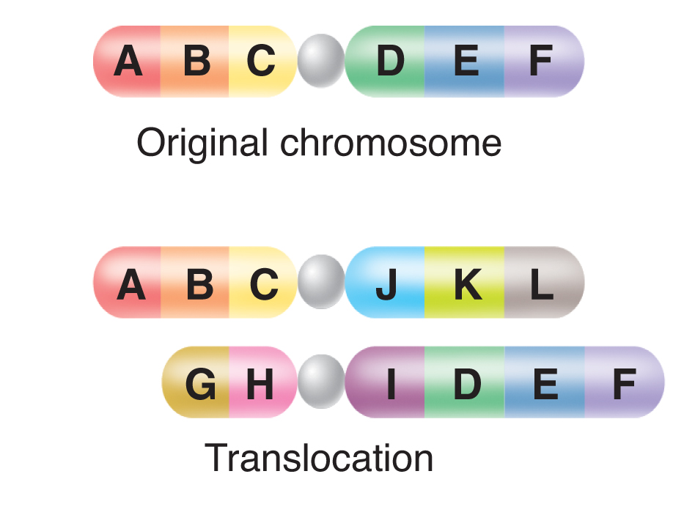
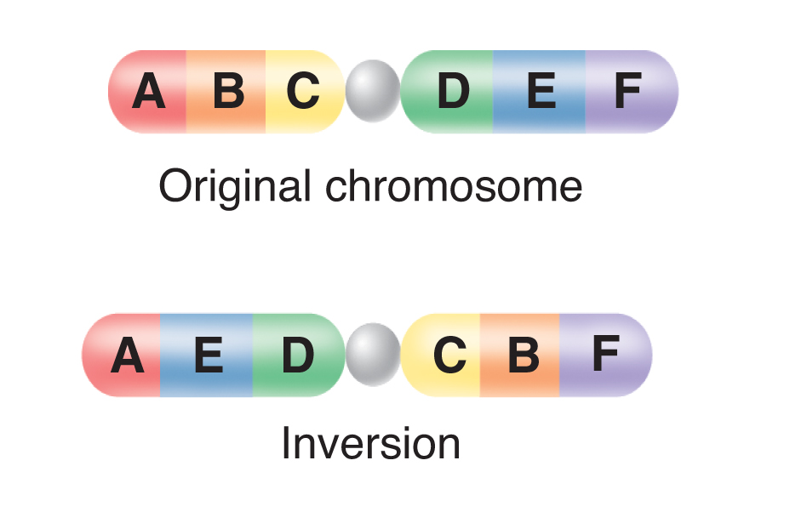
12-4 Mutations
Mutations

Slide 46
Mutations are changes in the genetic material.
    Errors in meiosis can lead to chromosomal mutations
      involve changes in the number or structure of chromosomes
      include deletions, duplications, inversions, and translocations

Slide 47
Deletions involve the loss of all or part of a chromosome.
Notes:
Can happen with an error in crossing over

Slide 48
    Duplications produce extra copies of parts of a chromosome.
Notes:
Can happen with an error in crossing over
Movie: Duplication

Slide 49
Inversions reverse the direction of parts of chromosomes.
Notes:
Chromosomal mutations involve changes in whole chromosomes.

Slide 50
Translocations occurs when part of one chromosome breaks off and attaches to another.
Notes:
Chromosomal mutations involve changes in whole chromosomes.
Movie: Translocation and inversion

Slide 51
Chromosomal Disorders
The most common error in meiosis occurs when homologous chromosomes fail to separate.
  Called Nondisjunction
    “not coming apart.”
    abnormal numbers of chromosomes may find their way into gametes
      May have 3 copies of the same chromosome
      May have only 1 copy of a chromosome

Slide 52
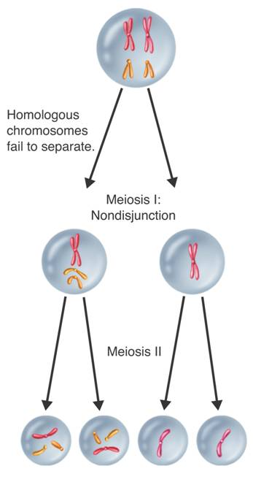
Chromosomal Disorders
Nondisjunction
  Example Down Syndrome
    Down syndrome involves three copies of chromosome 21.
Meiosis I:
Nondisjunction
Meiosis II
Notes:
Nondisjunction causes gametes to have abnormal numbers of chromosomes. The result of nondisjunction may be a chromosome disorder such as Down syndrome.
Movie: Nondisjunction

Slide 53
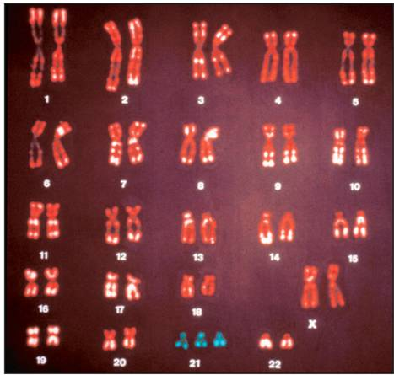
Chromosomal Disorders
Down Syndrome Karyotype
Down syndrome produces mild to severe mental retardation.
It is characterized by:
    increased susceptibility to many diseases
    higher frequency of some birth defects
Notes:
This karyotype is from a person with Down syndrome. Down syndrome causes mental retardation and various physical problems. People with Down syndrome can, however, lead active, happy lives. Photo credit: ©Dr. Dennis Kunkel/CNRI/Phototake

Slide 54
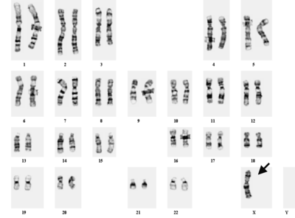
Chromosomal Disorders
Sex Chromosome Disorders
  A female with Turner’s syndrome usually inherits only one X chromosome (karyotype 45,X).
  Women with Turner’s syndrome are sterile.

Slide 55
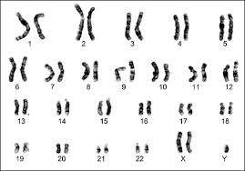
Chromosomal Disorders
Sex Chromosome Disorders
  A male with Klinefelter’s syndrome inherits an extra X chromosome (karyotype 47,XXY).
  The extra X chromosome interferes with meiosis and usually prevents these individuals from reproducing.

