Slide 1
Mimicry
palatable or harmless species mimics a harmful model
Batesian mimicry
green parrot snake
hawkmoth larvae
Hawkmoth larva puffs up to look like poisonous snake
Notes:
In some cases, a prey species may gain significant protection by mimicking the appearance of another species
In Batesian mimicry, a palatable or harmless species mimics an unpalatable or harmful model

Slide 2
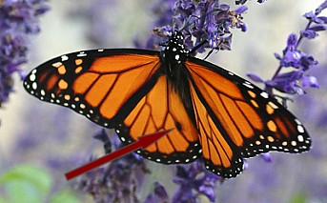
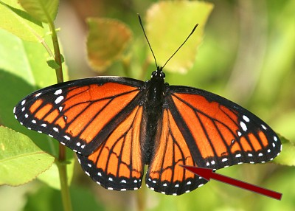
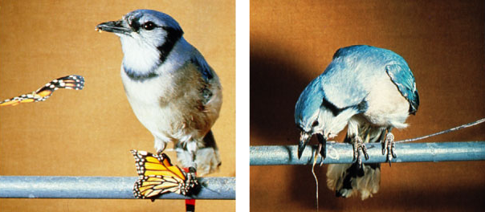
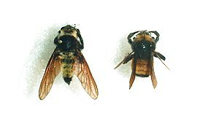
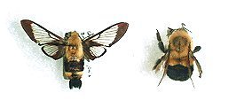
Batesian mimicry
Monarch male
poisonous
Viceroy male
edible
Which is the moth vs. the bee?
Which is the fly vs. the bee?
fly
bee
moth
bee
Notes:
In some cases, a prey species may gain significant protection by mimicking the appearance of another species
In Batesian mimicry, a palatable or harmless species mimics an unpalatable or harmful model

Slide 3
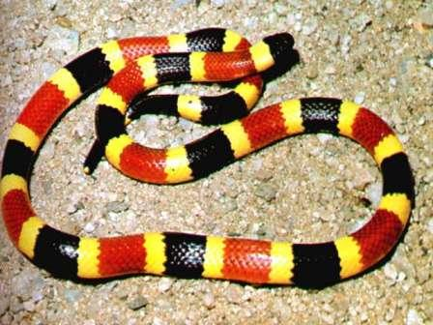
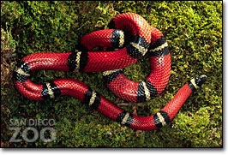
Batesian mimicry
Coral snake is poisonous
King snake is not
Red on yellow, poison fellow; red on black, safe from attack

Slide 4
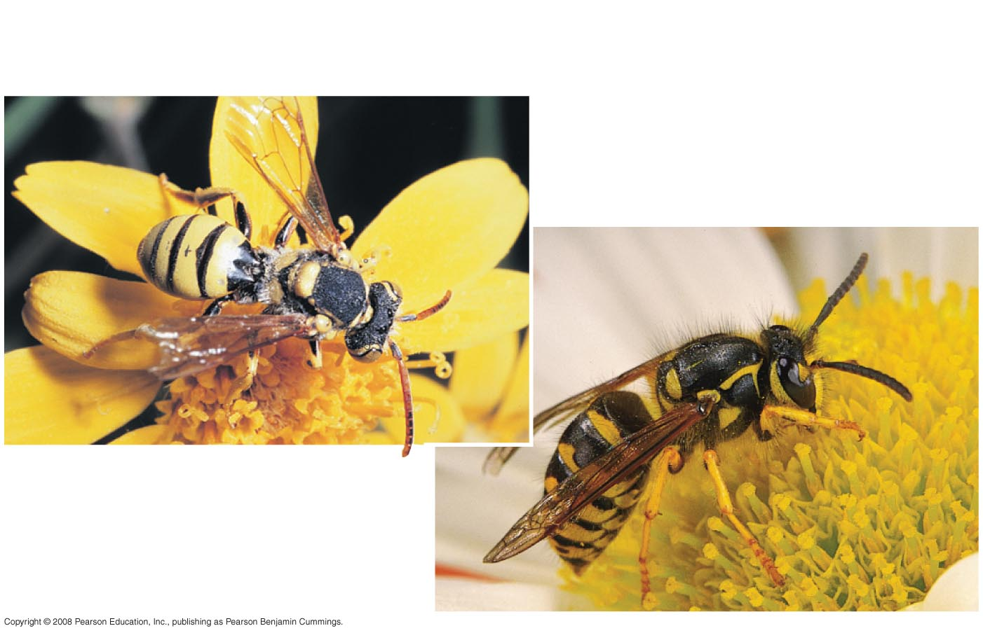
Mullerian mimicry
two or more protected species look like each other
cuckoo bee
yellow jacket
- group defense?
- predators may evolve innate avoidance
Notes:
In Müllerian mimicry, two or more unpalatable species resemble each other

Slide 5
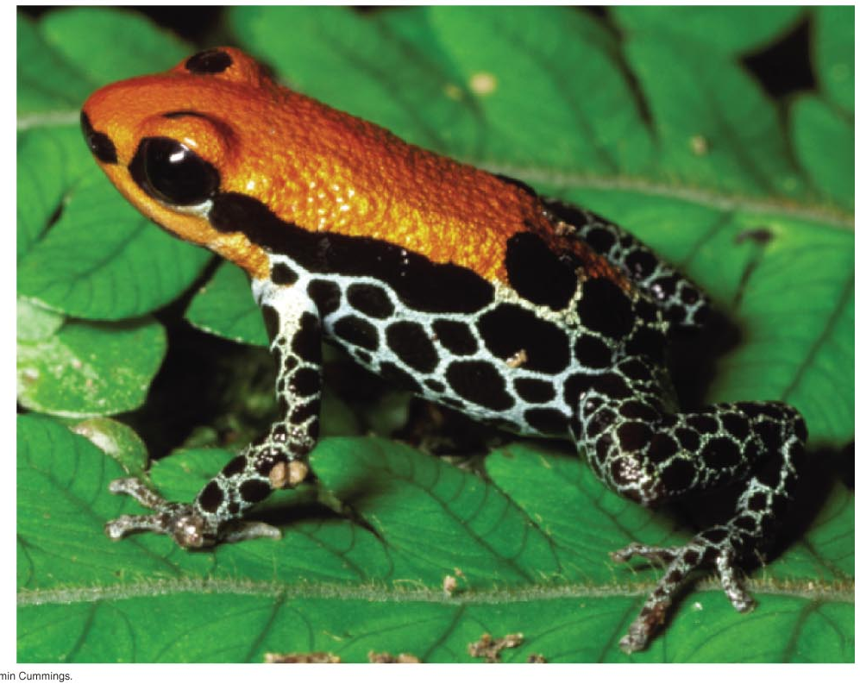
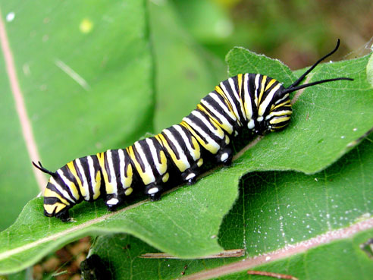
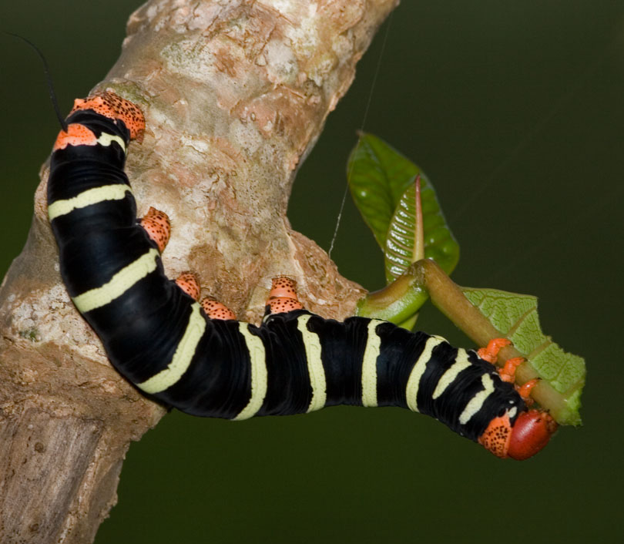
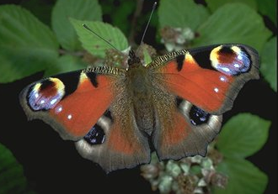
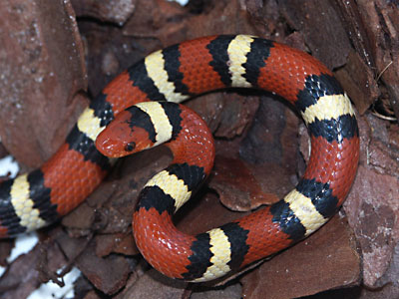
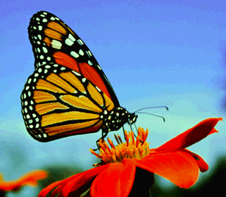
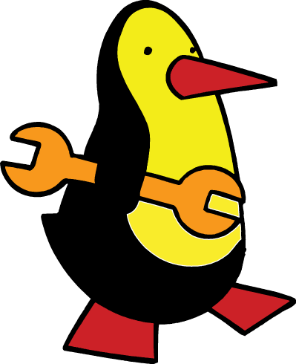
Common warning coloration
Aposematic species come to resemble each other
black, red, orange & yellow means: DON’T EAT ME!
Notes:
Animals with effective chemical defense often exhibit bright warning coloration, called aposematic coloration
Predators are particularly cautious in dealing with prey that display such coloration

Slide 6
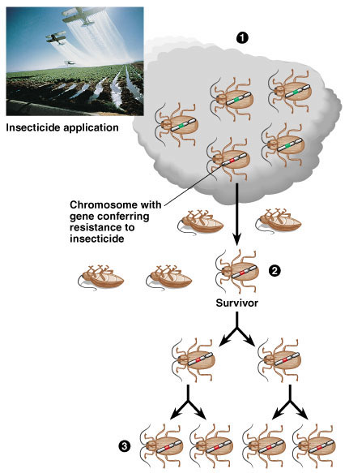
Natural selection in action
Insecticide & drug resistance
insecticide doesn’t kill all individuals
resistant survivors reproduce
resistance is inherited
insecticide becomes less & less effective
Notes:
The evolution of resistance to insecticides in hundreds of insect species is a classic example of natural selection in action.
The results of application of new insecticide are typically encouraging, killing 99% of the insects.
However, the effectiveness of the insecticide becomes less effective in subsequent applications. The few survivors from the early applications of the insecticide are those insects with genes that enable them to resist the chemical attack. Only these resistant individuals reproduce, passing on their resistance to their offspring. In each generation the % of insecticide-resistant individuals increases.

Slide 7
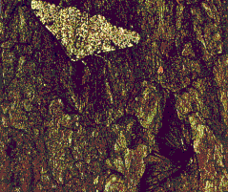
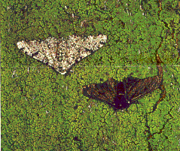
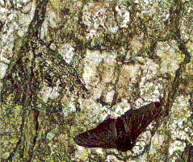
Peppered Moths
Dark vs. light variants
Year % dark % light
1848 5 95
1895 98 2
1995 19 81

Slide 8
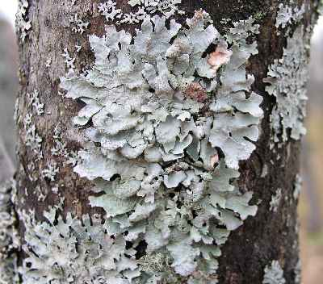
Peppered moth
What was the selection factor?
early 1800s = pre-industrial England
low pollution
lichen growing on trees = light colored bark
late 1800s = industrial England
factories = soot coated trees
killed lichen = dark colored bark
mid 1900s = pollution controls
clean air laws
return of lichen = light colored bark
industrial melanism

Slide 9
Artificial selection: something other than the environment (aka humans) is doing the selecting
Natural selection: the environment is doing the selecting

Slide 10
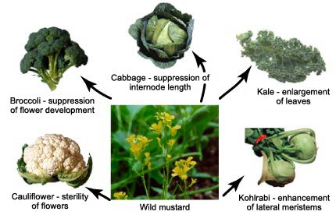
Artificial selection
Artificial breeding can use variations in populations to create vastly different “breeds” & “varieties”
Notes:
----- Meeting Notes (4/22/15 12:12) -----
YOOOO WASSUP MS FRANKS

Slide 11
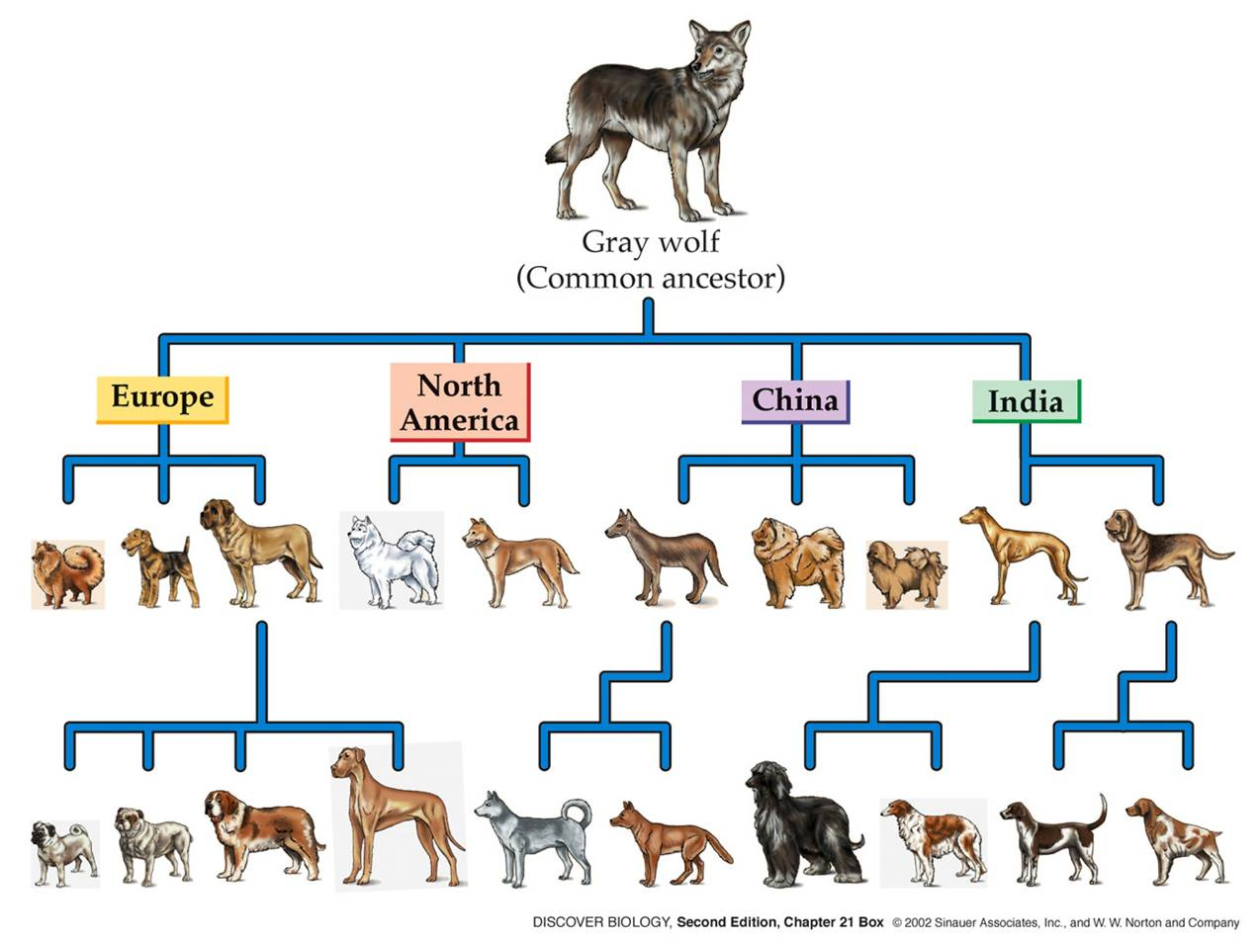
Artificial selection
Artificial breeding can use variations in populations to create vastly different “breeds” & “varieties”

