Slide 1
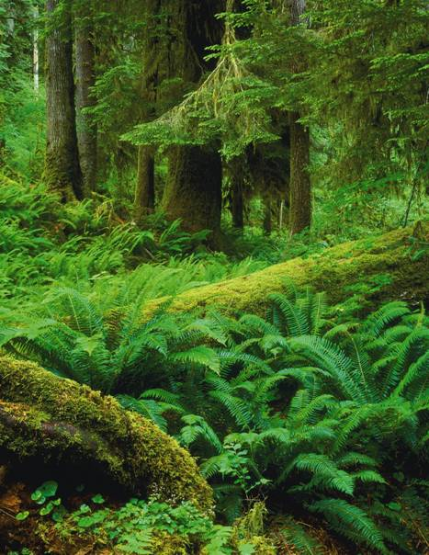
Domain Eukarya
Plantae
Plants are/have
multicellular
eukaryotic
photosynthetic
green pigments chlorophyll a and b
cell walls made of cellulose
nonmotile—cannot move
includes cone-bearing and flowering plants as well as mosses and ferns

Slide 2
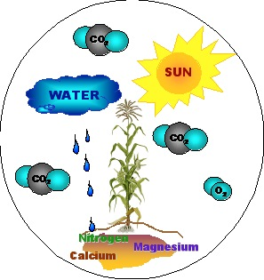
What Plants Need to Survive
In order to survive, plants need:
sunlight
water and minerals
gas exchange
way to transport water
and nutrients
throughout the plant
body

Slide 3
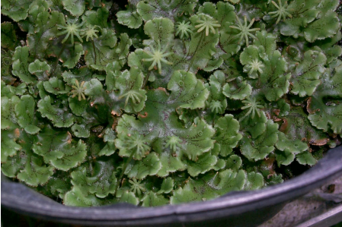
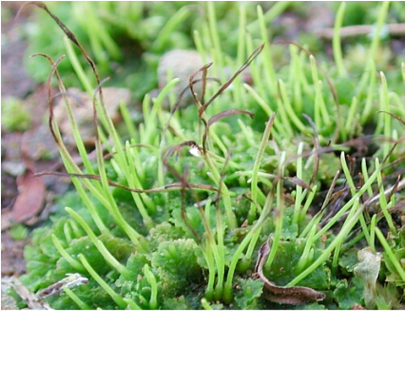
Bryophytes
low-growing plants found in moist, shaded areas
Ex: Mosses, liverworts, and hornworts
Notes:
The most common bryophytes are mosses.
Mosses:
are adapted to life in wet habitats and nutrient-poor soils.
can tolerate low temperatures.
are clumps of gametophytes growing together.

Slide 4
Human Use of Mosses
natural sponge
fuel
improve the soil’s ability to retain water
increase soil acidity

Slide 5
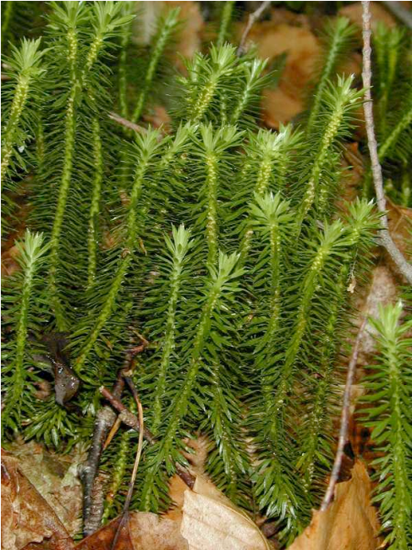
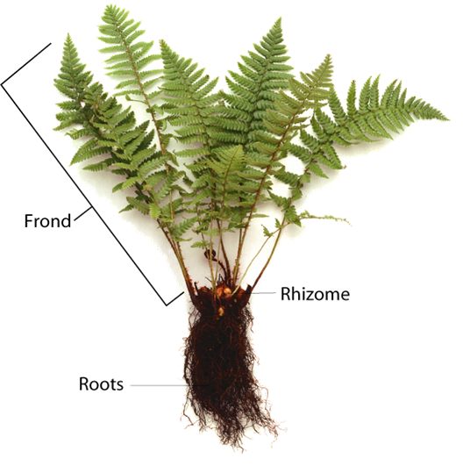
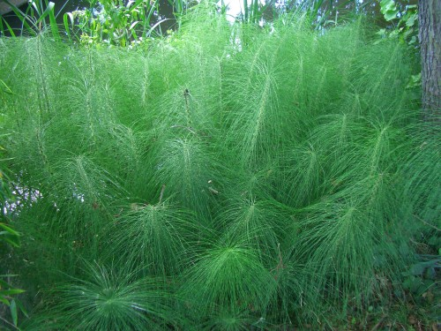
Ferns and Their Relatives
Seedless vascular plants
Reproduce by release of spores
Include:
club mosses
horsetails
ferns

Slide 6
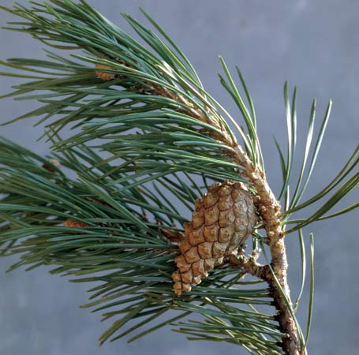
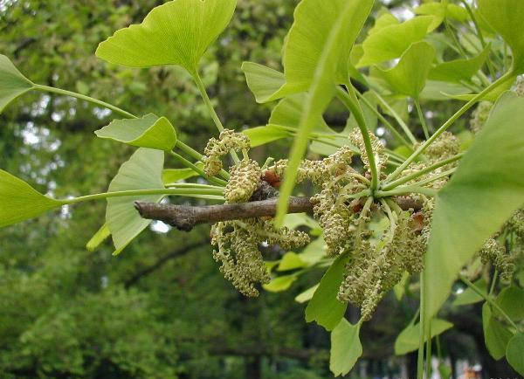
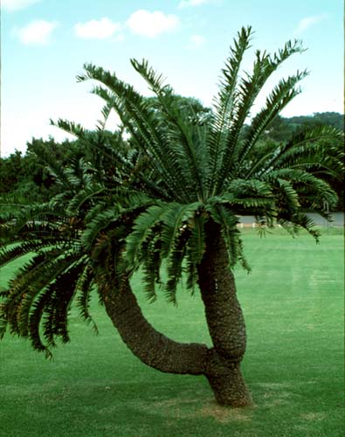
Seed Plants
Gymnosperms ( cone bearing): seeds directly on the surfaces of cones.
Include conifers, cycads, and ginkgoes
Notes:
Seed plants are the most dominant group of photosynthetic organisms on land.

Slide 7
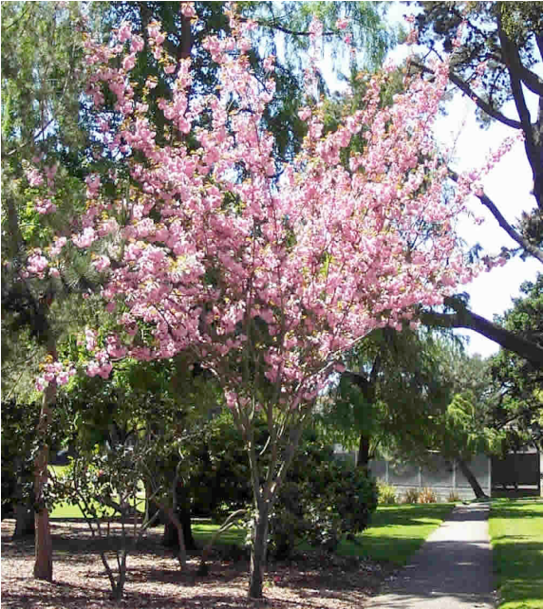
Seed Plants
Angiosperms (flowering plants) bear seeds within a layer of tissue (fruit) that protects the seed.
Include grasses, flowering trees and shrubs, and all species of flowers

Slide 8
Domain Eukarya
Animalia
multicellular heterotrophs
do not have cell walls
most can move
great diversity

Slide 9
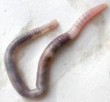
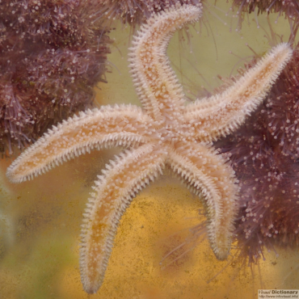
What Is an Animal?
Invertebrates do not have a backbone, or vertebral column.
make up 95% of all animal species.
include
worms
sea stars
jellyfish
insects

Slide 10
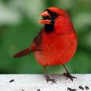
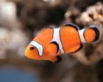
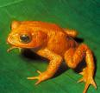
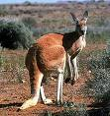
What Is an Animal?
Vertebrates have a backbone
5% of animal species
include
Birds
Fish
Amphibians
Reptiles
Mammals

Slide 11
9 Phyla of the Animal kingdom
Porifera 6) Mollusca
Cnidaria 7) Echinoderm
Platyhelmenthes 8) Arthropoda
Nematoda 9) Chordata
Annelida

Slide 12
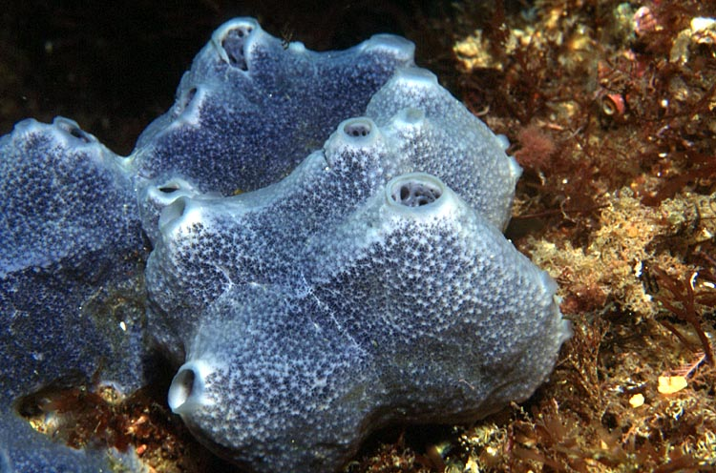
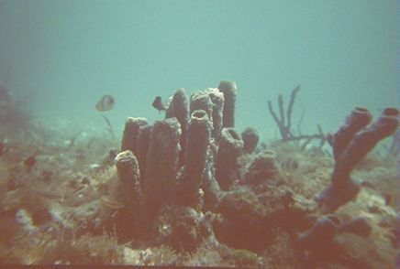
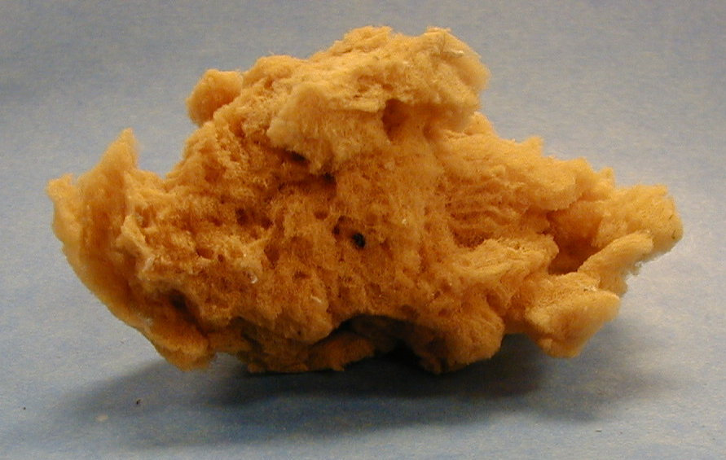
The Animal Kingdom Cont’d
Porifera:
Invertebrates
Means “having pores”
Ex: sponges

Slide 13
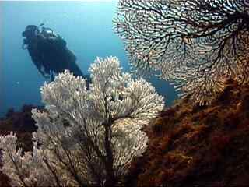
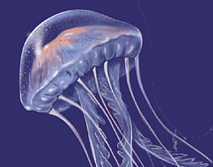
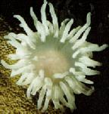
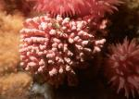
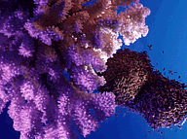
The Animal Kingdom
Cnidaria:
Invertebrates
Sac-like body
Have tentacles
Ex: hydras, jelly fish, coral, sea anemones

Slide 14
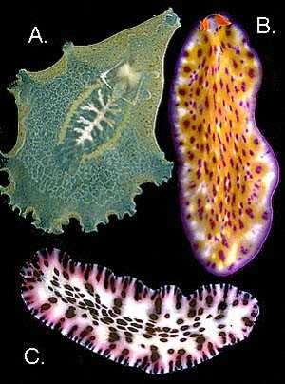
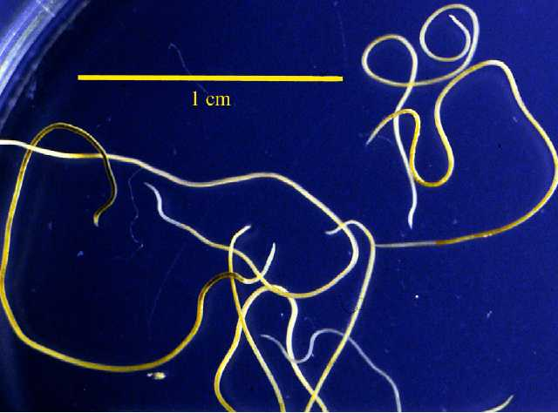
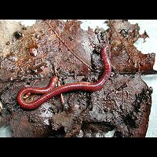
3 Phyla of Worms:
All invertebrates
Platyhelmenthes
Flatworms
Nematoda
Roundworms
Annelida
Segmented worms

Slide 15
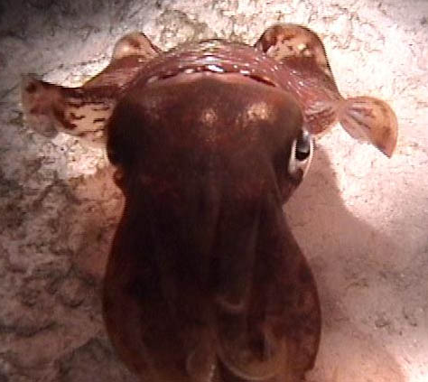
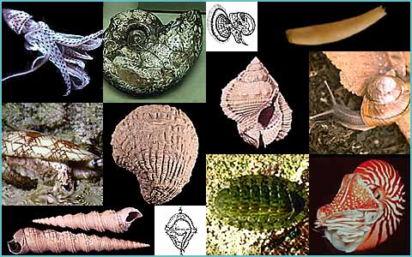
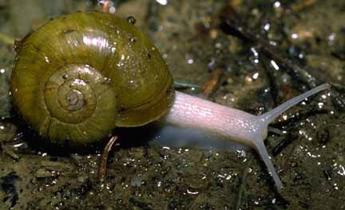
Mollusca:
Hard shell surrounding soft body parts
Invertebrates
Live in water & damp places
Examples:
Snail, & Sea Scallop
Only a few do not have shells:
Octopus & Sea slug

Slide 16
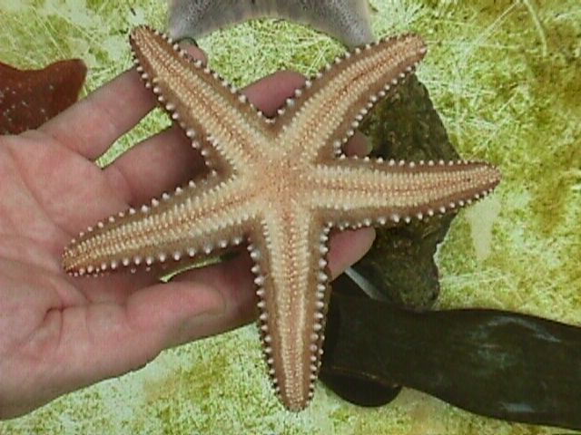
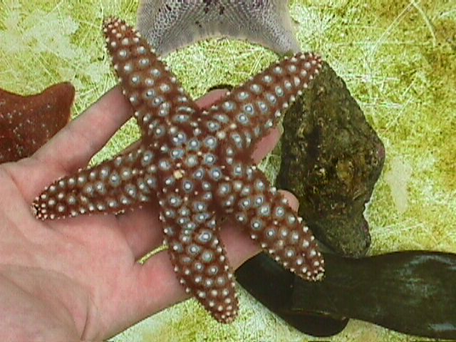
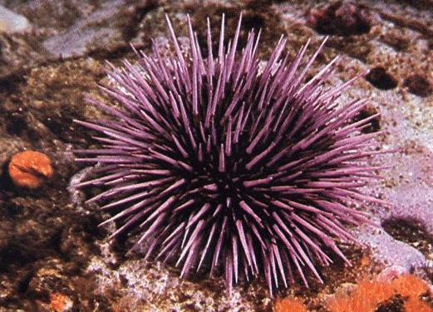
Echinoderms:
Means “spiny-skin”
Invertebrates
Commonly Star shaped
Spiny
Ex:
Starfish & Sea Urchin

Slide 17
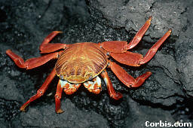
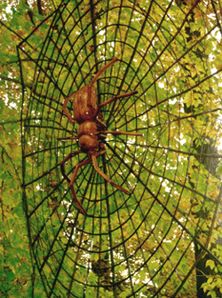
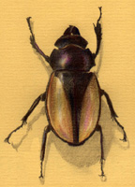
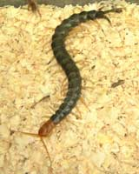
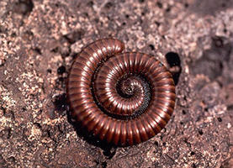
Arthropoda:
Makes up 75% of the animal kingdom
Basic Characteristics:
hard external skeleton
segmented body
jointed legs
Invertebrates
Ex: beetle, milli & centipede, spider, crab

Slide 18
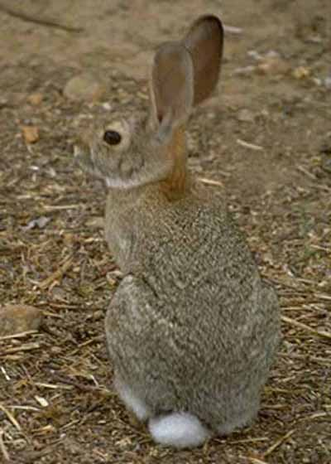
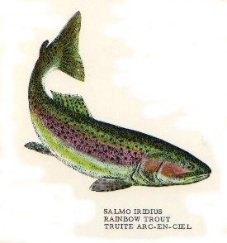
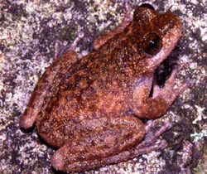
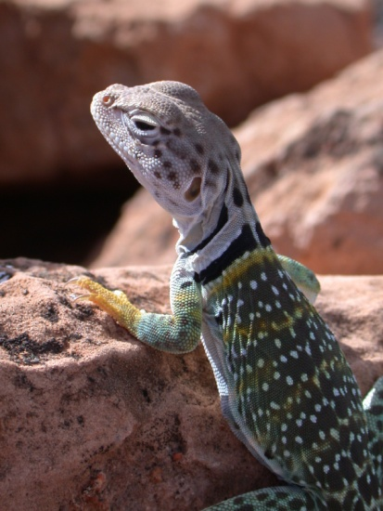
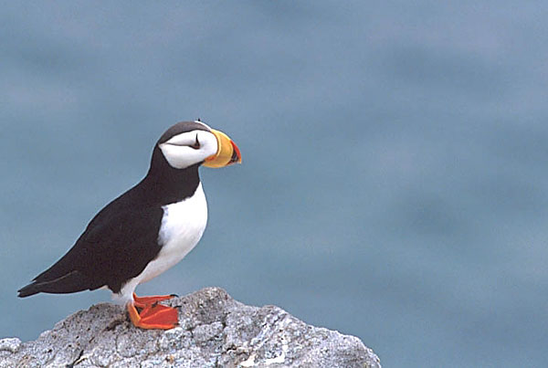
Chordata:
Vertebrates
Have internal skeleton
Vertebral column
Limbs
Ex: fish, amphibians, reptiles, birds, mammals

Slide 19
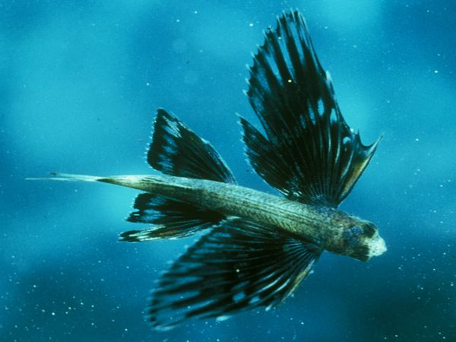
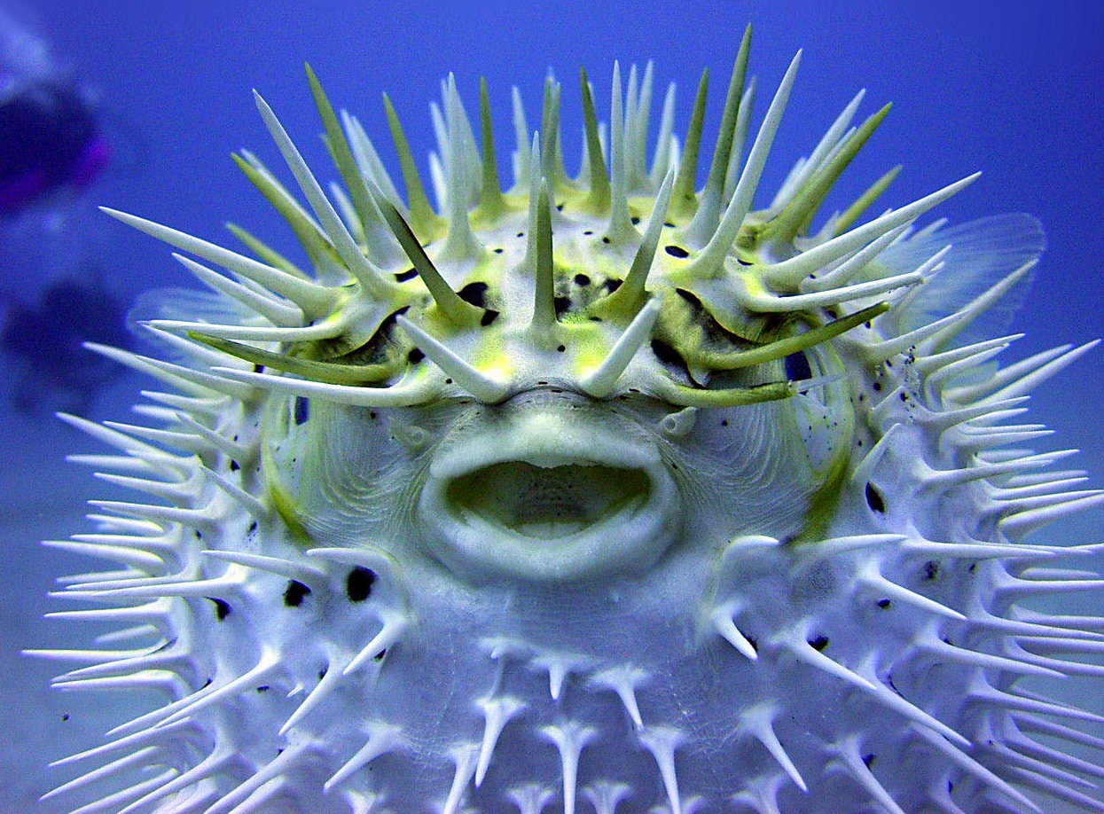
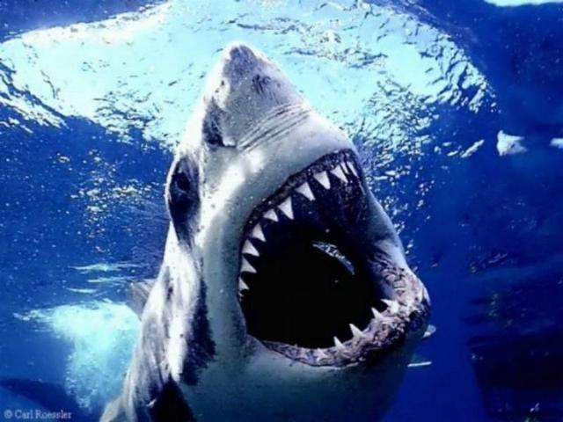
Fish
Class Fish, Phylum Chordata
Characteristics
Paired fins
Scales
Gills- used for breathing
Reproduce using eggs
Cold-blooded (Ectotherm)

Slide 20
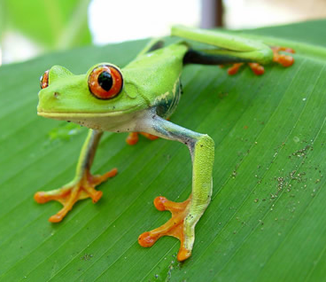
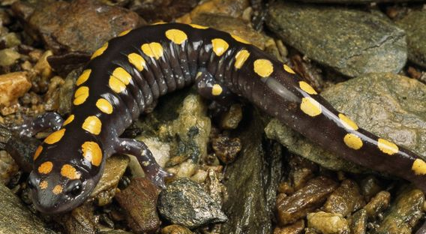
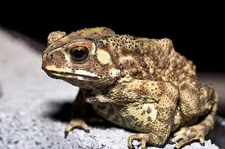
Amphibians
Class Amphibia, Phylum Chordata
Characteristics
Lives in water as larva.
Lives on land as adults.
Breathe with lungs.
Moist smooth skin.
No claws
Cold-blooded (Ectotherm)

Slide 21
Reptiles
Class Reptilia, Phylum Chordata
Characteristics
Have dry scaly skin.
Breathe with lungs.
Lays eggs on land.
Cold-blooded (Ectotherm)

Slide 22
Birds
Class Aves, Phylum Chordata
Characteristics
Breathe with lungs
Feathers
Two legs covered with scales
Front limbs modified into wings
Warm-blooded (Endotherm)

Slide 23
Mammals
Class Mammalia, Phylum Chordata
Characteristics
Hair
Mammary glands- produce milk
Breathe with lungs
Warm-blooded (Endotherm)
Live births

