Slide 1
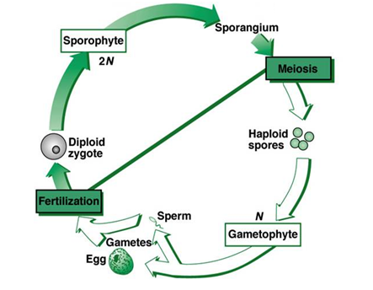
Plant Phyla & Alternation of Generations Review

Slide 2
Bryophyta (mosses)
Dominant generation: gametophyte (n)
Produced by haploid spore
Sporophyte (2n) grows from gametophyte
Flagellated sperm produced in antheridia swim to and unite with egg in archegonia

Slide 3
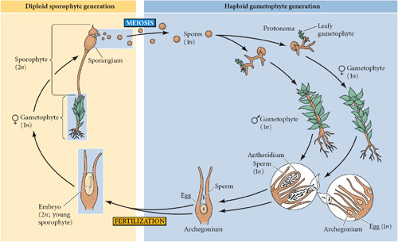
Moss Life Cycle

Slide 4
Pterophyta (ferns) & Lycophyta (club mosses)
Dominant generation: sporophyte (2n)
Produced when flagellated sperm from antheridia swim to and unite with egg in archegonia
Gametophyte is reduced (found at or below soil surface)
Sporophyte grows from female gametophyte (archegonium)

Slide 5
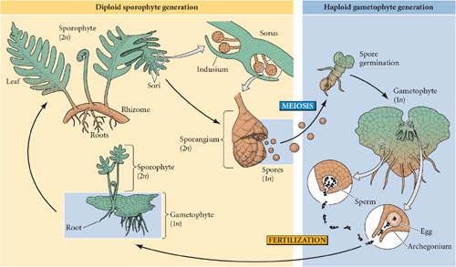
Fern Life Cycle

Slide 6
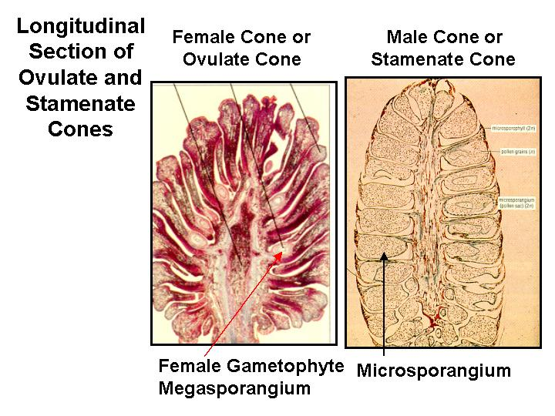
Gymnosperms (naked seed plants)
Dominant generation: sporophyte (2n)
Gametophyte (1n) is reduced
Megaspore (female) will produce eggs in an ovule
Microspore (male) will produce sperm in a pollen grain
Zygote (seed) “naked” in a cone

Slide 7
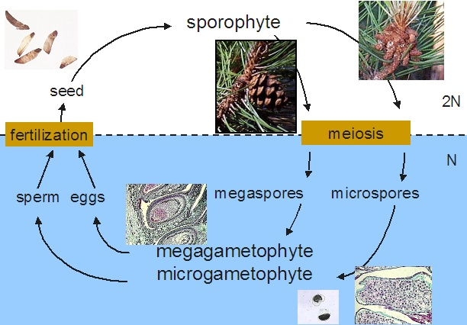
Gymnosperm Life Cycle

Slide 8
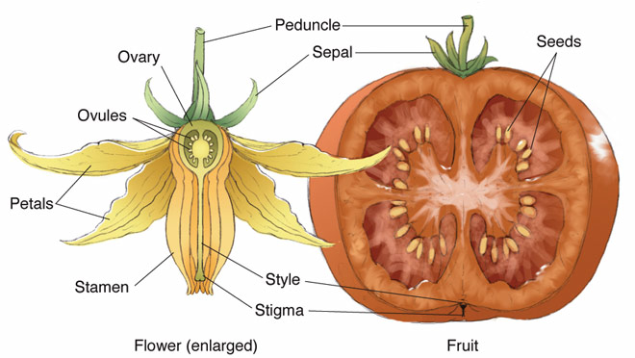
Angiosperms (flowering plants)
Dominant generation: sporophyte (2n)
Gametophyte is reduced
Megaspore (female) will produce eggs in an ovule
Microspore (male) will produce sperm in a pollen grain
Zygote (seed) encased in fruit

Slide 9
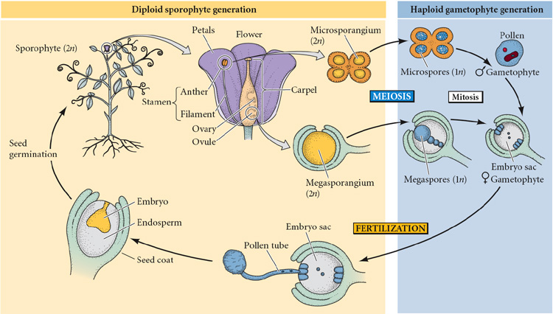
Angiosperm Life Cycle

