Slide 1
Domain Eukarya
The domain Eukarya consists of organisms that have a nucleus.
This domain is organized into four kingdoms:
Protista
Fungi
Plantae
Animalia

Slide 2
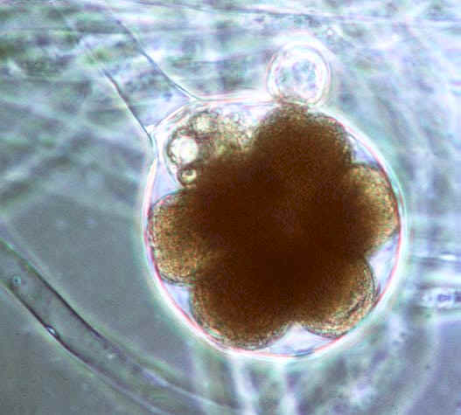
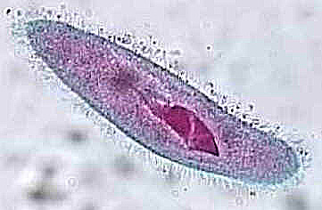
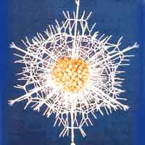
Kingdom Protista
Eukaryotic organisms that cannot be put in any other kingdom
share some characteristics with plants, fungi, or animals
includes more than 200,000 species
Notes:
The first eukaryotic organisms on Earth were protists.
Mitochondria and chloroplasts in eukaryotic cells may have descended from prokaryotes that lived inside larger cells.

Slide 3
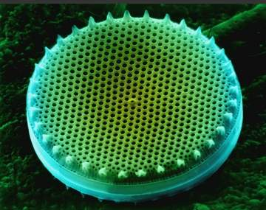
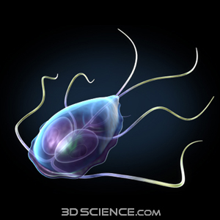
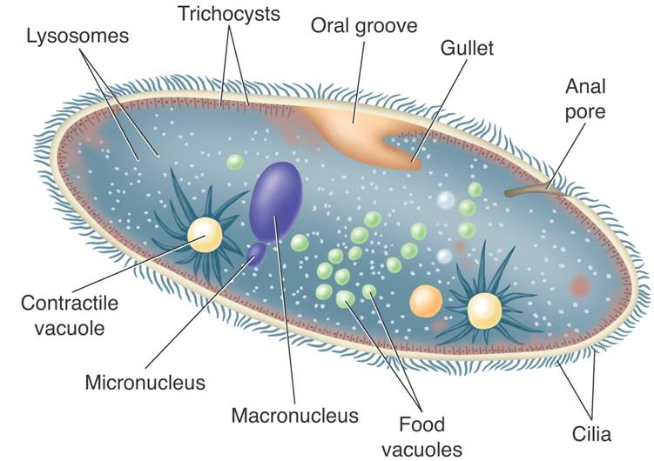
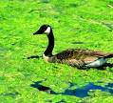
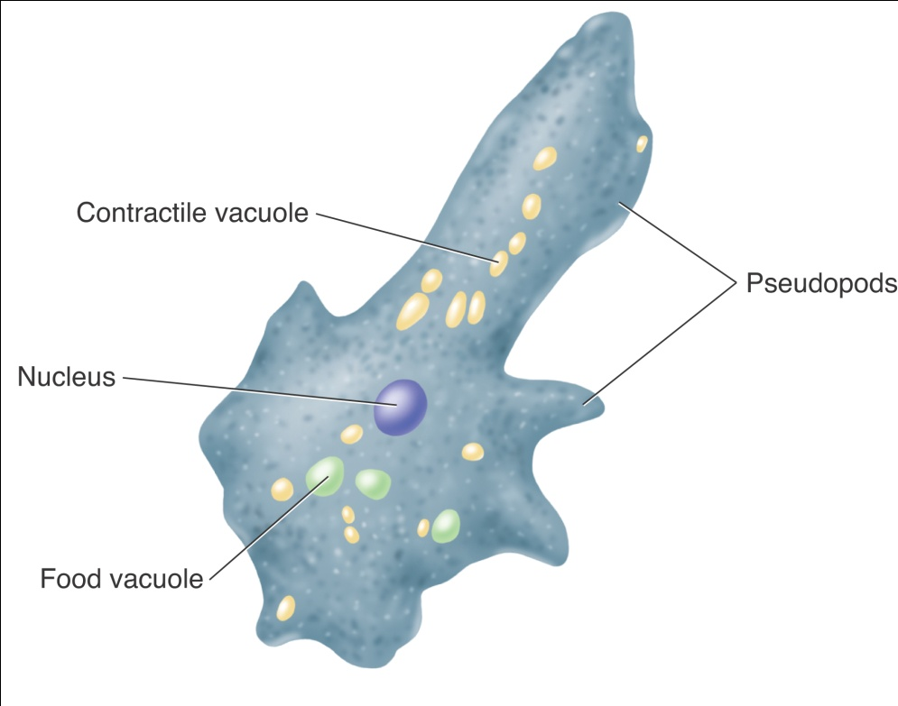
Kingdom Protista
Classification of Protists
One way protists can be classified is by how they obtain nutrition:
Heterotrophs are called animal-like protists.
Autotrophs are called plantlike protists.
Decomposers are called funguslike protists.

Slide 4
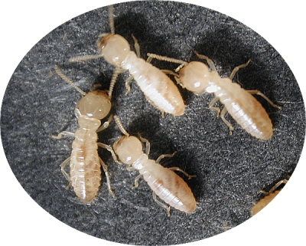
Animal-like Protists
Some animal-like protists cause serious diseases, including
malaria
African sleeping sickness
Many animal-like protists are essential to the living world.
Symbiotic relationship
Some live within the digestive tract of termites and breaks down the wood that the termites eat
Decomposers
Bottom of food chain
Notes:
Malaria: Symptoms of malaria include fever, shivering, arthralgia (joint pain), vomiting, anemia (caused by hemolysis), hemoglobinuria, retinal damage,[10] and convulsions. The classic symptom of malaria is cyclical occurrence of sudden coldness followed by rigor and then fever and sweating lasting four to six hours. Malaria has been found to cause cognitive impairments, especially in children. It causes widespread anemia during a period of rapid brain development and also direct brain damage.
African sleeping sickness: Symptoms begin with fever, headaches, and joint pains. As the parasites enter through both the blood and lymph systems, lymph nodes often swell up to tremendous sizes. Winterbottom's sign, the tell-tale swollen lymph nodes along the back of the neck, may appear. If untreated, the disease slowly overcomes the defenses of the infected person, and symptoms spread to include anemia, endocrine, cardiac, and kidney diseases and disorders. The disease then enters a neurological phase, when the parasite passes through the blood-brain barrier. The symptoms of the second phase give the disease its name; besides confusion and reduced coordination, the sleep cycle is disturbed, with bouts of fatigue punctuated with manic periods progressing to daytime slumber and night-time insomnia. Without treatment, the disease is invariably fatal, with progressive mental deterioration leading to coma and death. Damage caused in the neurological phase can be irreversible.[4]

Slide 5
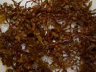
Plant-like Protists
produce oxygen through photosynthesis
found in sushi, ice cream, and other foods
Chemicals from algae are used to make
plastics deodorants
waxes paints
transistors artificial wood
medicines

Slide 6
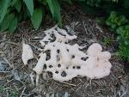
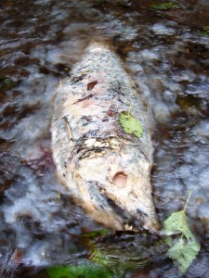
Fungus-like Protists
Decomposers
Cause plant diseases

Slide 7
Fungi

Slide 8
Domain Eukarya
Fungi
heterotrophs
Most are decomposers
Secrete digestive enzymes into food and absorb small food molecules into their bodies
multicellular (mushrooms) or unicellular (yeasts)

Slide 9
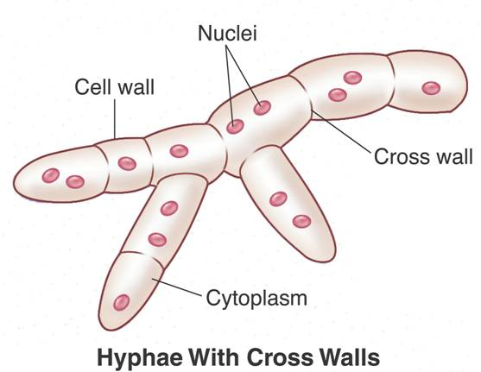
Structure and Function of Fungi
Fungi are made up of thin filaments called hyphae.

Slide 10
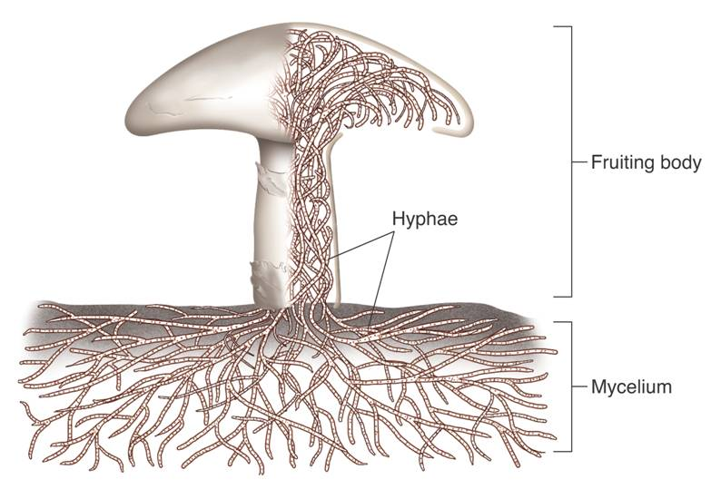
Structure and Function of Fungi
Mycelium: many hyphae tangled together into a thick mass
Notes:
allows a large surface area to come in contact with the food source through which it grows

Slide 11
Structure and Function of Fungi
fruiting body: reproductive structure growing from the mycelium
Example: mushroom

Slide 12
How Fungi Spread
Many fungi produce dry spores that scatter easily in the wind.
Other fungi are specialized to lure animals, which disperse spores over long distances.

Slide 13
The Common Molds
Phylum Zygomycota
Familiar molds that grow on meat, cheese, and bread
Reproduce both sexually and asexually

Slide 14
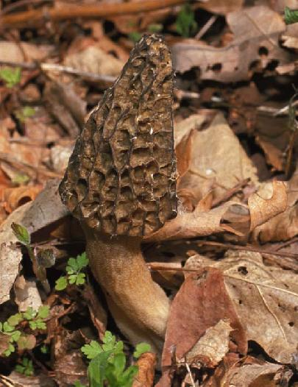
The Sac Fungi
The phylum Ascomycota
named for the ascus, a reproductive structure that contains spores.
usually includes both asexual and sexual reproduction
Notes:
The zygote divides by meiosis, producing four haploid cells.
In most ascomycetes, meiosis is followed by mitosis, so that eight cells called ascospores are produced.
An ascospore can germinate and grow into a haploid mycelium.

Slide 15
The Club Fungi
Phylum Basidiomycota
club fungi
specialized reproductive structure that resembles a club, called the basidium

Slide 16
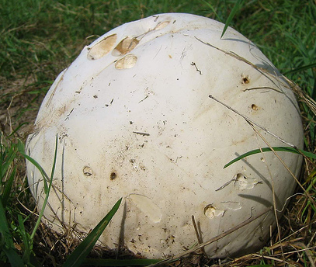
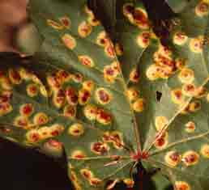
The Club Fungi
Shelf fungi
Puffballs
Earthstars
Jelly fungi
Rusts

Slide 17
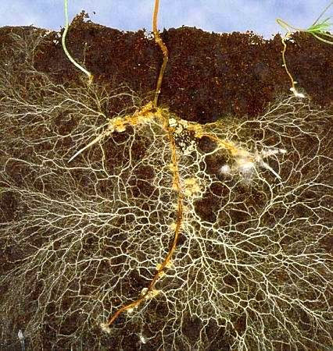
Symbiotic Relationships
Mycorrhizae
Fungi form mutualistic relationships with plants.
The associations of plant roots and fungi are called mycorrhizae.
essential for the growth of many plants.

Slide 18
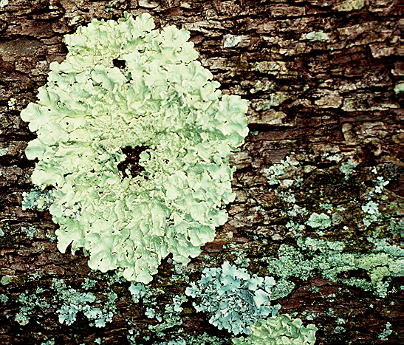
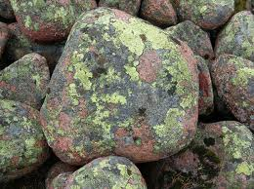
Symbiotic Relationships
Lichens
Lichens are symbiotic associations between a fungus and a photosynthetic organism
green alga
cyanobacterium
or both
Notes:
Some fungi form symbiotic relationships in which both partners benefit.
Two such mutualistic associations, lichens and mycorrhizae, are essential to many ecosystems.

Slide 19
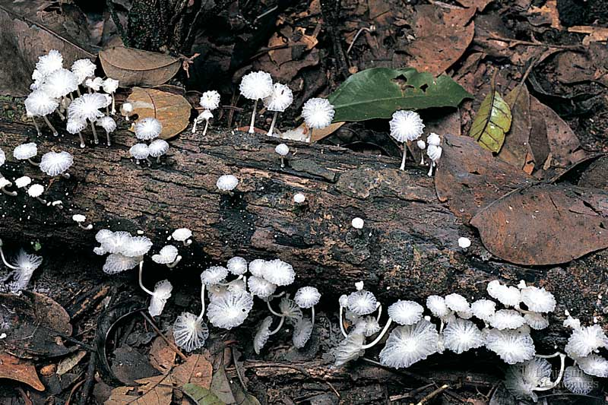
Fungi as Decomposers
Fungi maintain equilibrium
they recycle nutrients by breaking down the bodies and wastes of other organisms.

Slide 20
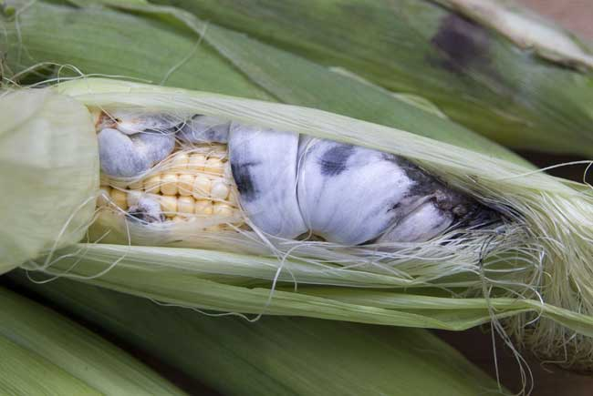
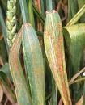
Fungi as Parasites
Parasitic fungi cause serious plant and animal diseases.
Corn smut
Wheat rust

Slide 21
Fungi as Parasites
A few fungi cause diseases in humans
Examples of fungus-caused disorders in humans include:
Athlete’s foot
Ringworm
Thrush

