Slide 1
Chapter 18: Taxonomy
Notes:
Photo credit: ©Gary Randall/Visuals Unlimited

Slide 2
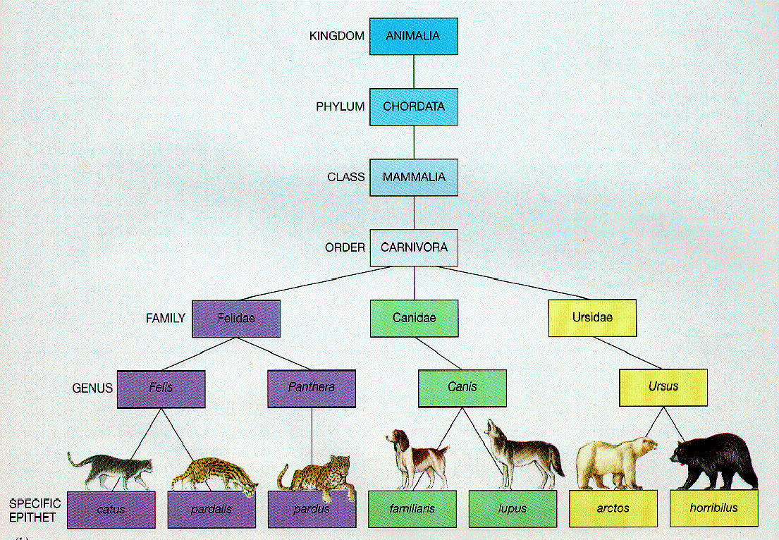
Taxonomy: classifying (grouping) organisms and assigning each organism a universally accepted name.
Organisms are grouped using biological significance.
Notes:
There are a lot of organisms in the world
Biologists have identified and named about 1.5 million species so far.
They estimate that 2–100 million additional species have yet to be discovered.
When you have a lot of information, it is best to organize and group items so that you can find them easier or easily see their relationship to other items

Slide 3
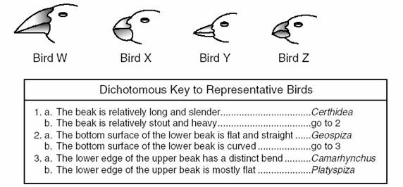
Dichotomous Key
An easy way to sort information
Commonly used by scientist to classify living organisms
Uses a series of yes or no questions to get to a single description that applies to only one item

Slide 4
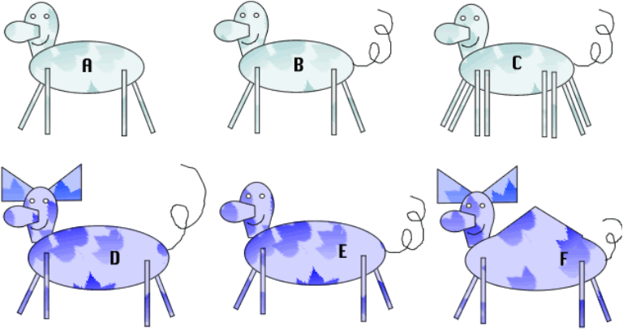
1. Has green colored body ......go to 2
Has purple colored body ..... go to 4
2. Has 4 legs .....go to 3 Has 8 legs .......... Deerus octagis
3. Has a tail ........ Deerus pestis Does not have a tail ..... Deerus magnus 4. Has a pointy hump ...... Deerus humpis
Does not have a pointy hump.....go to 5 5. Has ears .........Deerus purplinis Does not have ears ......Deerus deafus

Slide 5
Linnaeus's System of Classification
Linnaeus also came up with a way of classifying all organisms by putting them into categories
Each level is called a taxon, or taxonomic category.
Species and genus are the two smallest categories.
Grizzly bear
Black bear
Notes:
Linnaeus’s hierarchical system of classification uses seven taxonomic categories. This illustration shows how a grizzly bear, Ursus arctos, is grouped within each taxonomic category. Only some representative species are illustrated for each category above the species level.

Slide 6
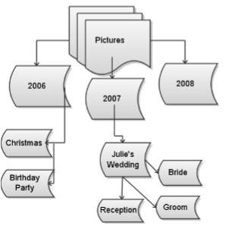
Grouping
Each group gets smaller and more specific – just think of the way you file things on your computer into folders and subfolders
Kingdom
Phylum
Class
Order
Family
Genus
Species

Slide 7
Linnaeus's System of Classification
Kingdom: Made up of several similar phylum
Includes the most organisms
Grizzly bear
Black bear
Giant panda
Red fox
Abert squirrel
Coral snake
Sea star
Notes:
Linnaeus’s hierarchical system of classification uses seven taxonomic categories. This illustration shows how a grizzly bear, Ursus arctos, is grouped within each taxonomic category. Only some representative species are illustrated for each category above the species level.

Slide 8
Linnaeus's System of Classification
Phylum: made up of several similar classes.
Grizzly bear
Black bear
Giant panda
Red fox
Abert squirrel
Coral snake
Notes:
Linnaeus’s hierarchical system of classification uses seven taxonomic categories. This illustration shows how a grizzly bear, Ursus arctos, is grouped within each taxonomic category. Only some representative species are illustrated for each category above the species level.

Slide 9
Linnaeus's System of Classification
Class: composed of similar orders
Grizzly bear
Black bear
Giant panda
Red fox
Abert squirrel
Notes:
Linnaeus’s hierarchical system of classification uses seven taxonomic categories. This illustration shows how a grizzly bear, Ursus arctos, is grouped within each taxonomic category. Only some representative species are illustrated for each category above the species level.

Slide 10
Linnaeus's System of Classification
Order: composed of similar families
Grizzly bear
Black bear
Giant panda
Red fox
Notes:
Linnaeus’s hierarchical system of classification uses seven taxonomic categories. This illustration shows how a grizzly bear, Ursus arctos, is grouped within each taxonomic category. Only some representative species are illustrated for each category above the species level.

Slide 11
Linnaeus's System of Classification
Family: Composed of several Genus that share many characteristics
Grizzly bear
Black bear
Giant panda
Notes:
Linnaeus’s hierarchical system of classification uses seven taxonomic categories. This illustration shows how a grizzly bear, Ursus arctos, is grouped within each taxonomic category. Only some representative species are illustrated for each category above the species level.

Slide 12
Linnaeus's System of Classification
Genus: is a group of closely related species
Species: often defined as a group of organisms capable of interbreeding and producing fertile offspring
based on similarity of DNA
Smallest most exclusive taxon
Grizzly bear
Black bear
Notes:
Speciation: the creation of a new species
Happens when
species evolve, change, so that they no longer look like their ancestor
different species interbreed and produce fertile offspring (hybrids)

Slide 13
Assigning Scientific Names
Binomial nomenclature
Developed by Carolus Linneaus
Scientific Name
two-part scientific name
Italicized
Latin or Greek
Same name no matter where you go
Less confusion
Notes:
Early Efforts at Naming Organisms
Described the physical characteristics of a species in great detail
Not standardized
different scientists described different characteristics
Not everyone’s ‘big’ is the same
Names were very long (polynomial system) up to 10 words.

Slide 14
Binomial nomenclature
First word
Genus
Capitalized
Second word
species
describes an important trait or where the organism lives
lowercased

Slide 15
Scientists also need a way to *NAME* organisms
The “common names” used by people can sometimes be misleading or confusing
In order to communicate effectively, biologists need a CONSISTENT naming protocol.

Slide 16
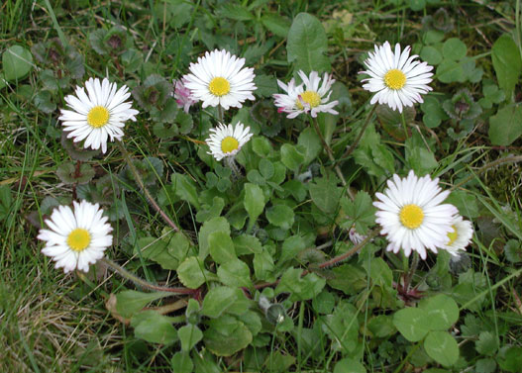
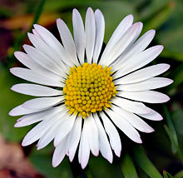
Why binomial nomenclature?
Common name: Common Daisy, Lawn Daisy, English Daisy
Polynomial system: Bellis scapo nudo uniflora
Binomial nomenclature: Bellis perennis

